Slide 1
Farmers’app
Kick-off workshop TKI-partners
Agenda, Introduction TKI

Slide 2
Agenda 26-04-2018
Part 1: 9:30 – 11.30
Project overview:
Introduction of participants
TKI Subsidy program
Project targets (Deltares – Achmea – Waterboards)
Planning and follow up actions
Part 2: 11.30 – 13.30
Technical meeting ‘Real-time yield forecasting’ (incl Lunch):
Concepts of FEWS, Models, data flow to/from the models (Deltares)
Concepts of SAF (Milan)
Planning/timing of project deliverables in the season

Slide 3
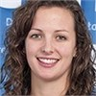
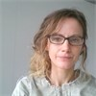
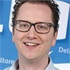
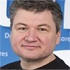
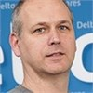
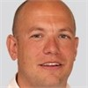
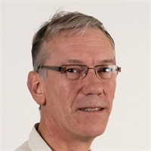
Deltares-WER team
Sheila
Ball
Model expert
Neeltje
Goorden
Hydrological
Modelling
Herman
Haaksma
FEWS Expert
Timo Kroon
Advisor
Hydrological
Modelling
Albrecht
Weerts
Advisor
FEWS &
Data-
assimilation
Edwin
Snippen
Project Lead
Paul van
Walsum
WER
METASWAP-WOFOST

Slide 4
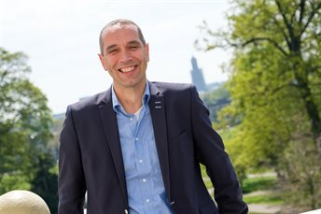
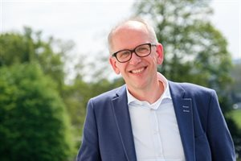
Waterboards
Waterschap Aa en Maas
Trekker
Lumbricus
proeftuin Zuid
Waterschap
Vechtstromen
Trekker
Lumbricus
proeftuin Oost

Slide 5
TKI Subsidy program
Topconsortia for Knowledge and Innovation (TKI's).
Public-Private cooperation to stimulate Climate cross-sectorale projects and Knowledge institutes
Organisations can be involved as Party (by investing cash or in kind) or as subcontractor (via Deltares)
Deltares coordinates the project
Current 84 projects at Deltares, mainly Deltatechnology

Slide 6
Reporting and Financial Obligations
Deltares and Parties have to sign the Cooperation Agreement within 3 months after the TKI Subsidy Decision (15-02-2018).
Progress will be reported in the Public Deltares WIKI
Once every 2 months meeting to discuss the progress of the Project and take decisions in consultation which may be necessary for the successful performance of the Project.
Once every 3 months Deltares has to deliver a TKI financial proress report including Parties who contribute in kind (e-mail).
Every year Parties who contribute in kind: Management statement for the purposes of the TKI arrangements (form)
Cash contributions are 0% BTW
  Cash – contribution has to be stated in the Cooperation Agreement
  Project and specific contribution has to be announced at the BTW-office of Deltares fnc-fz@deltares.nl

Slide 7
IE, Confidentiality and publication
Results of the Project will be made available to all Parties in the form of reports
Intellectual property rights flowing from the activities of the research institution are entirely attributed to the research institution.
The research institution can assign the intellectual property rights flowing from the Project to one or more other Parties.
Each of the Parties is entitled to use results obtained by the other Party on the basis of bilateral agreements.
Each Party will keep secret and will not use for any other purpose than the performance of the Project all information and data made available to it by the other Parties in the context of the performance of this Agreement.
Parties will only publish about the Project and its results after approval of the text by Parties.
Formal Articles Cooperation Agreement are leading

Slide 9
Expectations Deltares
Which outcome or results of the TKI project Farmers’app are needed to make it for your organisation a succesfull pilot?
The TKI project is succesfull for the knowledge institutes if we have insight in the quality operational real-time forcastingdata for crop production and can be realised within time and budget.
· What contribution can your organisation make in the project to make it a succes?
The role of Deltares (incl WER) in this project is the development of the modelsystem and hosting for the period of the project to test the usability of the forecast data. Deltares will lead the project and is responsible for the reporting of progress to the TKI organisation (based on the input of partners).
We offer knowledge and software in this project to make the project a succes.

Slide 10
Waterboard Aa and Maas
Waterboard Aa and Maas works on the realisation of a coherent, data driven set of instruments in order to improve the internal processes and to share information with stakeholders in order to facilitate the regional development. This project is part of the realisation.

Slide 11
Desired outcome Waterboards
Operational FEWS instrument to predict on daily basis 14 days in advance spatial distributed available (actual) moisture in the root zone, (potential and actual) evapotranspiration and (potential and actual) crop production.
Based on ensemble modelling using the 52 available KNMI weather-predictions in order to present the prediction for the ‘operational run’ with an indication (or even estimate?) of the corresponding uncertainty.
Meeting generic software quality requirements/conventions on structure, coding, comments, documentation.
Open data and codes, a technical user manual.
Validated on in situ measurement and historical RS data
Insight in the weaknesses of the used data an model concepts, (the choices made for) the data assimilation, effects and weaknesses of the data assimilation and options for improvement.
Insight in the effect of the spatial modelling scale on the predictions
The instrument being calibrated and tested and real time (daily) running in the AM hardware environment using the detailed AM groundwater model (as result of a test on making the system available and to evaluate the effect of spatial scale on the predictions).
The results being shared via both the farmers app (local) and the AM database / tools (regional).

Slide 12
Waterboard Aa and Maas
We offer the Raam catchment as pilot area with:
Our farmers network
Satellite observations based data on soil moisture, water on the soil surface and evapotranspiration.
In situ measurements of groundwater levels, surface water levels and soil moisture.
A 100x100 state of the art groundwater model to identify the effect of scale on the predictions i.e. the usability of the results / the requirements for the model
AM will contact the famers and will communicate with the farmers
Active participation in the project, hands on during the project, and optional (to be discussed) actively carrying out work related to the project.

