Slide 1
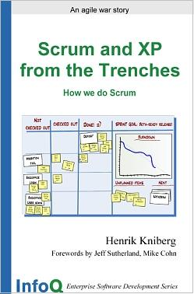
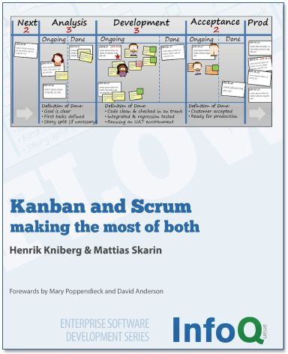


The Thinking Tool called Agile
Copyright notice
These slides are licensed under Creative Commons. Feel free to use these slides & pictures as you wish, as long as you leave my name and the Crisp logo somewhere.
For licensing details see: http://creativecommons.org/licenses/by/3.0/
All slides available at:
http://www.crisp.se/henrik.kniberg/
Keynote, Lean-Agile-Scrum conference
Zurich, Sep 7, 2010
Henrik Kniberg
Agile/Lean coach
www.crisp.se
Board of directors
henrik.kniberg@crisp.se
+46 70 4925284

Slide 2
Purpose of this presentation
To illustrate how Lean and Agile can fit together
Notes:
Scrum mainstream, lots of buzz on Kanban.
How do they relate?
Dialog with the operations guy.
Purpose

Slide 3

What is all this stuff?
TDD
Scrum
XP
Continuous Integration
Kanban
Pair programming
Refactoring
Lean
Planning poker
Agile
Notes:
Purpose of this presentation is to clarify how some of these things fit together
How does agile look when done well?

Slide 4

Tools

Slide 5



Thinking tools
a.k.a. ”mindsets” or ”philosophies”
Tool
Toolkits
a.k.a. ”frameworks”
Lean
Agile
Systems Thinking
”anything used as a means of accomplishing a task or purpose.”
- dictionary.com
Theory of Constraints
Scrum
RUP
XP
Physical tools
Kanban
Process tools
a.k.a. ”organizational patterns”
Product Owner role
Pair programming
Visualize the workflow

Slide 6


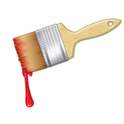


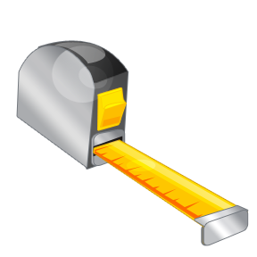


Lean & Agile process toolkits
Values & Principles
Lean, Agile, Theory of Constraints, Systems Thinking, etc
Kanban
XP
Other lean tools
(Value Stream Mapping,
Root Cause Analysis, etc)
Scrum

Slide 7
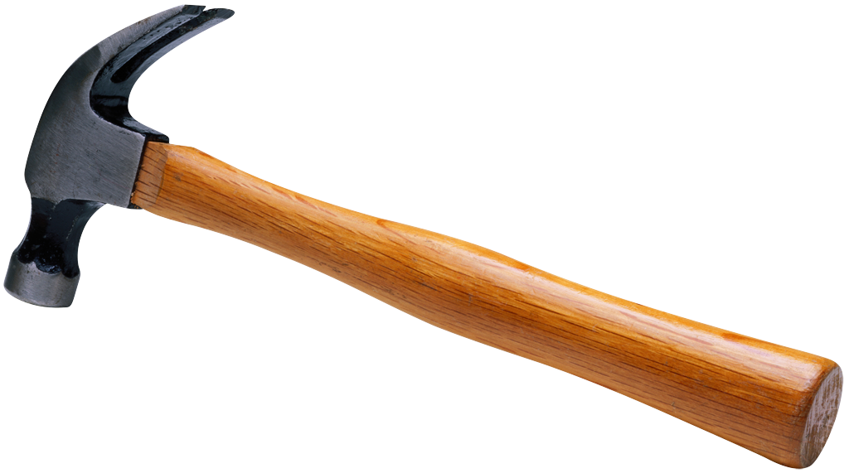
Key
point
Compare for understanding, not judgement
Tools can be combined

Slide 8
What is
”un-agile”?

Slide 9
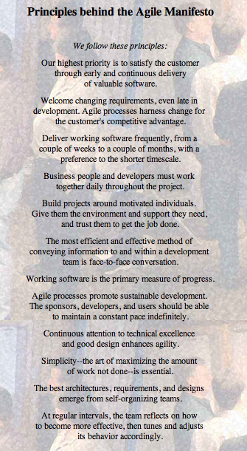
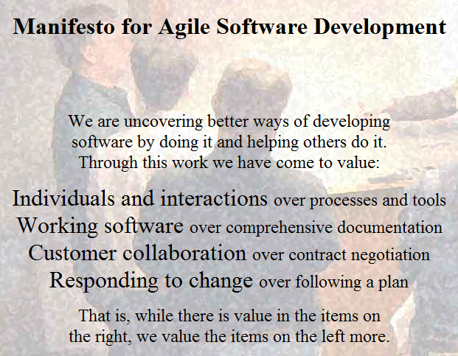
What is ”Agile”?
www.agilemanifesto.org

Slide 10
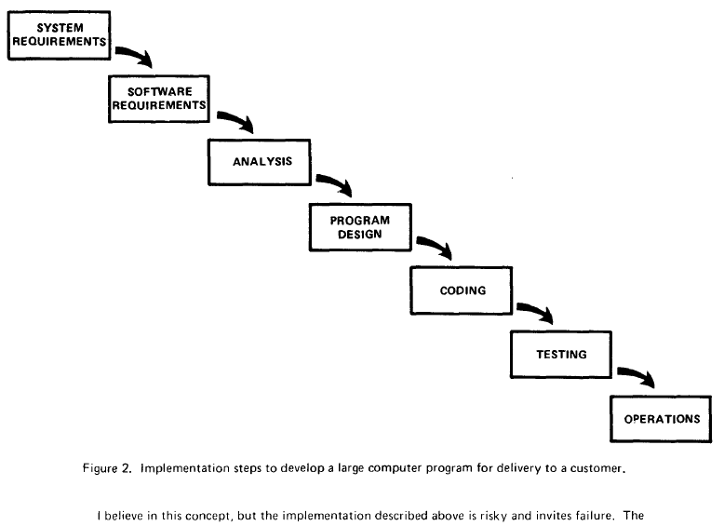
Waterfallitis
Waterfallitis (n)
(a.k.a. Waterfall obsession syndrome)
The mistaken assumption that everything that isn’t Scrum is Waterfall.
And that Waterfall always fails.

Slide 11

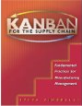



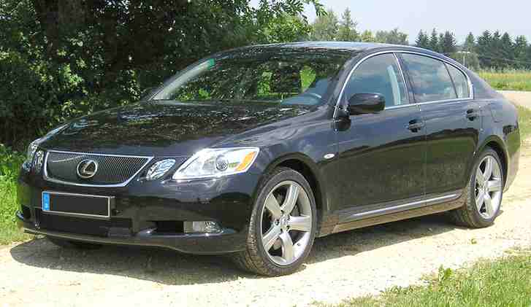

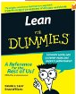



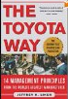

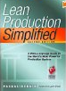

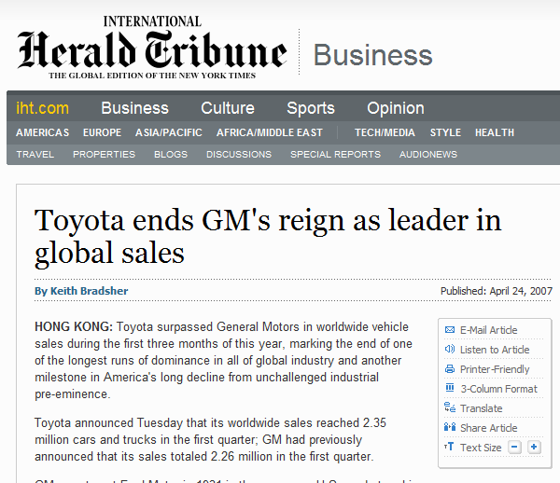




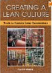

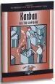


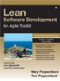


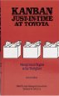



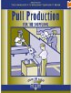


Toyota

Slide 12
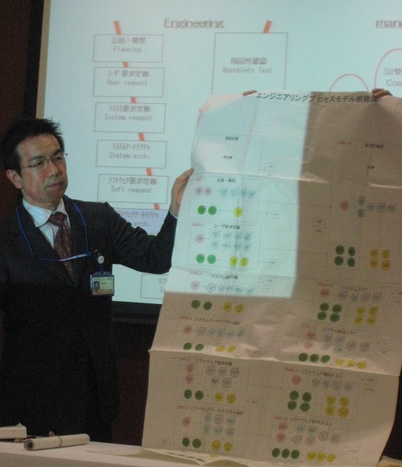
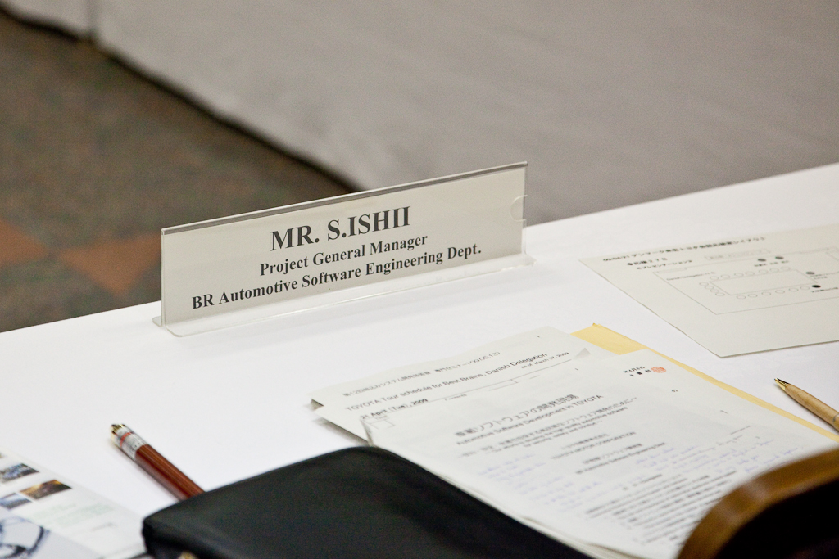
Waterfall @ Toyota
… but they are moving towards Lean & Agile SW dev
Requirements
Acceptance test
System design
System test
Architecture
Integration test
Module design
Unit test
Coding
Source:
We visited Toyota in Japan during our ”Lean Study Tour”, April 2009.
Notes:
Not happy with it though

Slide 13
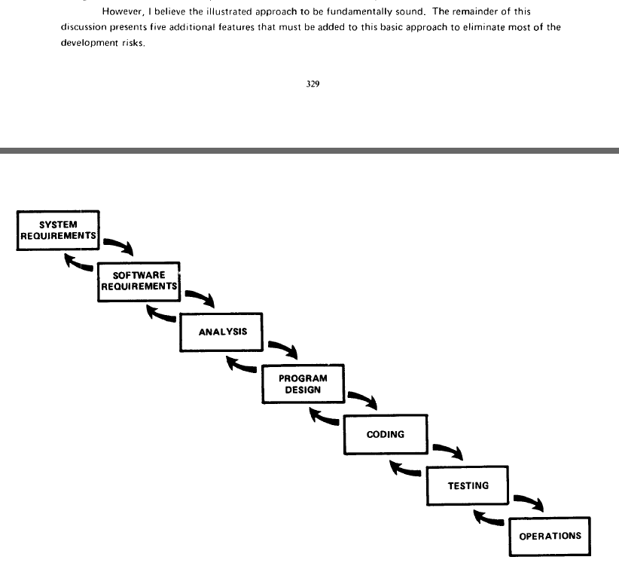
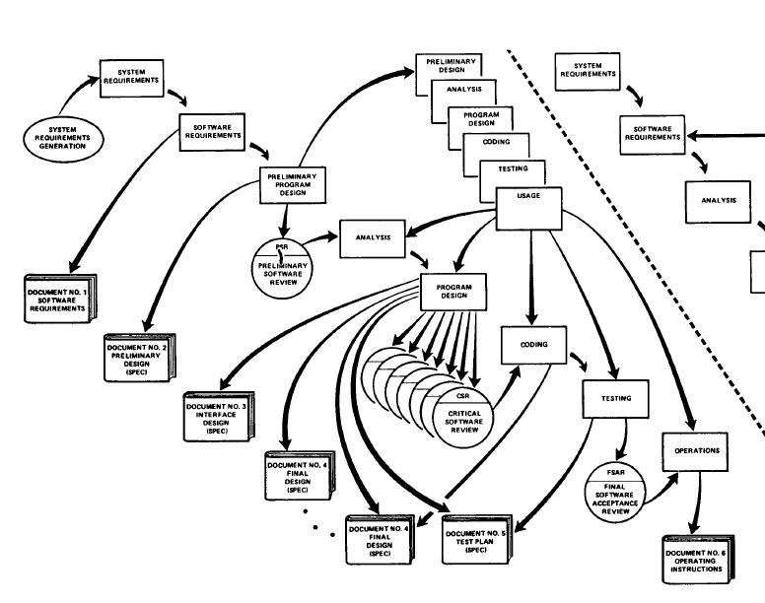
What is ”waterfall” anyway?
”Managing the development of large software projects”
Dr Winston Royce, 1970
The remainder of this discussion presents five additional features that must be added to the basic approach to eliminate most of the development risks
“I believe in this concept, but the implementation described above is risky and invites failure”
Step 5: Involve the customer – the involvement should be formal, in depth, and continuing

Slide 14
Key
point
The borders between Lean, Agile, and Waterfall are fuzzy

Slide 15
The illusion of ”good” and ”bad” tools

Slide 16
The illusion of a ”bad tool”
The old tool
was better!
Don’t blame
the tool!
Notes:
Never blame the tool!

Slide 17


The illusion of a ”good tool”
We succeeded thanks to Process X!
Placebo effect
The tendency of any medication or treatment,
even an inert or ineffective one, to exhibit results simply because the recipient believes that it will work.
Really?
Hawthorne effect
A form of reactivity whereby
subjects improve an aspect of their behavior being experimentally measured,
simply in response to the fact that they are being studied,
not in response to any particular experimental manipulation.
“It was suggested that the productivity gain was due to the motivational effect of the interest being shown in them”
Sources:
http://en.wiktionary.org/wiki/placebo_effect
http://en.wikipedia.org/wiki/Hawthorne_effect

Slide 18

Are there no universally
Good or Bad tools?
Probably not.
But some are pretty close.
Almost always a good idea:
Visualize the workflow
Limit work in progress
Focus on quality
Prioritize
Short feedback loops
Kanban
There is no silver bullet,
but agile methods come very close
Jim Johnson
Chairman of Standish Group

Slide 19
Distinguish between…
Using the tool wrong
Using the wrong tool
Neither of these problems are caused by the tool
Notes:
Never blame the tool!

Slide 20
Key
point
Don’t blame the tool
Tools don’t succeed or fail, people do.
People choose where, when, how, and why to use which tool.

Slide 21
Know your goal

Slide 22
The Goal is the goal!
A Tool is just a tool
How do we get Agile?
What is your goal?
We want to get Agile.
Why?
Notes:
Once Why is clear, How is a lot easier

Slide 23
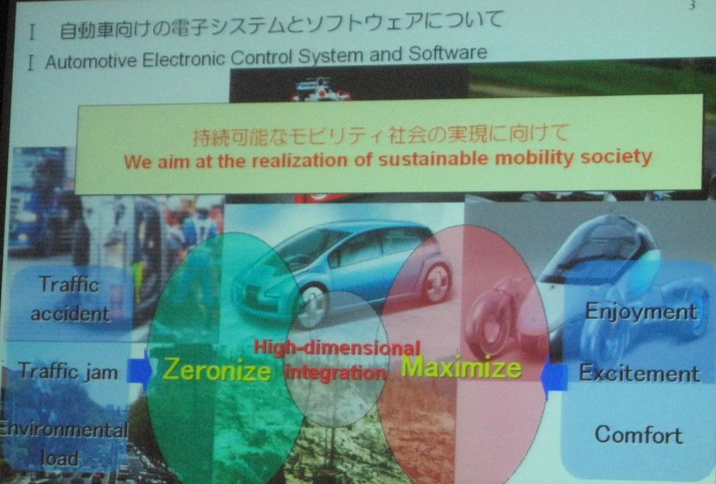
Sample goal - Toyota
Are you staying in business so you can earn money?
Or are you earning money so you can stay in business? (Toyota)
Source:
ishii-san’s slides during our ”Lean Study Tour” to Toyota, April 2009.

Slide 24
What is the goal?
Notes:
Never blame the tool!

Slide 25
Identify the goal
& alternative ways to reach it
Heat
Cozy
Put on a sweater
Electric heater
Light fire
Virtual Fireplace DVD
Get firewood
Gather deadwood
Chop down the tree
Buy firewood
Notes:
TODO animate

Slide 26
Key
point
Focus on Why first,
then How

Slide 27
Solve the right problem

Slide 28
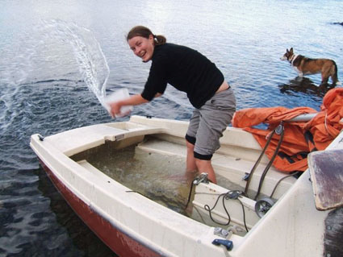
Solve root causes, not symptoms
Bail water
Water in boat
Fix hole
Hole in boat
Notes:
Causes:
Long lead time
Hard to plan

Slide 29
Key
point
Solve problems,
not symptoms

Slide 30
Example:
Evolving Scrum

Slide 31
Scrum Sprint
a timeboxed, fixed-commitment iteration
week 1
week 2
week 3
week 4
week 5
week 6
week 7
week 8
Sprint 1
Sprint 2
Plan & commit
Review
(release?)
Retrospective

Slide 32
Shu-Ha-Ri stages of learning
Shu = follow the rules
Ha = change the rules
Ri = never mind the rules
Scrumdamentalism (n)
The mistaken belief that Pure Scrum always is the right solution.
ScrumBag (n)
A coach or consultant with a Scrumdamentalist streak
Symptom: Spread of ScrumButophobia
ScrumButophobia (n)
See also: Scrumdamentalism
Fear of doing Scrum wrong
Symptom: Stuck in Shu

Slide 33
Example: Middle of sprint 1
I’d like to have E!
PO
To Do
Doing
Done
E
Wait until next sprint!
A
B
C
D

Slide 34
Example: Sprint 1 retrospective
PO
New policies:
Max 1 item in progress
Allow To Do items to be swapped out

Slide 35
Example:
Middle of sprint 2
Policy
Max 1 item in progress
Allow To Do items to be swapped out
I’d like to have J!
To Do
Doing
Done
PO
1
J
E
OK, swap out G or H
F
G
or wait until next sprint!
H
Is this still Scrum?

Slide 36
Example: Sprint 2 retrospective
PO
New policies:
Max 1 item in progress
Allow To Do items to be swapped out
Max 2 items in To Do
To Do items can be added at any time
(as long as limit isn’t exceeded)

Slide 37
Example:
A few weeks later
Process changes:
Max 1 item in progress
Allow To Do items to be swapped out
Max 2 items in To Do
To Do items can be added at any time (as long as limit isn’t exceeded)
I’d like to have P!
To Do
Doing
Done
PO
2
1
P
K
OK, swap out M or N
L
M
or wait until there is space in To Do
N
Is this still Scrum?

Slide 38
Alternatives to Sprints
Sprints
week 1
week 2
week 3
week 4
week 5
week 6
week 7
week 8
Sprint 1
Sprint 2
Plan & commit
Review
(release?)
Retrospective
Separate cadences
week 1
week 2
week 3
week 4
week 5
week 6
week 7
week 8
Retrospectives (4w)
Planning cadence (2w)
Release cadence (1w)
Event-driven
week 1
week 2
week 3
week 4
week 5
week 6
week 7
week 8
Retrospectives (4w)
Planning (on demand)
Release (on demand)

Slide 39
Key
point
Focus on process improvement rather than process compliance

Slide 40
Example:
Kanban

Slide 41
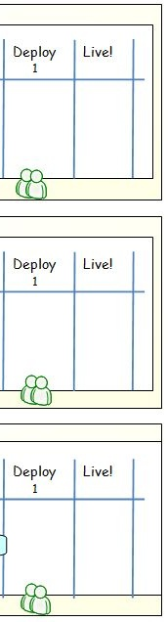
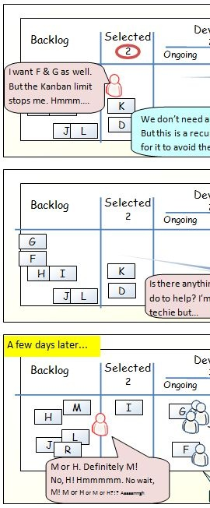
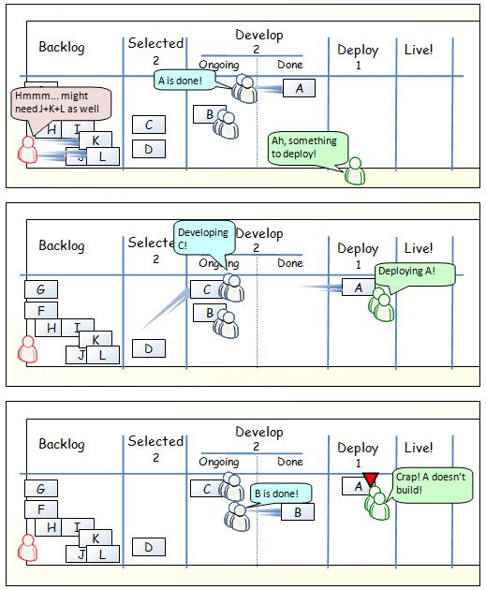
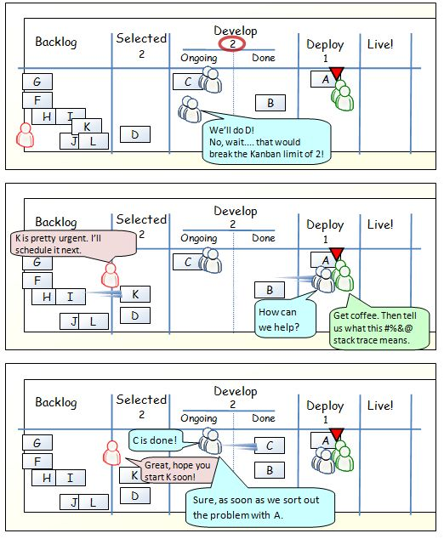
”One day in Kanban land”
http://blog.crisp.se/henrikkniberg/tags/kanban/

Slide 42
Scenario 1 – one piece flow
Dev
Backlog
Next
3
In production :o)
2
Ongoing
Done
A
G
B
C
F
D
H
I
J
L
E
M
K

Slide 43
Scenario 1 – one piece flow
Dev
Backlog
Next
3
In production :o)
2
Ongoing
Done
A
G
C
B
F
D
H
I
J
L
E
M
K

Slide 44
Scenario 1 – one piece flow
Dev
Backlog
Next
3
In production :o)
2
Ongoing
Done
A
G
C
B
F
D
H
I
J
L
E
M
K

Slide 45
Scenario 1 – one piece flow
Dev
Backlog
Next
3
In production :o)
2
Ongoing
Done
C
A
G
D
B
F
H
I
J
L
E
M
K

Slide 46
Scenario 1 – one piece flow.
Dev
Backlog
Next
3
In production :o)
2
Ongoing
Done
C
A
G
D
B
F
H
I
J
L
E
M
K

Slide 47
Scenario 2 – Deployment problem
Dev
Backlog
Next
3
In production :o)
2
PO
Ongoing
Done
A
G
B
C
F
D
H
I
J
L
E
M
K

Slide 48
Scenario 2 – Deployment problem
Dev
Backlog
Next
3
In production :o)
2
PO
Ongoing
Done
A
G
C
B
F
D
H
I
J
L
E
M
K

Slide 49
Scenario 2 – Deployment problem
Dev
Backlog
Next
3
In production :o)
2
PO
Ongoing
Done
C
A
G
D
B
F
H
I
J
L
E
M
K

Slide 50
Scenario 2 – Deployment problem
Dev
Backlog
Next
3
In production :o)
2
PO
Ongoing
Done
C
A
G
D
B
F
H
I
J
L
E
M
K

Slide 51
Scenario 2 – Deployment problem
Dev
Backlog
Next
3
In production :o)
2
PO
Ongoing
Done
C
A
G
D
!?
B
F
H
I
J
L
E
M
K

Slide 52
Scenario 2 – Deployment problem
Dev
Backlog
Next
3
In production :o)
2
PO
Ongoing
Done
!?
A
G
D
B
F
E
C
H
I
J
L
M
K

Slide 53
Scenario 2 – Deployment problem
Dev
Backlog
Next
3
In production :o)
2
PO
Ongoing
Done
A
G
D
B
F
E
C
H
I
J
L
M
K

Slide 54
Scenario 2 – Deployment problem
Dev
Backlog
Next
3
In production :o)
2
PO
Ongoing
Done
A
G
D
B
F
E
C
H
I
J
L
M
K

Slide 55
Scenario 2 – Deployment problem
Dev
Backlog
Next
3
In production :o)
2
PO
Ongoing
Done
D
A
G
B
F
E
C
H
I
J
L
M
K

Slide 56
Example: Portfolio mgmt

Slide 57
Portfolio-level kanban board
Next
Develop
Release
Done
1
3
2
Concept
Playable
Features
Polish
Game
Team
1
Pac man
Bingo
Solitaire
Zork
Game
Team
2
Mine sweeper
Pong
Dugout
Game
Team
3
Donkey Kong
Duck hunt
12
FLOW Avg lead time: weeks

Slide 58
Game teams
Game team 1
Current game: Pac Man
Game team 2
Current game: Pong
Game team 2
Current game: Donkey Kong
Notes:
TODO clean up

Slide 59
Example:
Connecting Scrum & Kanban

Slide 60
Connecting Scrum & Kanban
Step 1
Step 2
Step 3
Feature
team 1
Feature
team 2
Feature
team 2
Feature
team 1
Feature
team 2
Feature
team 2
Feature
team 1
Feature
team 2
Feature
team 2
Scrum
Scrum
Scrum
Scrum
Scrum
Scrum
Scrum
Scrum
Scrum
Operations / support team
Operations / support team
Scrum
Kanban
Notes:
Wrong attitude: "We have a problem, we can't figure out how to do Scrum in operations/support"
Got there via Inspect & Adapt!

Slide 61
Wrapup

Slide 62







































Agile is ”simple”
... and maybe some on DSDM and Crystal and Lean while you’re at it.
... and Scrum...
A few books on Agile...
... and XP

Slide 63


Agile is Simple but Hard
... like chess
... and piano playing

Slide 64
Agile & Lean fit well together
Customer value
Visual management
Build quality in
Continuous improvement
Empirical approach
Empowerment

Slide 65
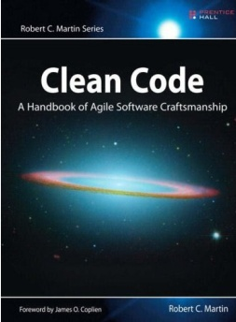
Essential skills needed regardless of process
Splitting the system into useful pieces
Software craftsmanship
Retrospectives
As a buyer
I want to save my shopping cart
so that I can continue shopping later

Slide 66
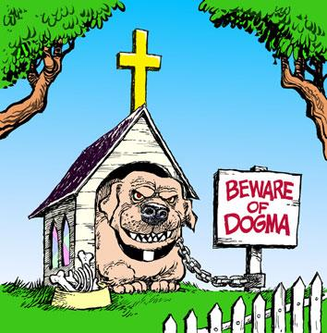
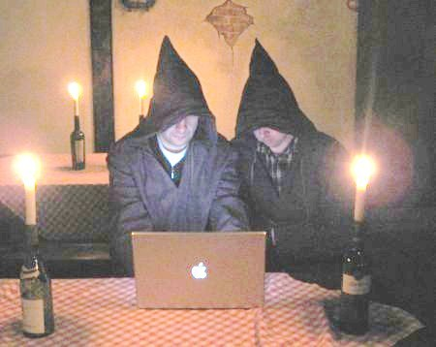
Don’t be dogmatic
Go away! Don’t talk to us!
We’re in a sprint.
Come back
in 3 weeks.
Though Shalt
Limit WIP

Slide 67
Take-away points
Know your Goal
  Focus on Why
Agile/Lean are tools, not goals
  Tools don’t fail or succeed. People do.
  There is no such thing as a good or bad tool. Only good or bad decisions about when, where, how, and why to use which tool.
Don’t limit yourself to one tool
  Mix & match
  Compare for understanding, not judgement.
Experiment & enjoy the ride
  Don’t worry about getting it right from start. You won’t.
  The important thing isn’t your process.
  The important thing is your process for improving your process.
Notes:
Don’t love agile.

Slide 68


Perfection is a direction, not a place

