Slide 1

Delta Shell
Technical Aspects

Slide 2
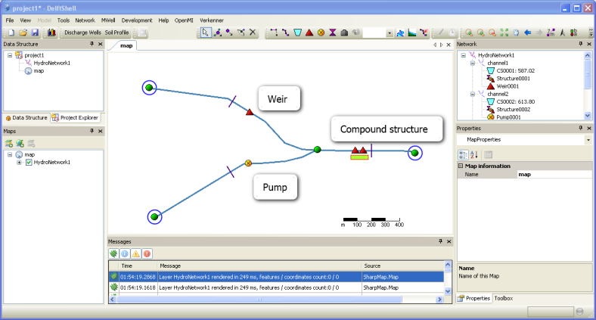
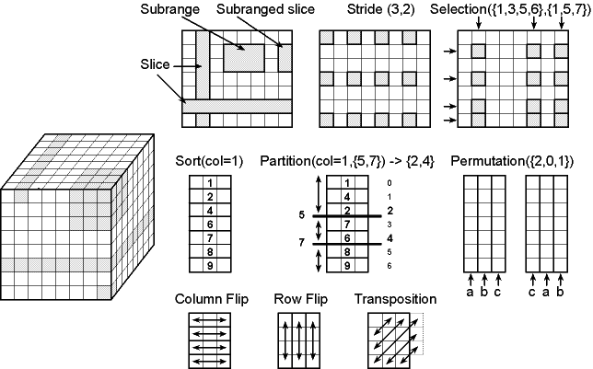

Contents
Delta Shell
New Version
NetCDF File Format

Slide 3
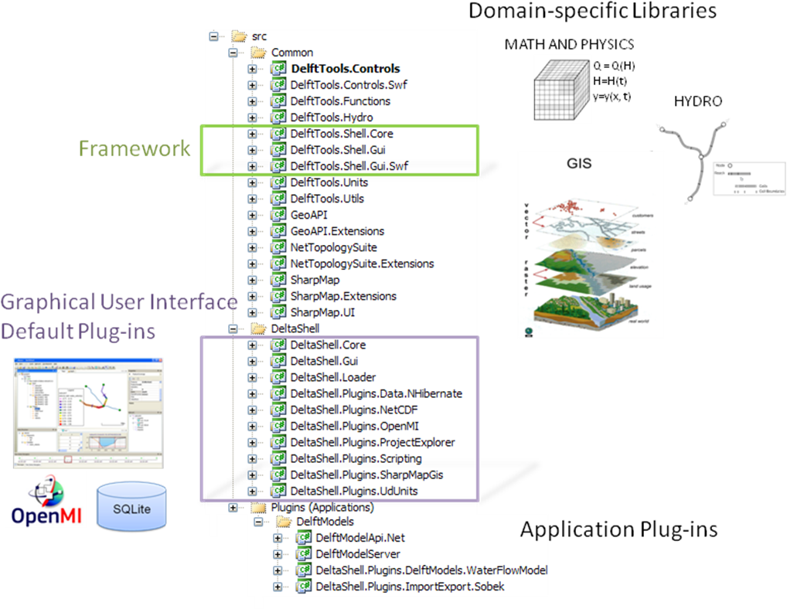
What is Delta Shell?

Slide 4
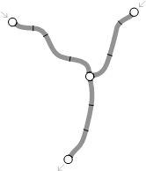
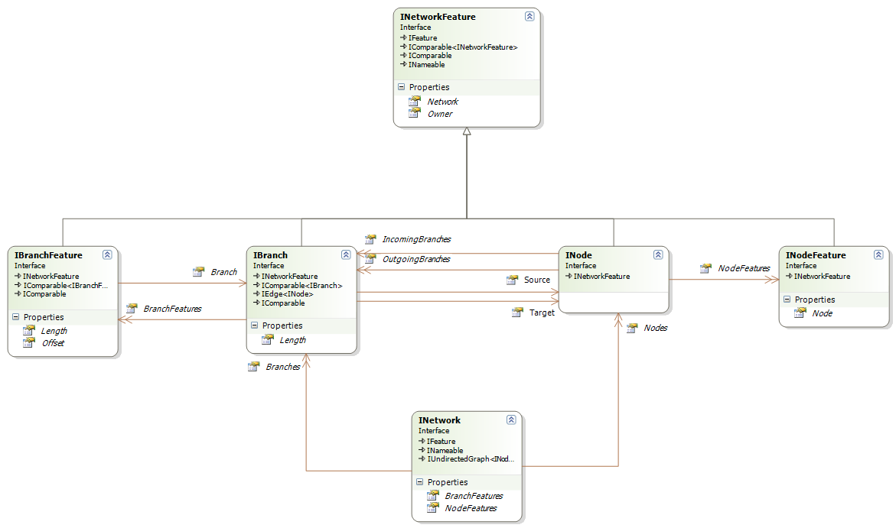
Network (GIS)
Pump
Cross-Section

Slide 5
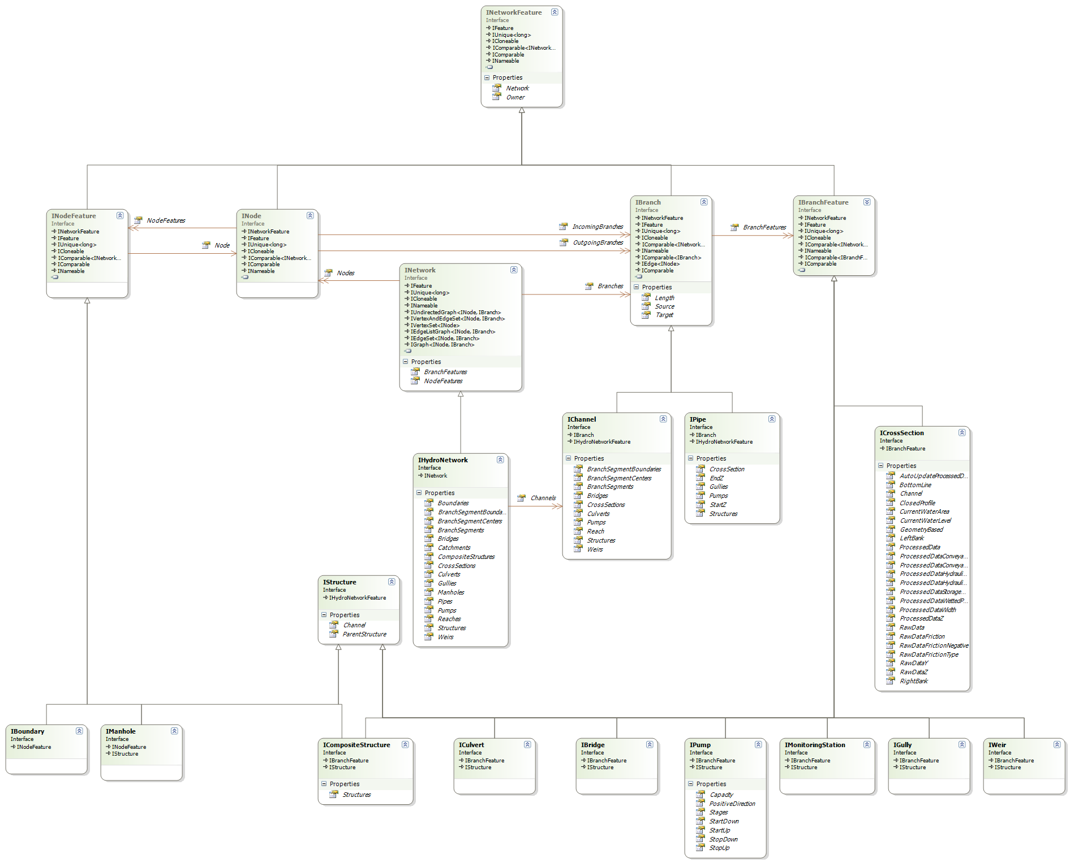
Hydro Network

Slide 6
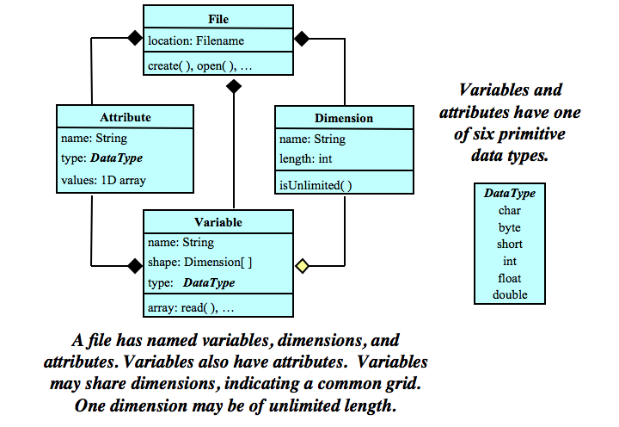
NetCDF as file format (output)

Slide 7

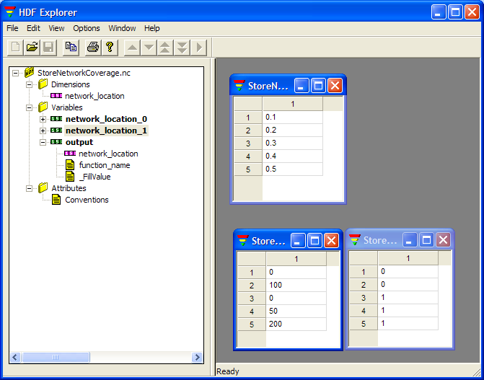
NetCDF Network Coverage
Branch | Offset | Value
1 | 10.1 | 101.00
1 | 80.5 | 102.00
1 | 90.0 | 103.00
2 | 15.5 | 104.00
2 | 30.0 | 105.00

Slide 8
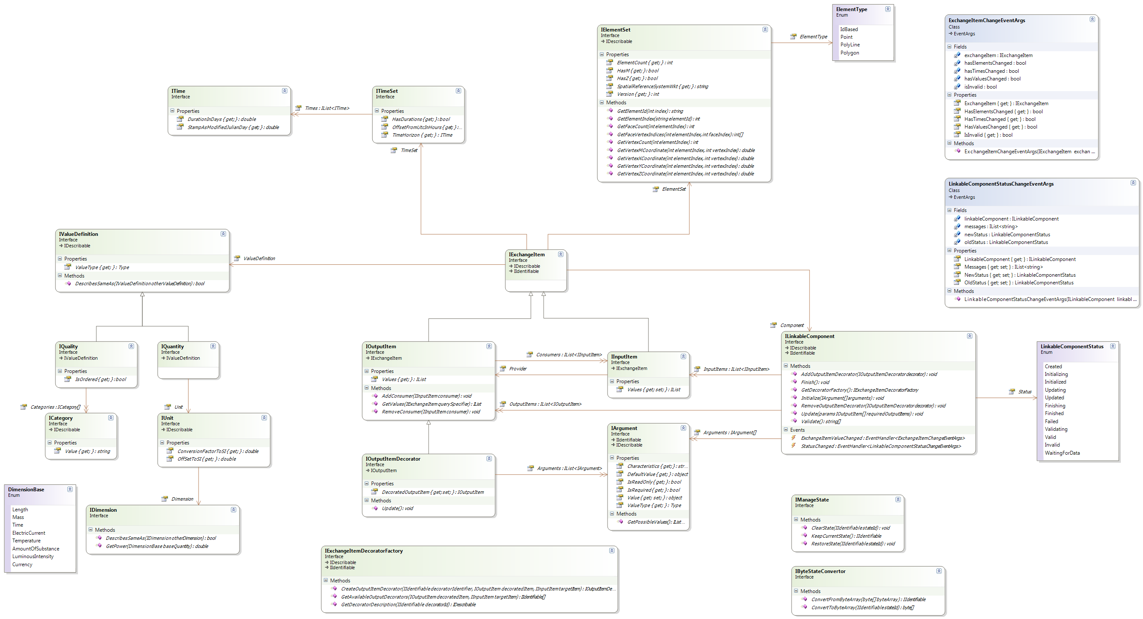
OpenMI 2.0

Slide 9
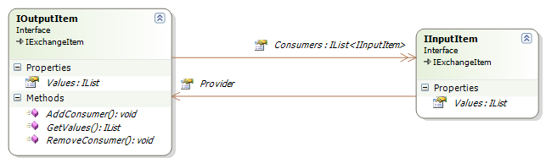
OpenMI 2.0
Component1
Component2

Slide 10
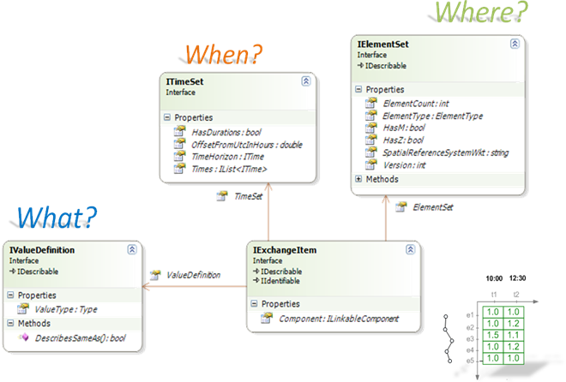
Exchange Items

Slide 11
Input and Output

Slide 12
Exchanging Values
Using Linked Exchange Items
Notes:
Component developer may decide if values are passed automatically into the next component or if they should be pulled by another component

Slide 13
Exchanging Values
Using Linked Exchange Items

Slide 14
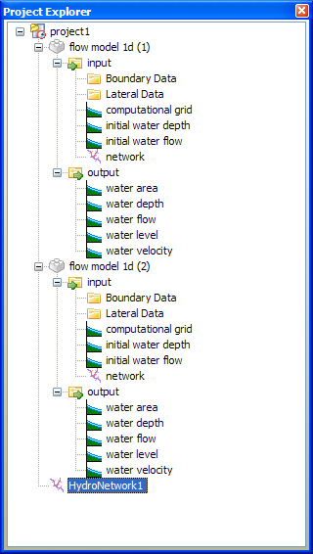
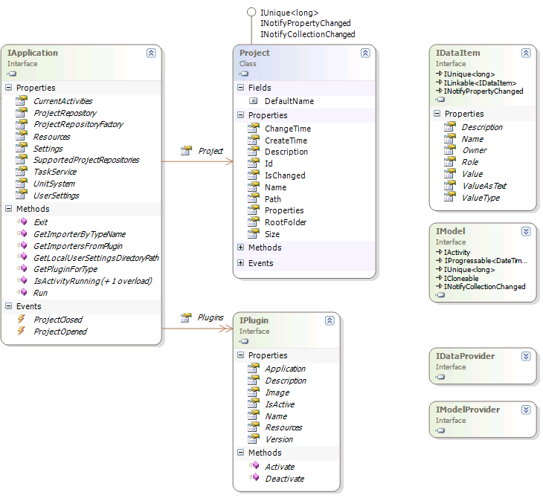
How Models are connected in Delta Shell?

Slide 15
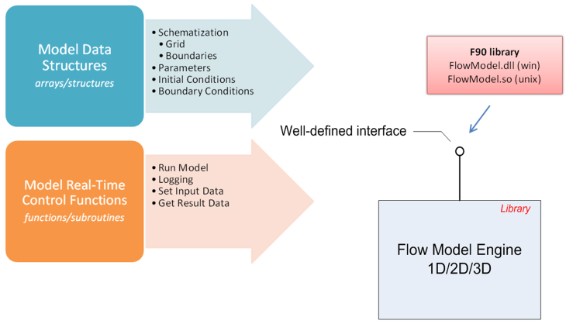
How models are integrated into Delta Shell?

Slide 16
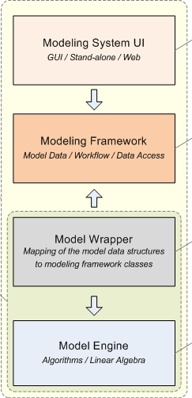
How models are integrated into Delta Shell?

Slide 17
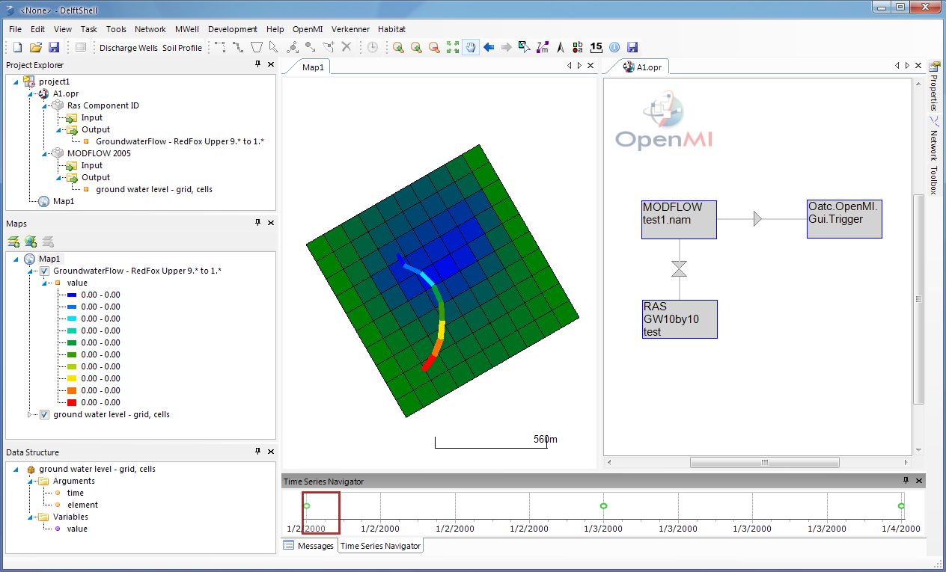
How Models are connected in Delta Shell?
Using OpenMI (prototype version only!)

Slide 18
OpenMI and Delta Shell
Delta Shell
Model
Delta
Delta Shell Model
OpenMI Component
Delta Shell
Model

Slide 19
OpenMI and Delta Shell
OpenMI Component
OpenMI Component
Delta Shell
Model
OpenMI Component

Slide 20
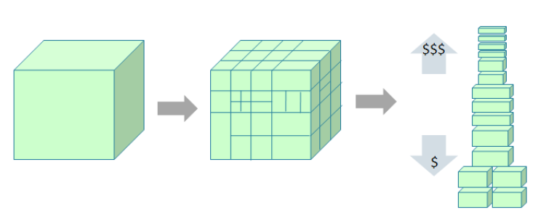
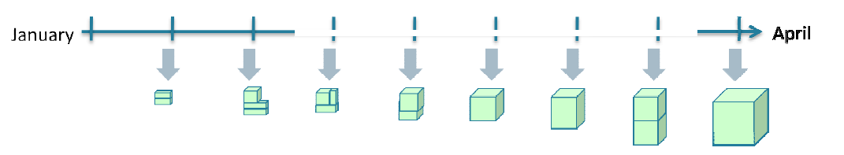
SCRUM
Split your work into a list of small, concrete deliverables. Sort the list by priority and estimate the relatice effort for each item
Split time into short fixed-length iterations (1-4 weeks), with potentially shippable code demonstrated after each iteration

Slide 21
SCRUM
Measure velocity!

Slide 22
Example: evolution of a product backlog
Week 1
Week 2
monday
Week 3
friday
Week 4
monday
Week 5
friday
Product Vision
Product backlog
Sprint 1
Incremental
Release
Sprint 2
Incremental
release

