Slide 1
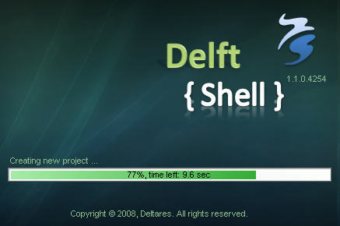
Impressie van de nieuwe User Interface(s)
G.V. Donchyts, Deltares

Slide 2
Contents
Status of development in 2008
Live demo
Planned developments for 2009
Questions

Slide 3
Status of development
Flexible framework, extendable using plug-ins
Unified graphical user interface as a modeling environment
Flow 1D hydrodynamic model integrated
  Initial conditions
  Boundary conditions
  Run parameters
  Results
GIS functionality, using ISO/OGC standards
Data import functionality
File format - one document format for all data types

Slide 4
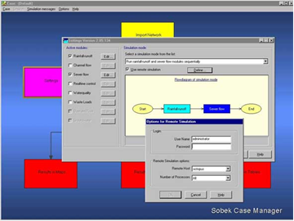
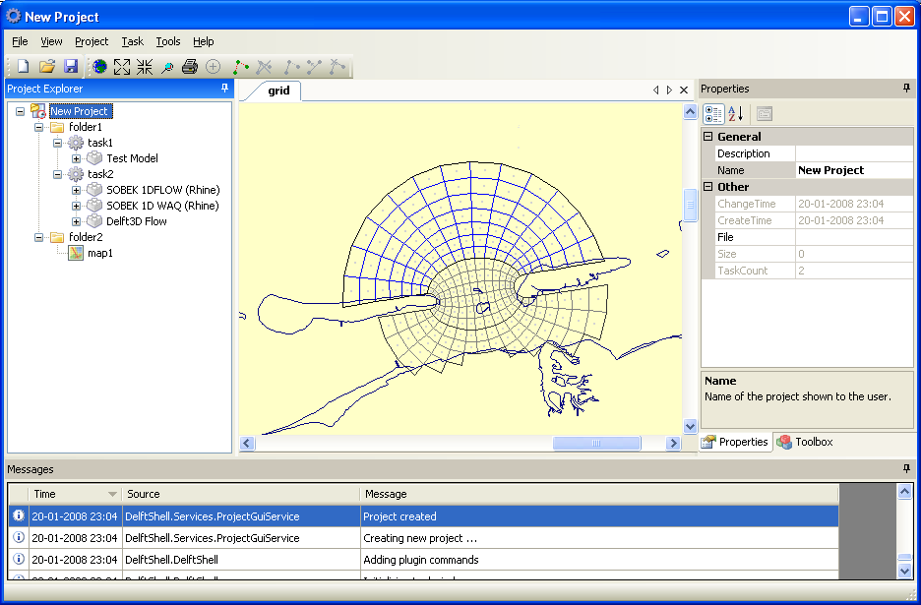
Gestructureerd → ongestructureerd
Notes:
Main line: user-centric, much more user-friendly, less clicks to do the same

Slide 5
System Design
Notes:
One file format for all data: scalability, consistency (no broken project on save, automatic validation)
Graphical user interface as modelling environment
Flexible framework: DelftTools
Third-party plugins

Slide 6
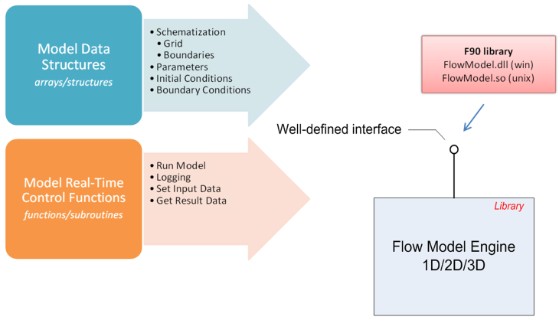
Modulaire code
Notes:
Communication with model is completely refactored:
more modular
model engine as a dll component
use of IPC/RPC client-server instead of file-based communication
easier to test

Slide 7
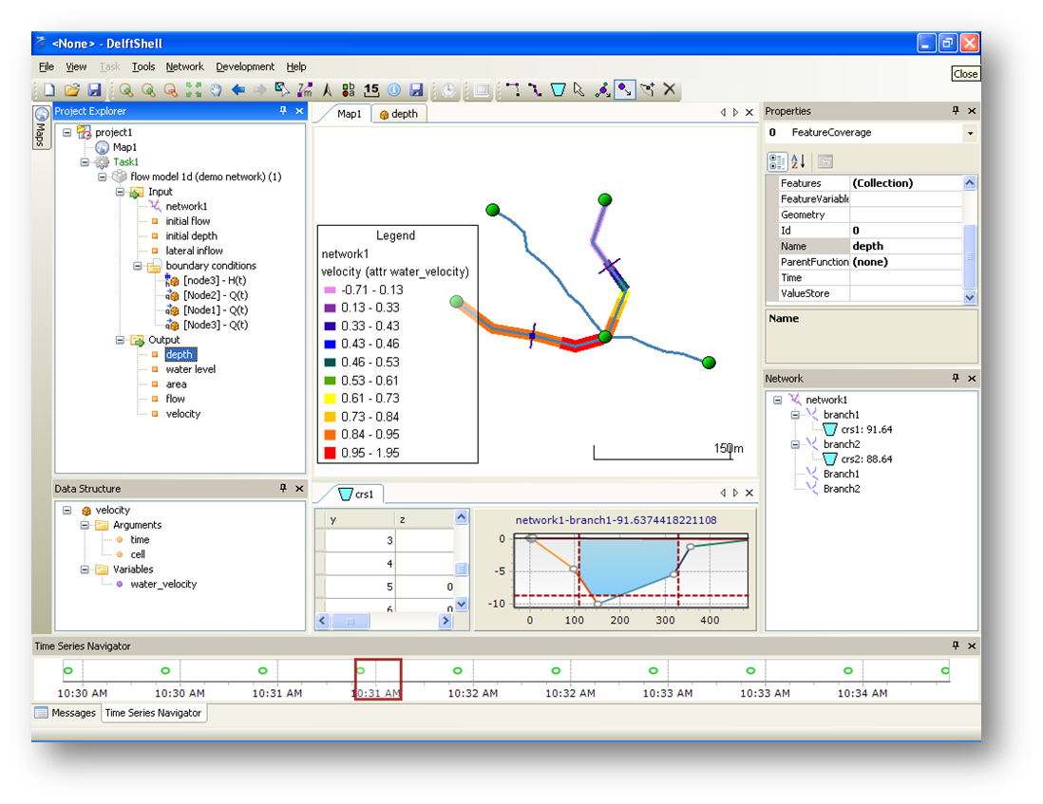
Live Demo
Notes:
- Gui (very short)
Docking
Tool views
Document views
Messages
Properties
Project explorer
- Project explorer
Folders
Data
Models
- Import data
.bui -> time series
.tp -> network
- GIS functionality
Shapefiles
WMS
Symbology for lines, polygons and points, show cities + rivers on Demis WMS map
Grids, grid(t)
Legend
- Network editor
Draw branches
Auto-detection of boundaries
Move vertices
Move nodes
Insert node
Add cross-sections
Generate discritization, set symbology for cells based on offset
- Flow model 1D
Add demo network
Add model
Show boundary conditions
Edit model run parameters
Run model
Show results in a data table
Show results on a map
Last thing: use selected polylines from vector layer as a source for network branches

Slide 8
PLANS for 2009
  1D model
  Rainfall-Runoff
  Urban / Rural
  Water Quality (WAQ)
  Sediment Transport
  Hydraulic Structures
  Case Analysis Features
Framework
  Finish support for NetCDF
  Undo / Redo
  Scripting
  Localization
  Versioning
More integration with GIS
Support for OpenMI models
Publish SDK for third-party plug-in development
Work more
together with users!
Notes:
Work more together with users:
setting priority for development
testing & bug fixes
screen casts, tutorials, documentation

Slide 9
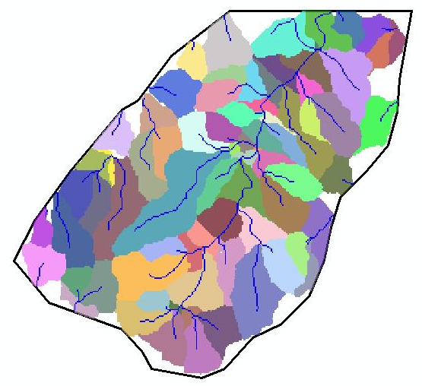
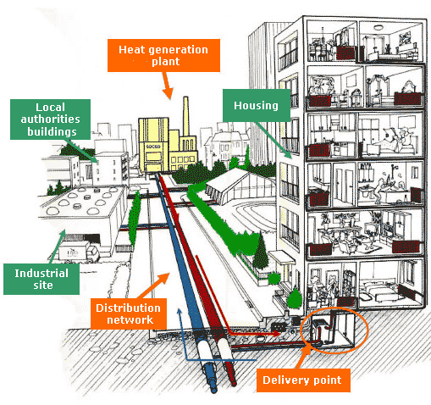
Rainfall-Runoff Modeling

Slide 10
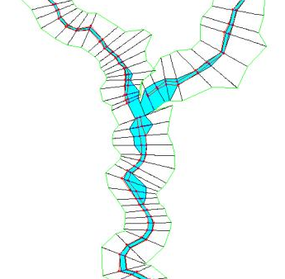
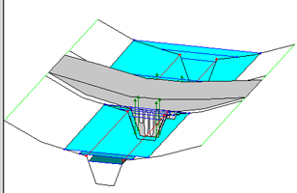
Better handling of cross-sections and structures

Slide 11
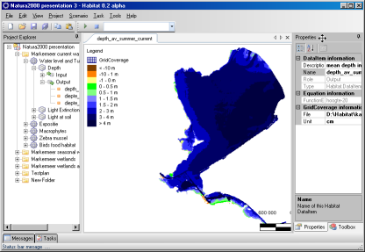
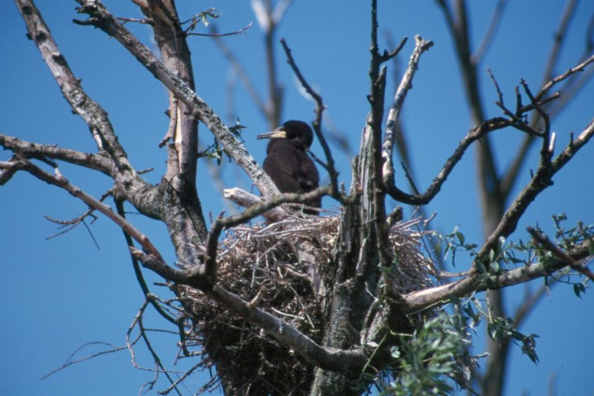
HABITAT 2.0
Notes:
Dynamic gridded data management (Spatial Analyst alike but with support for time)

Slide 12
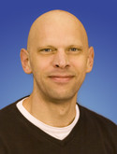
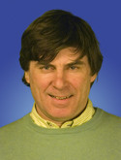

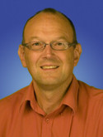
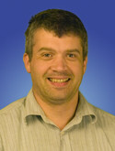
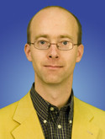
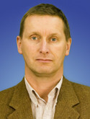
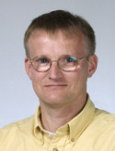

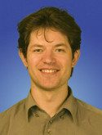
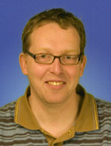
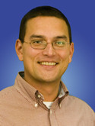
Team

Slide 13

Questions

