Slide 1
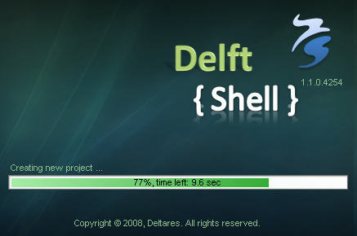
Impressie van de nieuwe User Interface(s)
G.V. Donchyts, Deltares

Slide 2
Contents
Why new user interface?
Status of development in 2008
Live demo
Planned developments for 2009
Questions

Slide 3
Why new user interface?

Slide 4
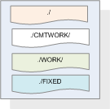
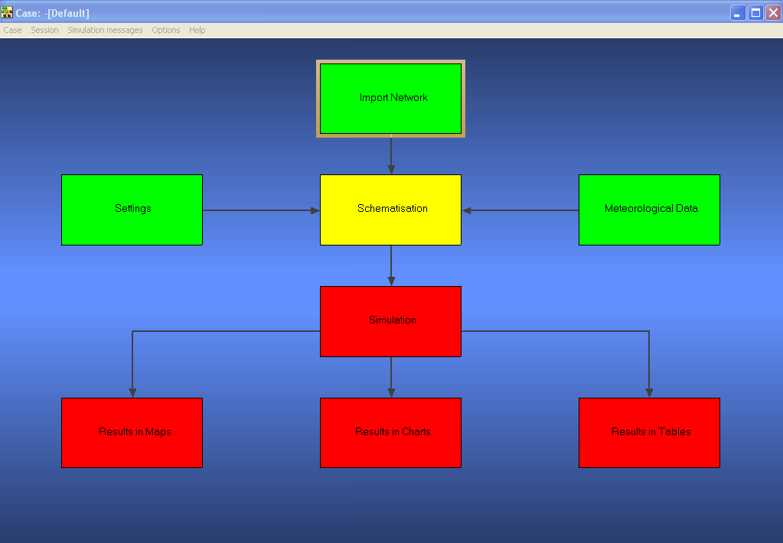
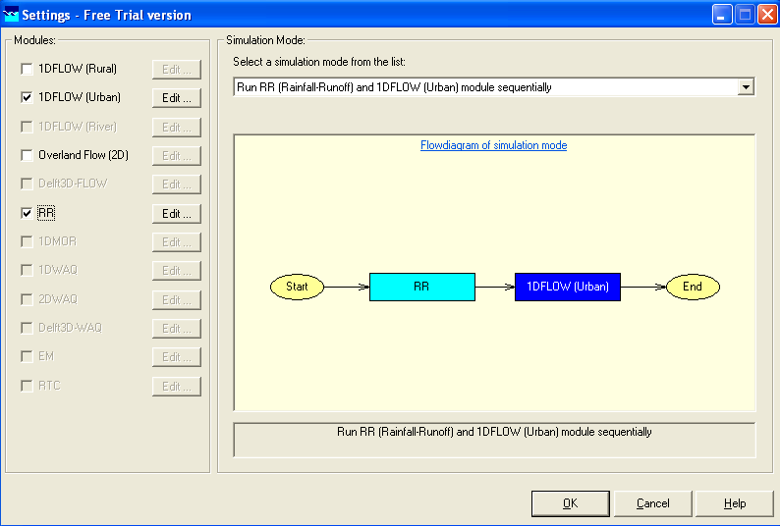


Slide 5
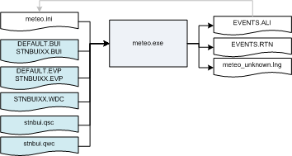
!

Slide 6
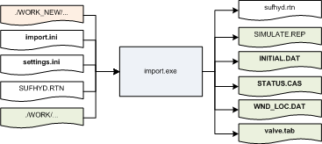
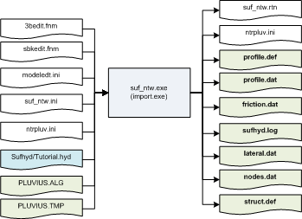
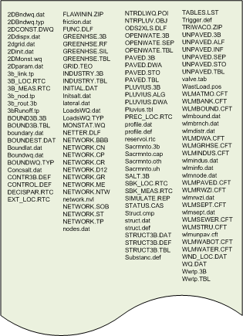
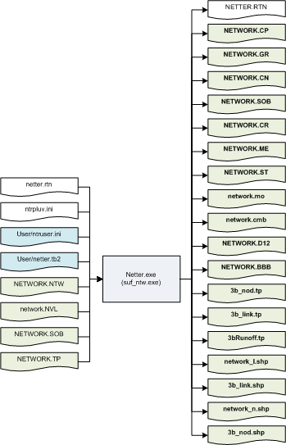

Slide 7
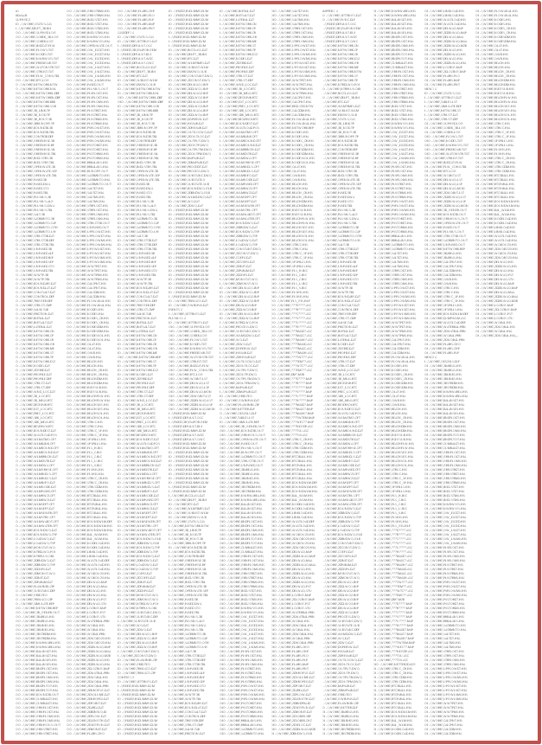
CASEDEF.EXE
CASEMAN.EXE
Cat\Cat.exe
CMUPDATE.EXE
CMUTIL.EXE
DELWAQ\CoefEdit.exe
Conv_Sbk\Conv_Sbk.exe
DELWAQ\DELWAQ1.EXE
DELWAQ\DELWAQ2.EXE
DH_SOBEK\dh_sobek.exe
DH_SOBEK\dh2sobek.exe
DSSHELL.EXE
EditHis.exe
DELWAQ\EditObj.exe
DH_SOBEK\Hydraa\HYDRAA.EXE
IMPORT.EXE
ISIS_SBK\Isis_sbk.exe
MAPLINK.EXE
METEO.EXE
WLM\MIE.EXE
MODELEDT.EXE
ModelPaste.exe
FLOW\Morpho.exe
NETTER.EXE
NtrRedef.exe
ODS_VIEW\ODS_View.exe
FLOW\parsen.exe
FLOW\parser2d.exe
FLOW\parsetxt.exe
DELWAQ\PLCT.EXE
PREPMAPP.EXE
RGFILTER.EXE
3B\RRCheck.exe
REMOTE\rsh.exe
RTC\MATLAB5\RTC.EXE
RTC\MATLAB6\rtc.exe
RTC\MATLAB61\RTC.exe
RTC\MatLab65\RTC.exe
RTC\MatLab7\RTC.exe
RTC\MatlabR2006b\RTC.exe
RTC\MatlabR2007a\RTC.exe
RTC\RtcEdit.exe
Sbk2Suf.exe
SbkBatch.exe
FLOW\SBKCHECK.EXE
SbkExportAccesMDB.exe
SbkOpt.exe
SbkOutput.exe
SUFOWMDB\Sbkstekker.exe
Schemat.exe
SELAPPS\SELAPPS.EXE
SETTINGS.EXE
SFStat.exe
SHOWLIST.EXE
SIDEVIEW\SIDEVIEW.EXE
simulate.exe
3B\SOBEK_3B.EXE
WLM\SobekEM.exe
FLOW\SOBEKSIM.EXE
STARTUP.EXE
STORAGE\Storage.exe
STORAGE\StorUI.exe
SUF_NTW.EXE
SUFTABLE.EXE
Update.exe
vervng32.exe
VIEWTEXT.EXE
DELWAQ\WATERBAL.EXE
DELWAQ\wq2dint.exe
DELWAQ\WQCheck.exe
DELWAQ\wqinp.exe
DELWAQ\wqinr.exe
x72
..\WORK\REACH.HIA
OI ..\WORK\REACH_CR.HIS
OI ..\WORK\REACH_CR.HIA
OI ..\WORK\REACHDIM.HIS
OI ..\WORK\REACHDIM.HIA
OI ..\WORK\RSEGSUB.HIS
OI ..\WORK\RSEGSUB.HIA
OI ..\WORK\REACHFLW.HIS
OI ..\WORK\REACHFLW.HIA
OI ..\WORK\REACHSEG.HIS
OI ..\WORK\REACHSEG.HIA
OI ..\WORK\REACHVOL.HIS
OI ..\WORK\REACHVOL.HIA
OI ..\WORK\STRUC.HIS
OI ..\WORK\STRUC.HIA
OI ..\WORK\STRUC_SF.HIS
OI ..\WORK\STRUC_SF.HIA
OI ..\WORK\SFSPILLS.HIS
OI ..\WORK\SFSPILLS.HIA
OI ..\WORK\FLSHIS.HIS
OI ..\WORK\FLSHIS.HIA
OI ..\WORK\STRUC_CR.HIS
OI ..\WORK\STRUC_CR.HIA
OI ..\WORK\STRUCDIM.HIS
OI ..\WORK\STRUCDIM.HIA
OI ..\WORK\RTC3BALL.HIS
OI ..\WORK\RTC3BALL.HIA
x1700

Slide 8
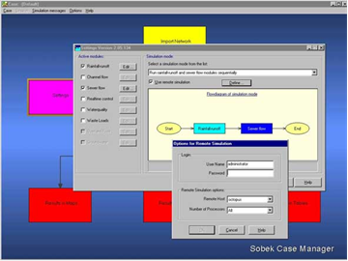
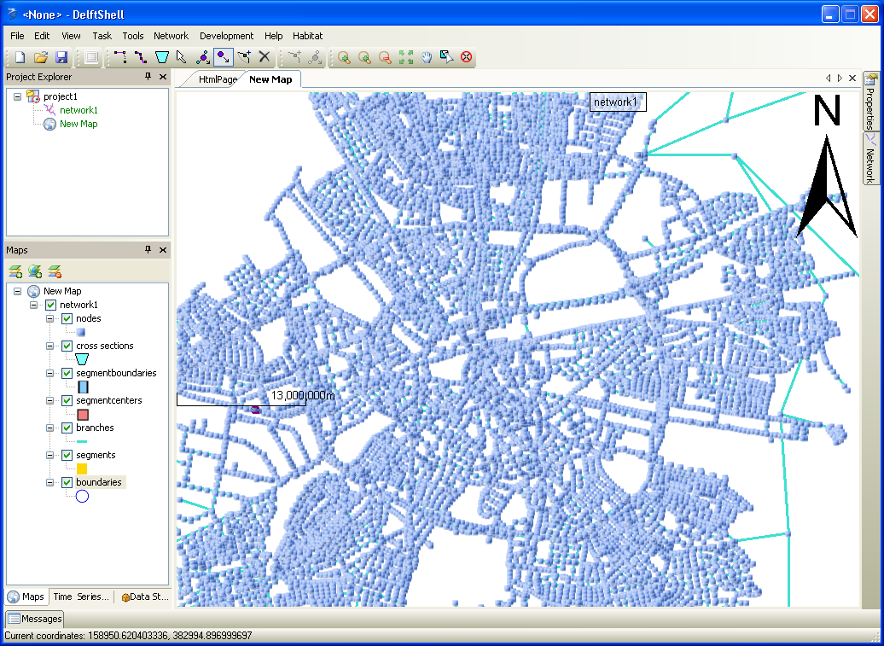
Gestructureerd → ongestructureerd
Notes:
Main line:
user-centric
much more user-friendly
less clicks to do the same
much less files

Slide 9
Status of development

Slide 10
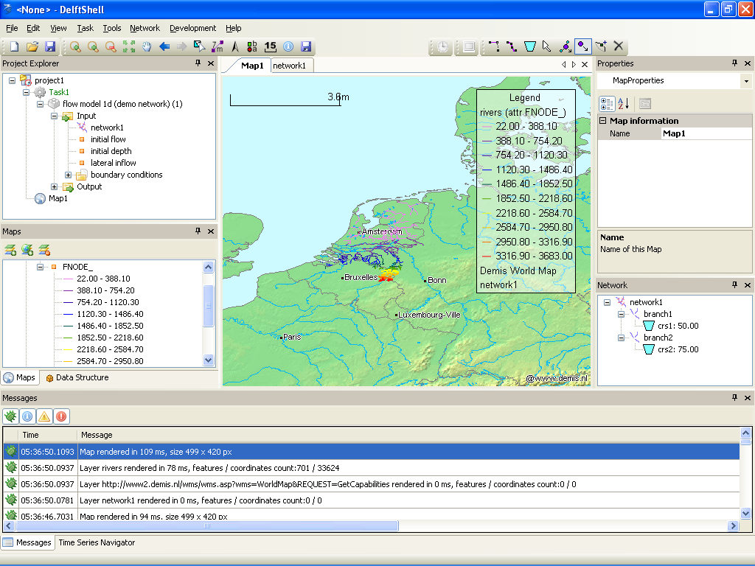
Graphical user interface
Project Explorer
Documents, tab-based
Property Grid
Logging Window
Toolbars & Menus
Positionering, branding en huisstijl Deltares -
12 september 2007
10
Notes:
Mention that FEWDOR showed examples of HABITAT, Verkenner
10

Slide 11
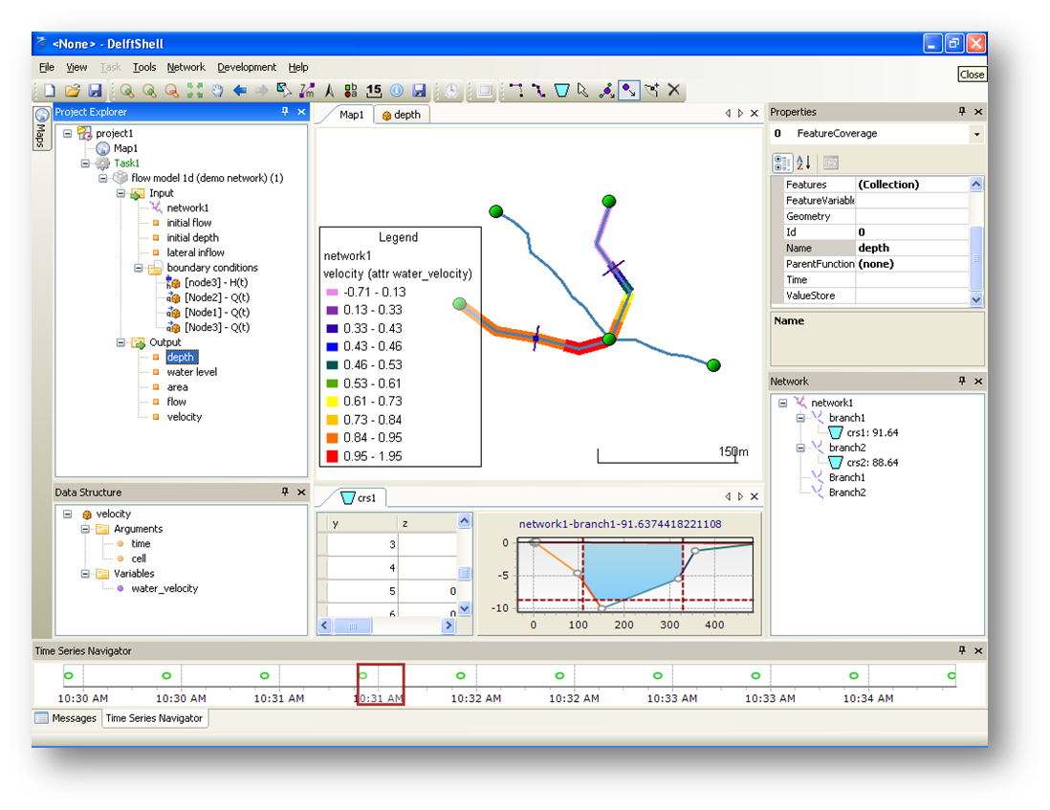
Live Demo
Notes:
- Gui (very short)
Docking
Tool views
Document views
Messages
Properties
Project explorer
- Project explorer
Folders
Data
Models
- Import data
.bui -> time series
.tp -> network
- GIS functionality
Shapefiles
WMS
Symbology for lines, polygons and points, show cities + rivers on Demis WMS map
Grids, grid(t)
Legend
- Network editor
Draw branches
Auto-detection of boundaries
Move vertices
Move nodes
Insert node
Add cross-sections
Generate discritization, set symbology for cells based on offset
- Flow model 1D
Add demo network
Add model
Show boundary conditions
Edit model run parameters
Run model
Show results in a data table
Show results on a map
Last thing: use selected polylines from vector layer as a source for network branches

Slide 12
Nog meer wensen
Undo/Redo
ArcGIS integration
Integration with:
  Delft-FEWS
  WIS
  LIZARD
  IRIS
  Waterplanner
  IDSS
More models
Support for Linux
More applications: HABITAT, Verkenner …
Notes:
Problemen die kunnen niet met de huidige tools opgeloost woorden

Slide 13
Oplossing: open and flexible
Notes:
One file format for all data: scalability, consistency (no broken project on save, automatic validation)
Graphical user interface as modelling environment
Flexible framework: DelftTools
Third-party plugins
Maximum re-use of third-party components:
NHibenate, log4net, GDAL, SharpMap – QA, we can concentrate more on core business
Use of standards: OGC, NetCDF, OpenMI (will come soon)
Possible extensions/plug-ins
ArcGIS
Models
Interaction with another systems

Slide 14
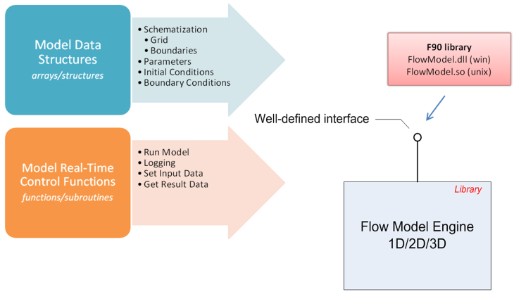
Modulaire code
Notes:
Communication with model is completely refactored:
more modular
model engine as a dll component
use of IPC/RPC client-server instead of file-based communication
easier to test

Slide 15
Results of 2008
Flexible framework, extendable using plug-ins
Unified graphical user interface as a modeling environment
Flow 1D hydrodynamic model integrated
  Initial conditions
  Boundary conditions
  Run parameters
  Results
GIS functionality, using ISO/OGC standards
Data import functionality
File format - one document format for all data types

Slide 16
PLANS for 2009
  1D model
  Hydraulic Structures
  Rainfall-Runoff
  Water Quality (WAQ)
  Sediment Transport
  Urban
Framework
  Case Analysis Features
  Finish support for NetCDF
  Undo / Redo
  Scripting
  Localization
  Scenarios
More integration with GIS
Support for OpenMI models
Publish SDK for third-party plug-in development
More user involvement in development!
Notes:
Work more together with users:
setting priority for development
testing & bug fixes
screen casts, tutorials, documentation

Slide 17
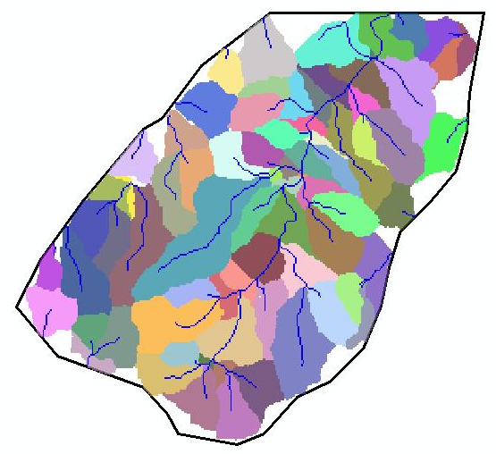
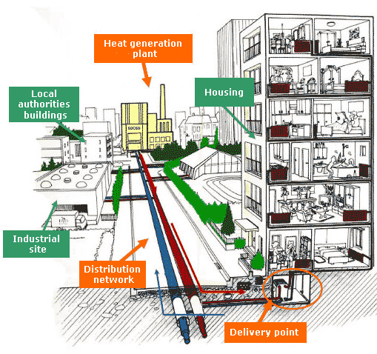
Rainfall-Runoff Modeling

Slide 18
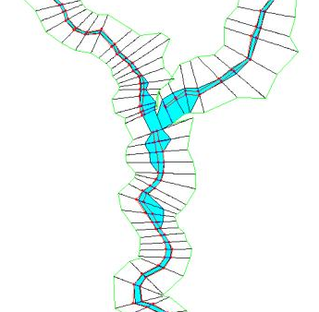
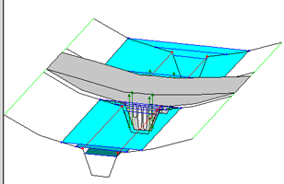
Better handling of cross-sections and structures

Slide 19
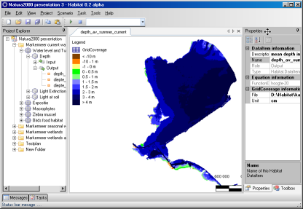
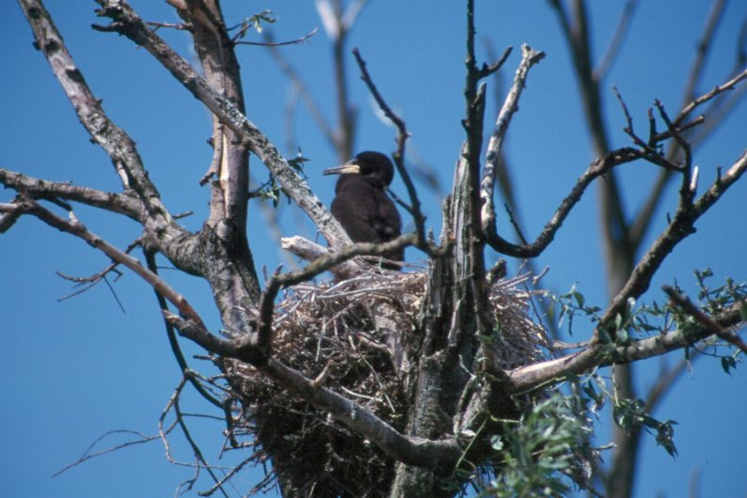
HABITAT 2.0
Notes:
Dynamic gridded data management (Spatial Analyst alike but with support for time)

Slide 20
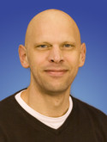
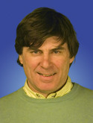

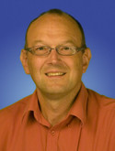
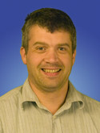
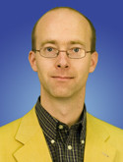
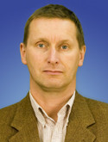
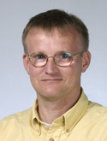
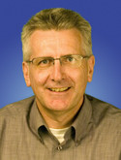
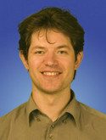
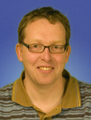
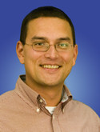
Team

Slide 21

Questions

