Slide 1
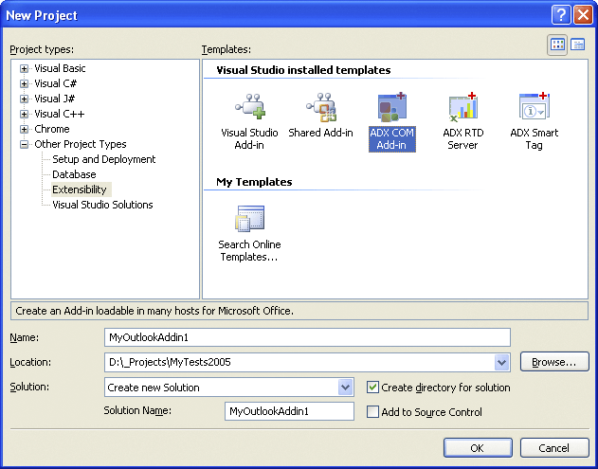
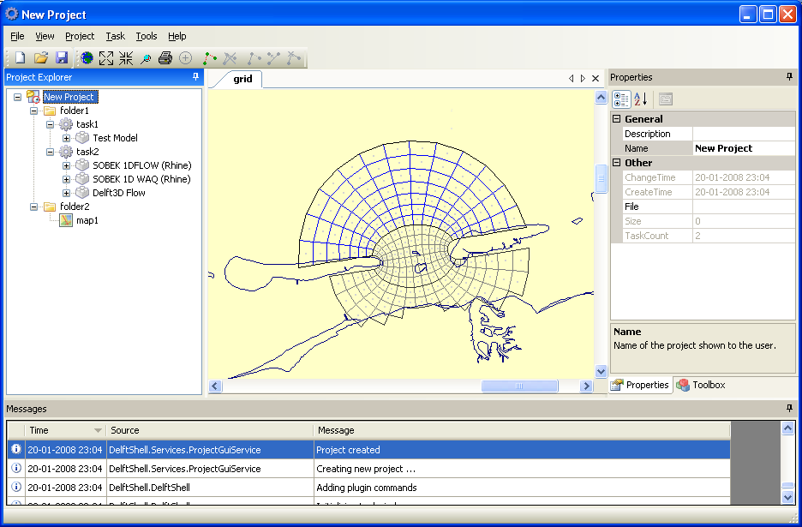
Delft Shell
Graphical User Interface
1D Flow
1D Flow Engine
F90
Project File Format
SQLite
GIS
Network Editor
Delft Tools
Framework – set of libraries
Data Series
Core
IApplication, IPlugin, Project, Task, IModel,
Gui
IGui, IMenuItem, IToolBarItem, IView
Import / Export
Utils
Threading, Xml, IO and other utilities
Data Objects
IDataItem, Quantity
ITimeSeries, IFunction
.bui
.shp
.gdb

