Slide 1









Building with Nature Indonesia
Design of permeable structures
Tom Wilms
25 January 2018, Semarang

Slide 2

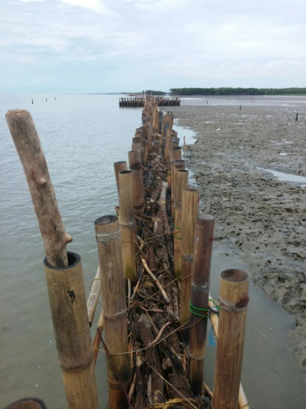
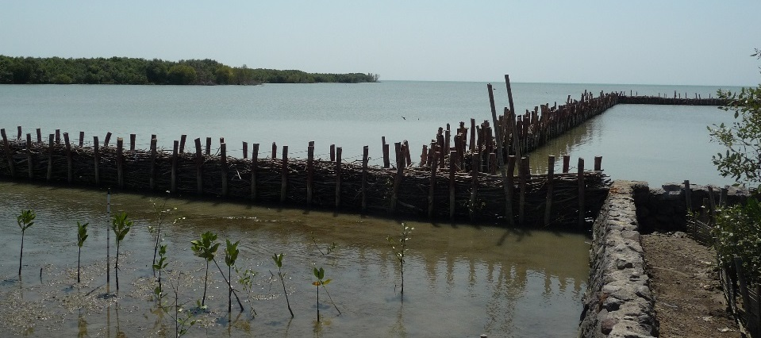
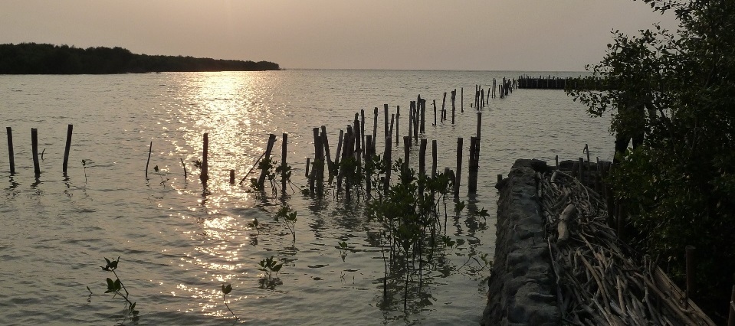
Technical Training – Structural design (1 hr)
Recapitulation (5 m)
What do you want to learn (5 m)
Function of the structure (10 m)
The permeable structure: (25 m)
  Locations
  Itself
  Its elements
  Materials
  Other shapes
  Lessons learnt (5 m)
  Evaluation (10 m)
2

Slide 3
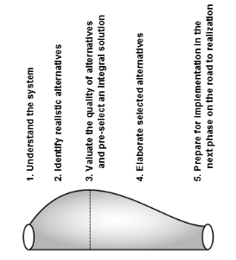
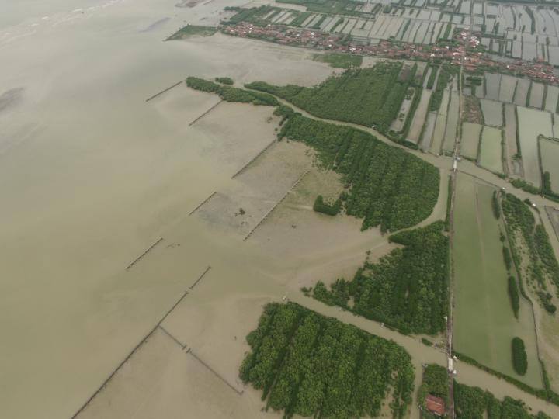
Recapitulation
BwN principles
Functional Design
Spatial design
What do you want to learn?
3

Slide 4
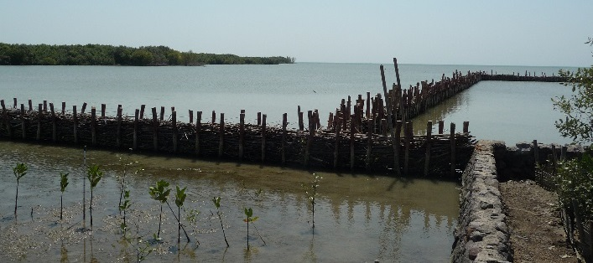

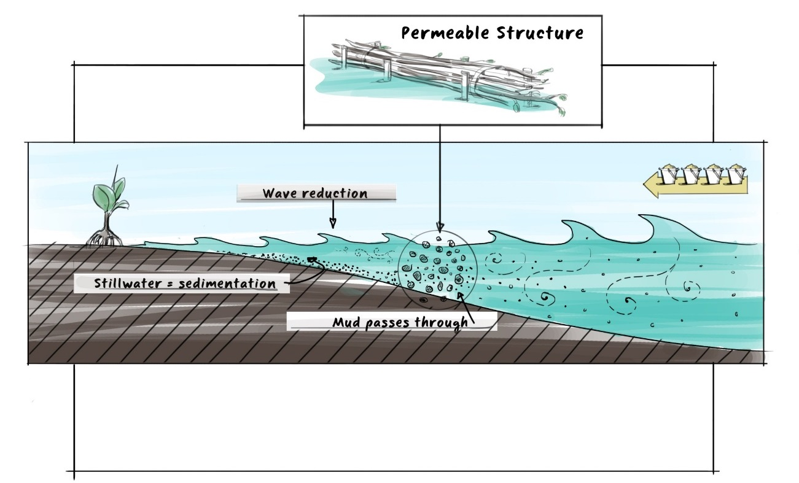
Functions of the permeable structure
Reduce wave energy:
  Dampen energy
  Wave overtopping
  -> Create sheltered conditions
  Allow sediment to pass
  -> Settlement
  Allow mangrove propaguls to pass
  -> Recolonisation
Limit reflection
-> Erosion at the toe
4

Slide 5
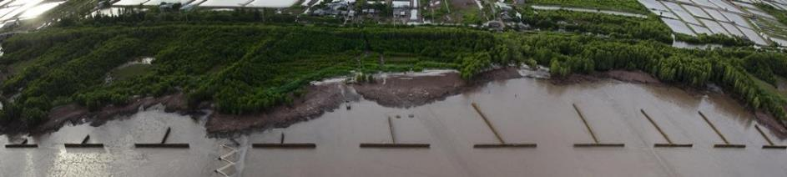
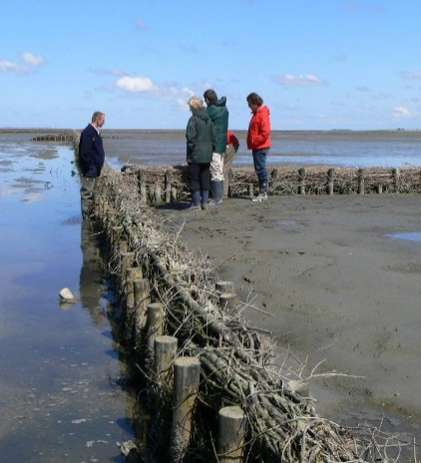
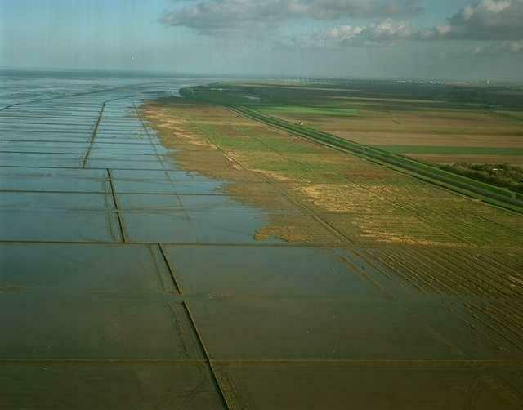
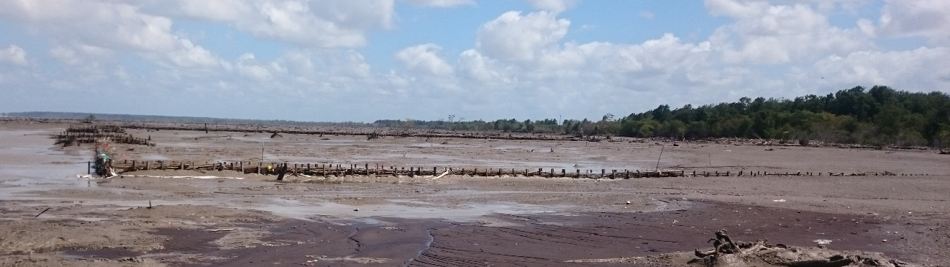
The permeable structures
Locations:
  The Netherlands
  Vietnam
  Surinam
  Indonesia
grids of semi-permeable
groins (brushwood).
5

Slide 6
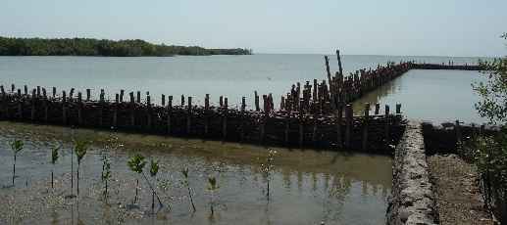
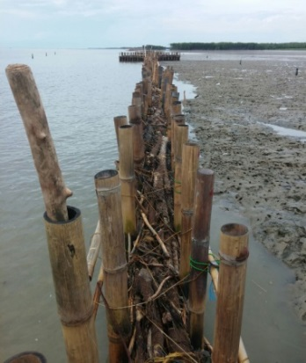
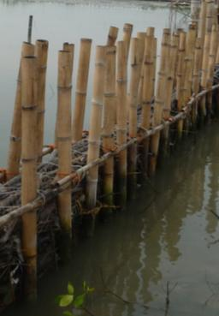
The permeable structures
Elements:
  Vertical Poles (keep fill in place)
  Horizontal Beams (tie wire)
  Fill material (damp waves)
  (with rope and net)
  Wire (keep fill in place)
6

Slide 7
The permeable structures - dimensions
  Vertical poles (keep fill in place):
  Diameter 0.12 m to 0.15 m
  Toe 3 m in the stiff soil (at least 2 m)
  Top 0.5 m above MHWS
  Length: around 5 m
  (2/3 in soil, 1/3 above)
7

Slide 8
The permeable structures - dimensions
  Vertical poles:
  Along the structure between poles: 0.5 m
  Between rows, between poles: 0.4 m
8

Slide 9
The permeable structures - dimensions
  Horizontal beams (tie wire):
  Diameter 0.10 m
  0.1 above MWL
  Wire for bundles and net:
  No special requirements
  Non-pollutant
  Wide mesh
9

Slide 10
The permeable structures - dimensions
  Fill material (wave damping):
  Very tight packed between poles, stiff soil and wire
  First bed layer of 0.3 m of palm leafs
  Fill material in bundles of 0.3 m diameter
  Length of bundles 2.0 m
  Level of fill at least 0.3 m above MHWS
  Wire (keep fill down and poles together):
  Diameter 5 mm
  Length 5 m
10

Slide 11
The permeable structures - materials
  Vertical Poles:
  Bamboo Betung, Apus
  Nibung, Coconut trunks and Walaba
  PVC (filled with concrete), HDPE
  Wood
  Steel
  Wrapping to protect from shipworm
11

Slide 12
The permeable structures - materials
  Horizontal beams:
  Bamboo Betung, Apus
  Wood
  PVC,
  Steel
  Wire for bundles and net:
  Nylon
  Local rope
12

Slide 13
The permeable structures - materials
  Fill material:
  Brushwood branches
  woven bamboo of 2x3 m,
  brushwood of mangrove,
  bamboo branches,
  coconut frounds
  Nipah palms
  First layer:
  Straw, banana leaves, palm leaves
  Wire:
  Nylon
  Gabions
13

Slide 14
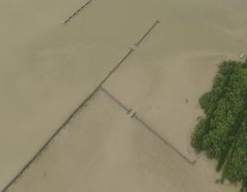
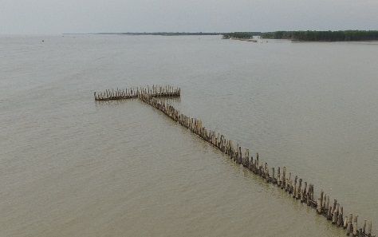
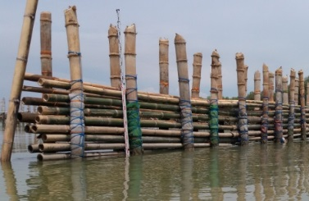
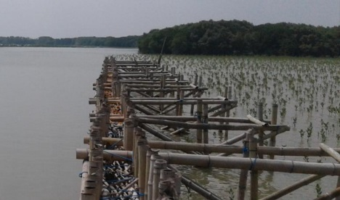
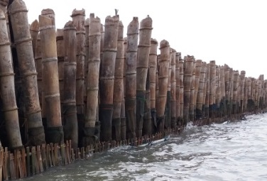
The permeable structures - variations and other shapes
  Variations
  T-end pieces
  Wider distances between the vertical poles
  Support behind the structure at exposed locations
  Thicker horizontal beam
  Extra horizontal support beam at the bed level, or at low water level
  Other shapes:
  Rows of vertical poles, no fill
  Rows of vertical poles and horizontal bamboo beams
14

Slide 15
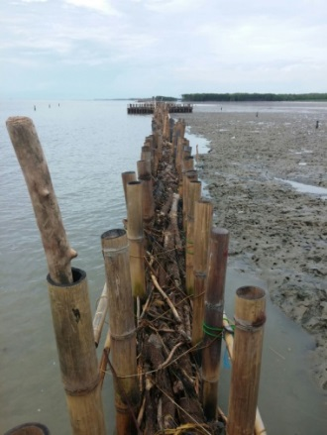
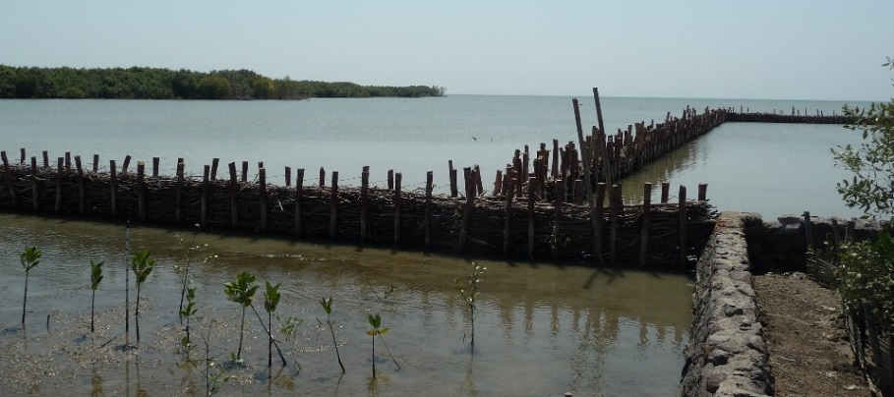

Lessons learnt
  Monitoring and Maintenance are very important as:
  Soft mud washes away in the first storms:
  Fill material:
    Decays
    Compresses
    Gives high horizontal loads to vertical poles
  Shipworm eats wood, bamboo and brushwood
  This learning by doing
  Adaptive planning cycle needed by all participants
  Best structure is not found yet
15

Slide 16
Evaluation
Recapitulation (5 m)
What do you want to learn (5 m)
Function of the structure (20 m)
The permeable structure: (20 m)
  Locations
  Itself
  Its elements
  Materials
16

Slide 17
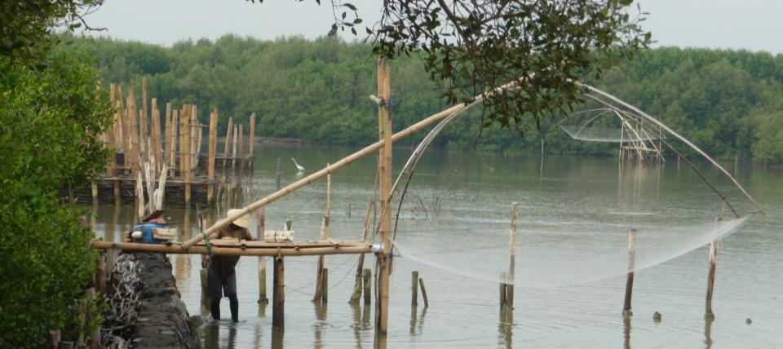
www.witteveenbos.com
www.ecoshape.nl

Slide 18
Functions of the permeable structure
Excercise:
Invent structures with these functions
Alone 2 structures in 5 minutes
In groups of 3, 4 more structures in 10 minutes
Sketch each structure on A3
Plenary presentation
18

