Slide 1
Module strategy building, design and decision-making
Training and awareness programme Building with Nature

Slide 2
Strategy
Select most effective measure
  Building with Nature versus traditional design
Design measure

Slide 3
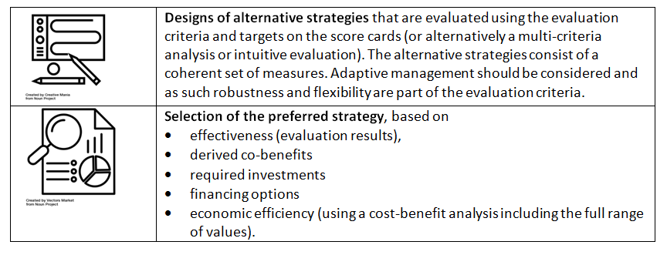
Strategy building process and outputs
Process
Outputs
1. Consider socio-political context, existing strategies and plans
2. Select a risk reduction target
3. Identify green, hybrid and conventional options
4. Select best strategies based on effectiveness, co-benefits and costs
From: Philippines Integrated Water Resources Management Planning Guidelines (World Bank 2016)
From: Implementing nature- based flood protection Principles and implementation guidance (World Bank 2017)

Slide 4
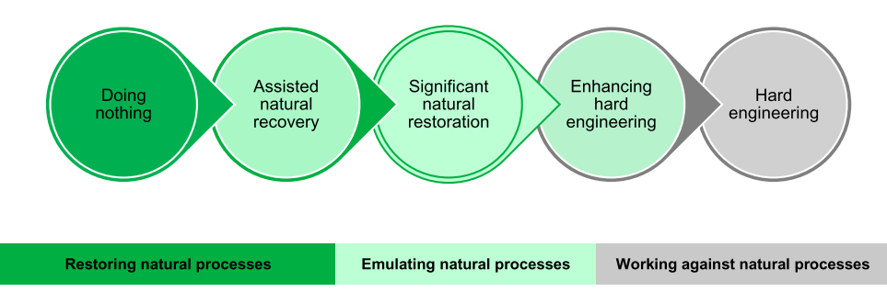
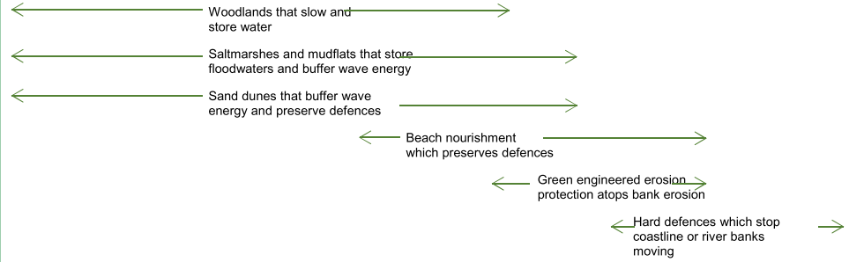
Choose a strategy
Management option
From: Evidence directory Working with Natural Processes (EEA 2017)

Slide 5
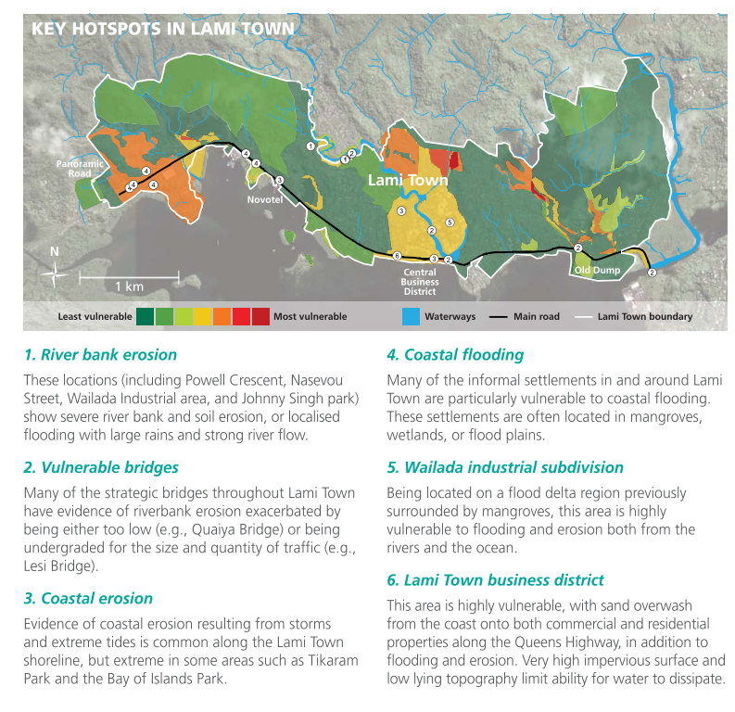
Example from Fiji islands
From: An economic analysis of ecosystem-based adaptation and engineering options for climate change adaptation in Lami Town, Republic of the Fiji Islands (Rao et al. 2013)

Slide 6
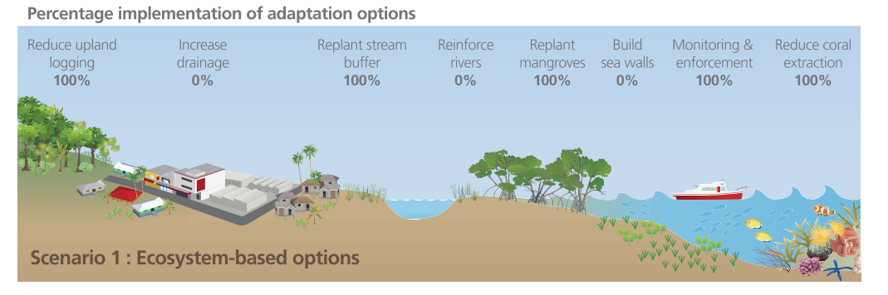
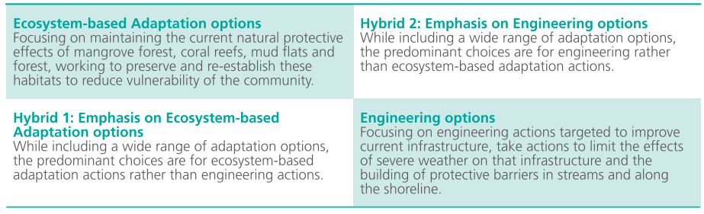
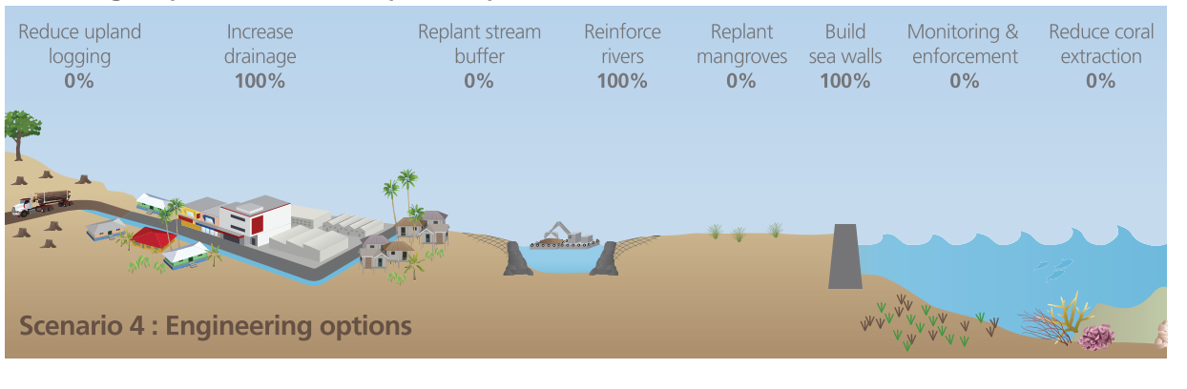
Design alternative strategies

Slide 7
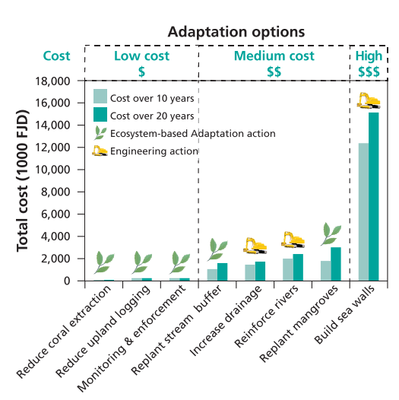
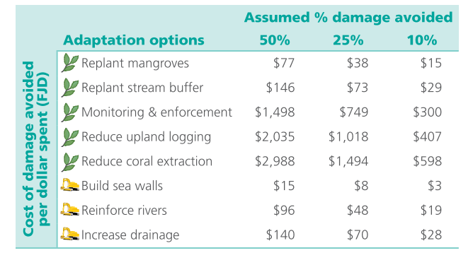
Compare interventions
Comparison of ecosystem-based and engineering climate adaptation interventions in Lami Town, Fiji islands
Results of least-cost analysis over 10 and 20 years
Results of avoided damages for Lami Town over 20-years (with 3% discount rate)
From: An economic analysis of ecosystem-based adaptation and engineering options for climate change adaptation in Lami Town, Republic of the Fiji Islands (Rao et al. 2013)

Slide 8
Methods to compare interventions
Economic tools | Description | Best applicable when: | Advantages/ disadvantages
Cost-Effectiveness Analysis (CEA) | All options are compared in effectiveness – to what extent do they contribute to one specific (flood-risk related) goal? | If there is one single, clear-defined goal for the project and it is of interest to find the most attractive alternative from a financial point of view. As a first screening of measures | A risk of using CEA is that the method does not take into account any additional benefits a measure might have.
Life Cycle Costing (LCC) | In an LCC all costs for the asset over its entire lifetime, operation and maintenance and if relevant breakdown costs are compared over a fixed (long) time horizon, for example 100 years and discounted. | You want to have an idea of the costs of a solution
Multi-Criteria Analysis (MCA) | A MCA is a semi-quantitative analysis in which the performance of measures is scored on multiple criteria based on expert/ stakeholders opinions | There are multiple criteria or effects to take into consideration Increase stakeholder engagement and support. | +Very good for engaging stakeholders (and using their local knowledge) and increasing support for project - MCA is a qualitative but relatively subjective approach
Cost-benefit analysis (CBA) | The costs of the project are compared to the welfare effects/ benefits. These are determined in relation to a reference situation that includes autonomous development. If possible, all effects are expressed in monetary terms to ensure comparability. | More objective than MCA: all effects from viewpoint of impact on welfare (increased comparability, more objective) | + Quantified, more objective overview of costs and benefits; comparable. + there are quite a number of other advantages - False sense of security through quantitative results

Slide 9
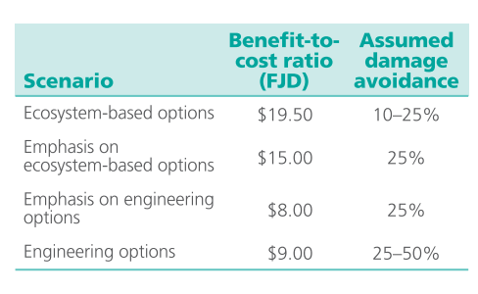
Select best alternative strategy
Question: Which strategy would you use?

Slide 10
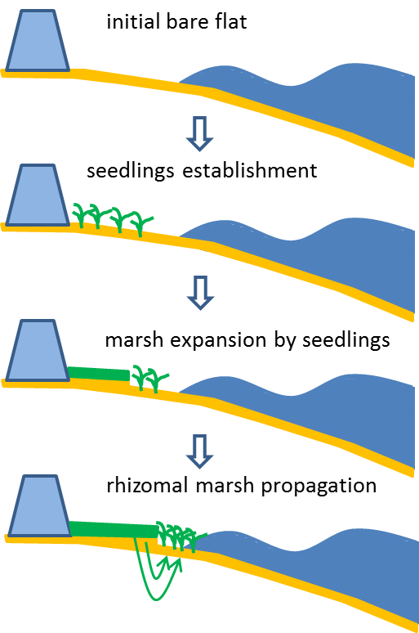
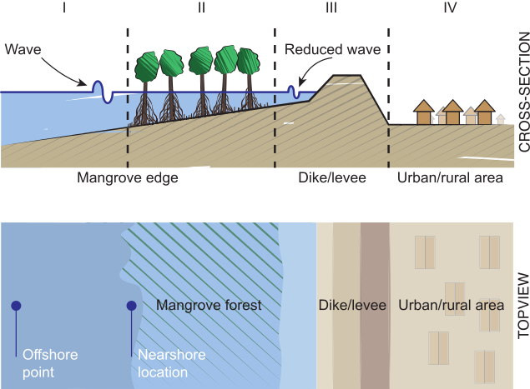
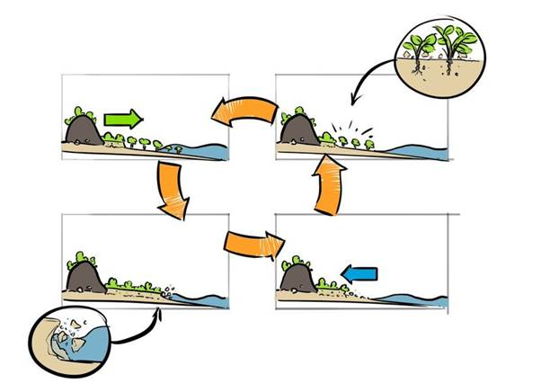
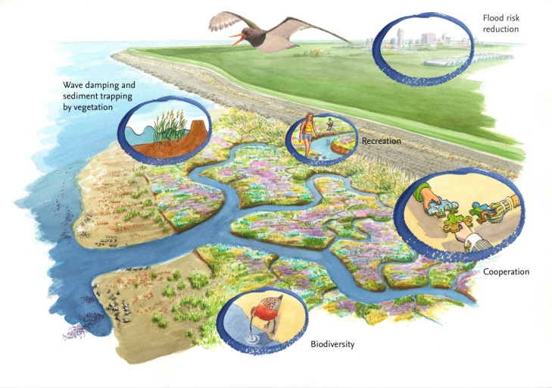
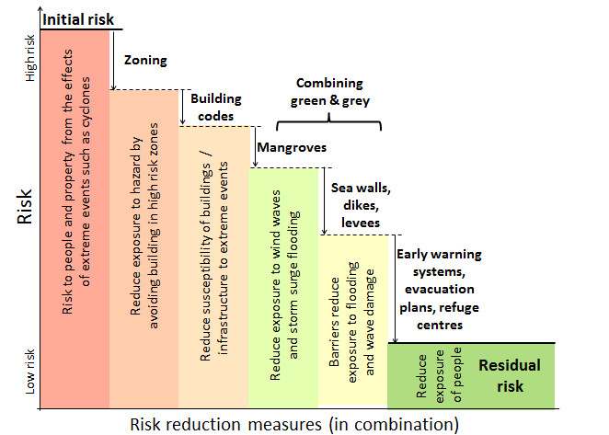
Characteristics of BwN
Wave height reduction
Adaptive capacity
Dynamic and uncertainty
Multi-functional
Just one of the possible measures
Notes:
Slide by Stephanie Janssen and Bregje

Slide 11
Wave height reduction
Picture by Merijn Janssen
Notes:
Slide by Stephanie Janssen and Bregje

Slide 12

Multifuctional
Source: BE SAFE & WNF
Notes:
Slide by Stephanie Janssen and Bregje

Slide 13
Adaptive capacity: natural growth with sea level rise
Source: Tjeerd Bouma
Notes:
Slide by Stephanie Janssen and Bregje
The build up of an salt marsh
Horizontal and vertical expansion of the salt marsh under ideal conditinos

Slide 14
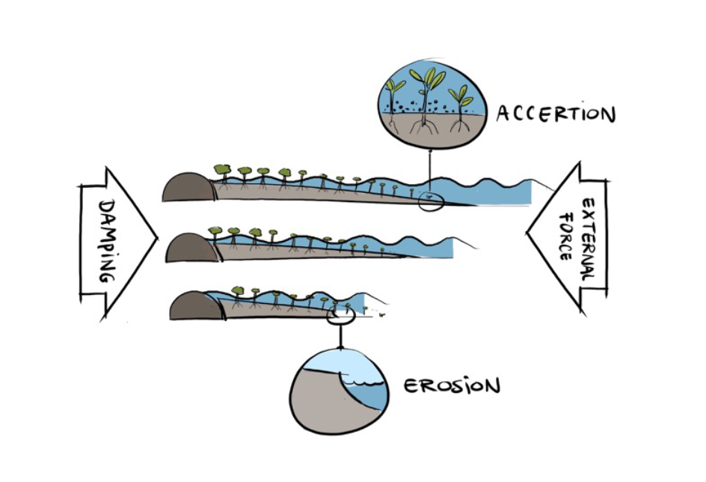
BwN in combination with other interventions
Offers good playing field for showing Deltares knowledge to full extent
Notes:
It is just one of the ways to reduce risk

Slide 15
Dynamic and uncertainty
Notes:
Slide by Stephanie Janssen and Bregje
BwN is not finished after construction!
Cyclic development of a saltmarsh.
Cliff formation the marsh will erode, untill there is sufficient quite area where new plants can grow

Slide 16
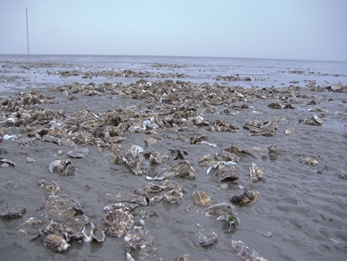
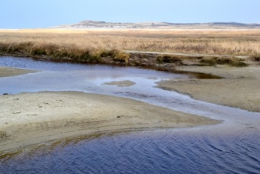
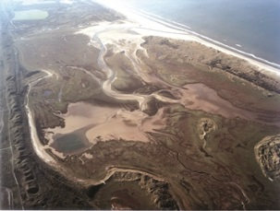
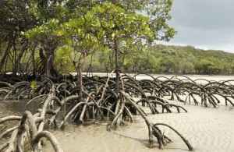
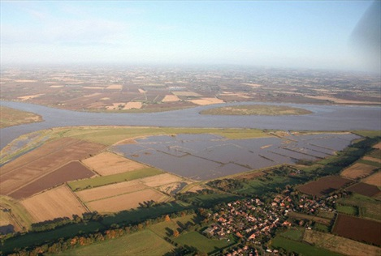
Different types of Building with Nature
Oyster reefs
Sand nourishments
Salt Marsh
Mangroves
Managed realignment
Notes:
Slide from Stephanie Janssen and Bregje

Slide 17
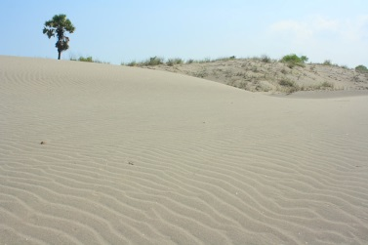
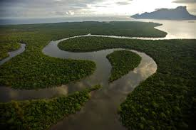
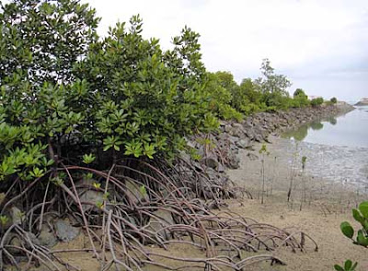
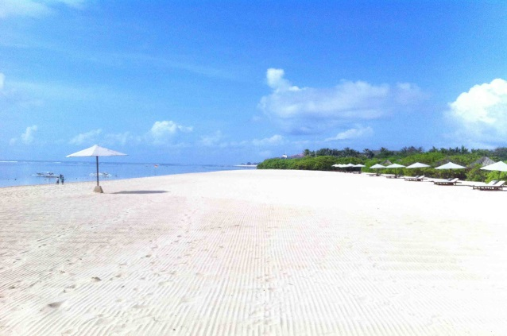
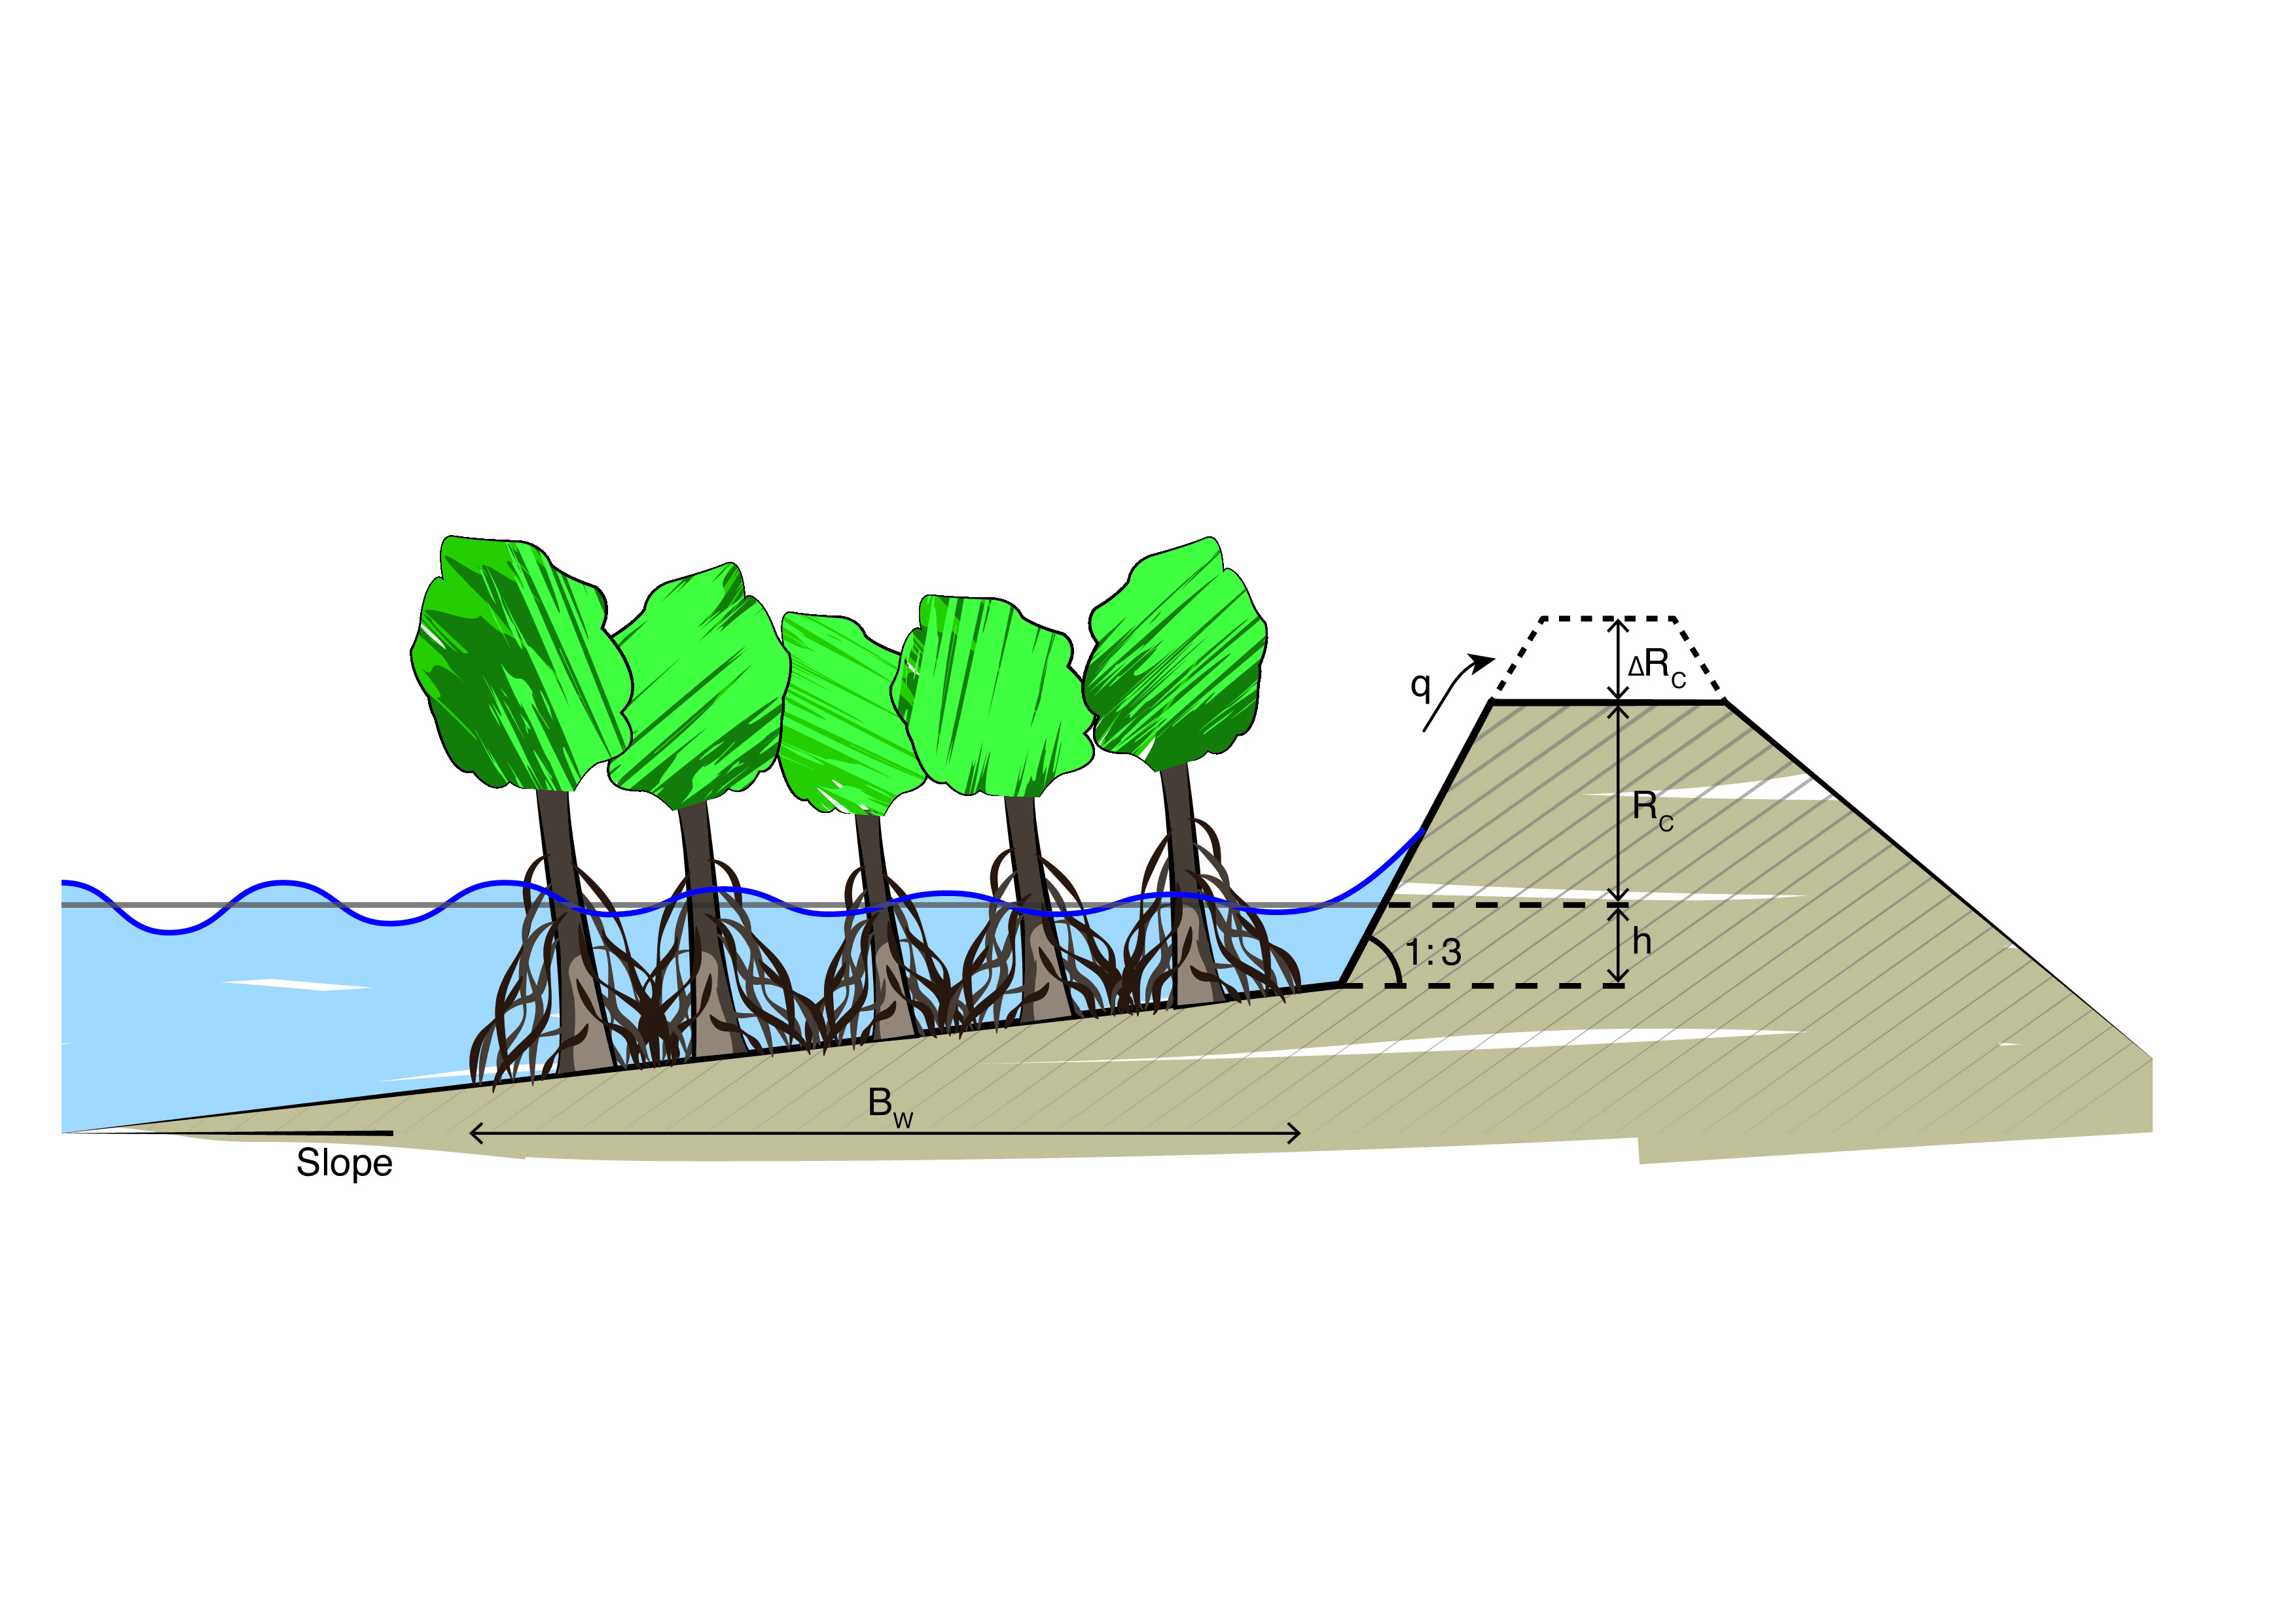
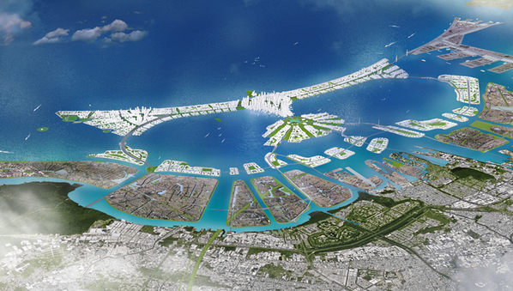
Soft, hybrid and hard measures
Soft solutions
Hybrid
Hard solutions
more space, more flexible, cost-effective
less space, less flexible, extra investment
Notes:
Slide from Bregje

Slide 18
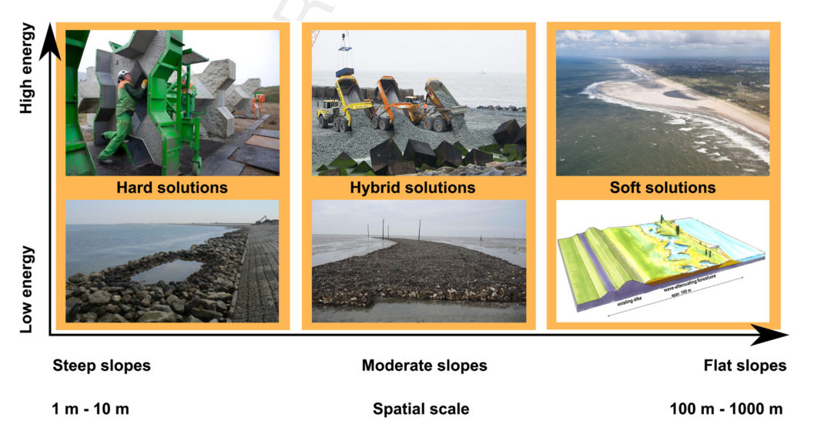
Soft, hybrid and hard measures
De Vriend et al. 2014
Notes:
Slide from Stephanie IJff
The application of soft, hybrid or hard measures is dependent on the steepness of the slope and the hydrodynamic energy.

Slide 19
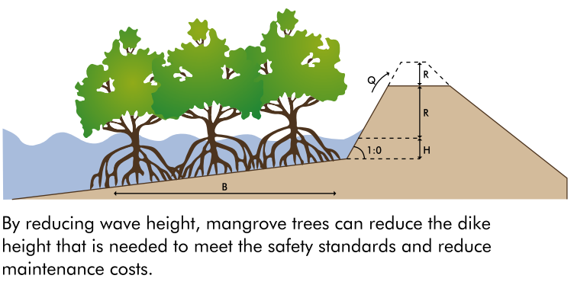
Design the intervention
From: Implementing nature- based flood protection Principles and implementation guidance (World Bank 2017)

