Slide 1





Strategy building
Notes:
This powerpoint is made with materials from Bregje van Wesenbeeck, …

Slide 2
Implementation Cycle
1. System understanding and identification of challenges
2. Assessment of strategy and measures
3. Implementation of strategy and measures
4. Monitoring and evaluation of strategy and measures
Problem?
Was this successful?
What did we think we should do about it?
What did we do about it?

Slide 3
Integrate
Natural system
Socio-economic
Institutional

Slide 4
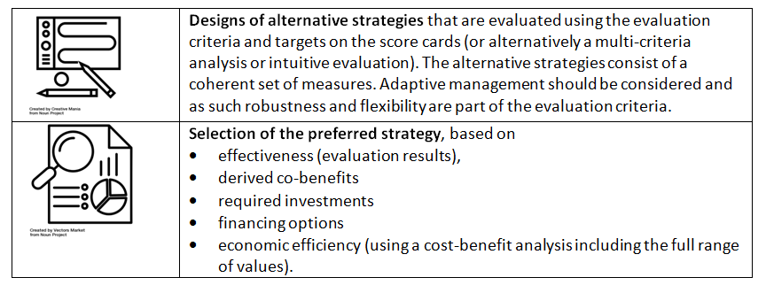
Strategy building process and outputs
Process
Outputs
1. Consider socio-political context, existing strategies and plans
2. Select a risk reduction target
3. Identify green, hybrid and conventional options
4. Select best strategies based on effectiveness, co-benefits and costs
From: Philippines Integrated Water Resources Management Planning Guidelines (World Bank 2016)
From: Implementing nature- based flood protection Principles and implementation guidance (World Bank 2017)

Slide 5
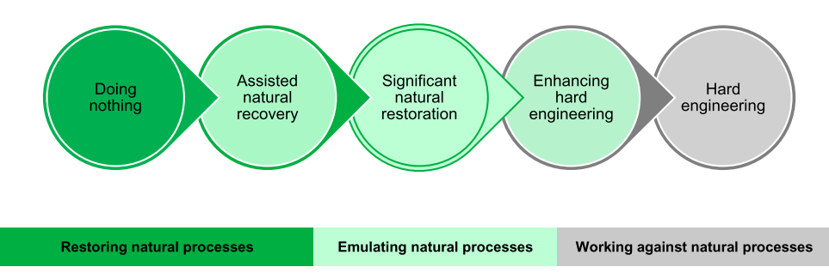
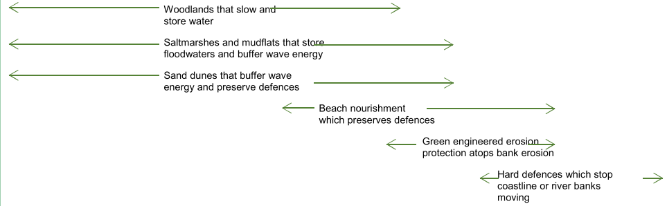
Choose a strategy
Management option
From: Evidence directory Working with Natural Processes (EEA 2017)

Slide 6
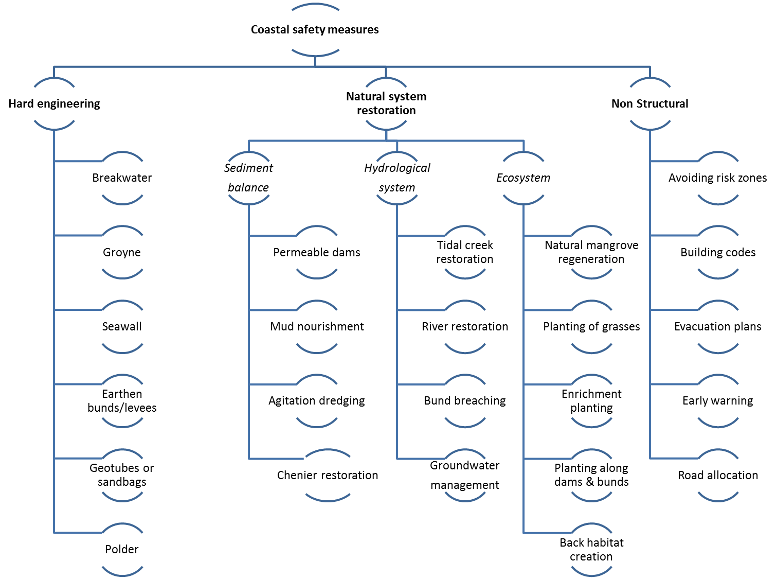

Slide 7
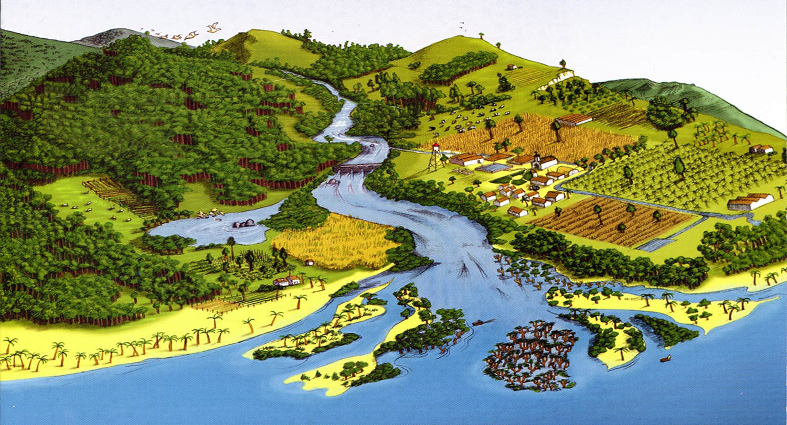

Building with Nature-decision making:
Multi-criteria analysis
Erik de Ruijter van Steveninck with contributions by Henk-Jan Verhagen
Notes:
Welcome
Department of Environmental Resources
Involved in the ES course:
functioning of ecosystems in module 2
module 9: Aquatic Ecosystems
My background:
PhD in tropical marine ecology (coral reefs)
Ecological Rehabilitation River Rhine (RIVM = EPA)
Ca 12 years at IHE/UNESCO-IHE

Slide 8
Multi-criteria analysis: aim
to assist decision makers in choosing a preferred course of action
among complex alternatives
having often contradicting users and functions
under uncertain conditions
There is not one solution

Slide 9
Step 1: What is the problem?
river
port
reclamation
sea
Mangrove forest retreat

Slide 10
Step 2: Alternatives to solve the problem
there is not one solution, but only different possible solutions
alternative is a possible solution
need for zero alternative (do nothing)
need for brainstorming with/by stakeholders
need for limited amount of alternatives

Slide 11
Step 2: generation of alternatives
construct breakwater
move port to somewhere else
re-educate fishermen to farmers
increase basin
dredge access channel
combinations of these

Slide 12
Step 3: scenario development
How do the alternatives function under different external developments (sensitivity analysis)?
External developments are external parameters (you cannot influence these)

Slide 13
Step 3: scenario development
Scenario 1 : drop of price of rice
Scenario 2 : population growth increases
Scenario 3 : fish disease
Scenario 4 : sea water level rise

Slide 14
Example: sea level rise
 | Scenario 1 20 cm/year | Scenario 2 100 cm/year
Alternative 1: Create breakwater | Case 1 | Case 2
Alternative 2: Dredge access channel | Case 3 | Case 4

Slide 15
Step 4: determination of effects
What is the effect of the alternatives and scenarios
  on the different users and functions and
  under different scenarios?

Slide 16
Example: sea level rise
Cost per year | Scenario 1 20 cm/year | Scenario 2 100 cm/year
Create breakwater | 40 million | 60 million
Dredge access channel | 50 million | 30 million

Slide 17
Step 5: comparing alternatives
Develop list of indicators
For each indicator make explicit how the alternatives respond
So you have an overview of the consequences of all the alternatives in one scorecard

Slide 18
Actions analysis – possible criteria
Social | distribution costs/benefits, gender, local involvement
Health | mortality rates, diseases
Technological | appropriateness, use local resources and knowledge, market suitability
Economic | economic return, economic impacts
Financial | income/yield, costs, sustainability
Institutional | capacity
Environmental | impacts, bio-diversity
But there are many others. Select the criteria that you think are important.
YOU???

Slide 19
Actions analysis – Scoring
  Alternative scales:
    High-medium-low
    +/-
    Extensive/limited.
    Scale 0-5 (or 1-10)
    Absolute numbers
    Colours
Weights for criteria and possible ‘minimum required score’

Slide 20
Example

Slide 21
Example

Slide 22
Step 6: take decision
Politicians take decision on the basis of policy analysis by civil servants
Important is that politicians explain why they choose a certain alternative
Use of scorecard to make decision transparent to users

Slide 24
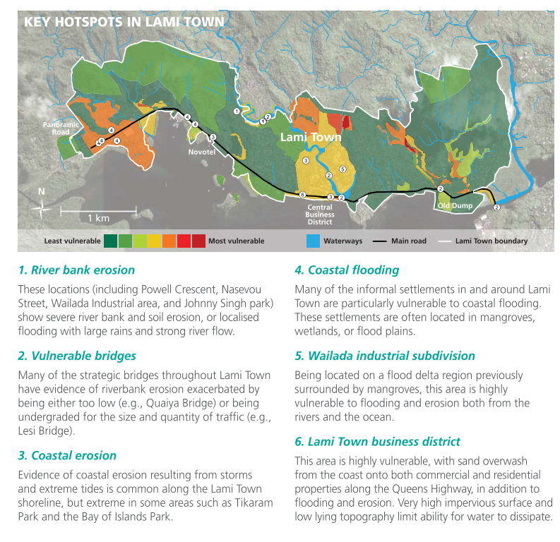
Example from Fiji islands
From: An economic analysis of ecosystem-based adaptation and engineering options for climate change adaptation in Lami Town, Republic of the Fiji Islands (Rao et al. 2013)

Slide 25
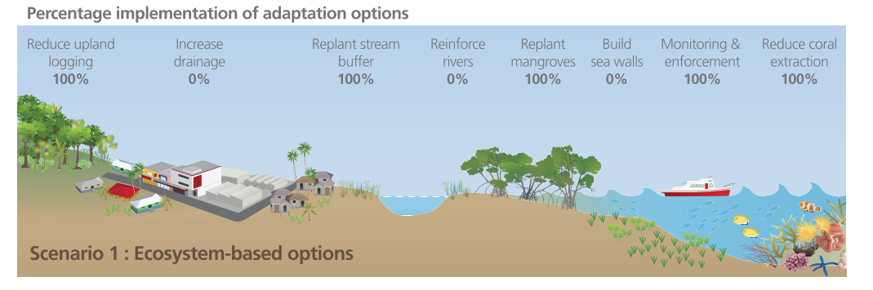
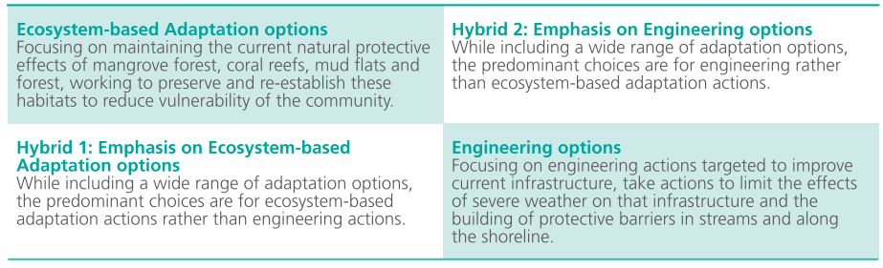
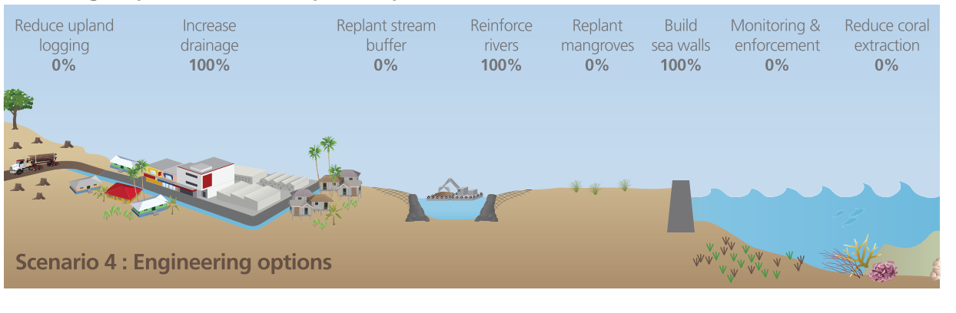
Design alternative strategies

Slide 26
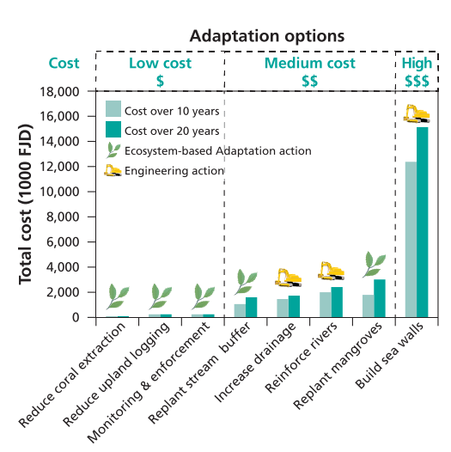
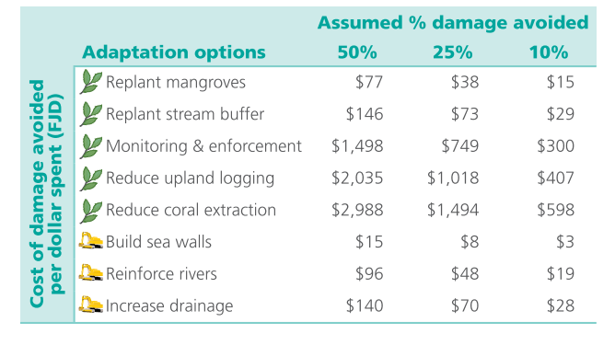
Compare interventions
Comparison of ecosystem-based and engineering climate adaptation interventions in Lami Town, Fiji islands
Results of least-cost analysis over 10 and 20 years
Results of avoided damages for Lami Town over 20-years (with 3% discount rate)
From: An economic analysis of ecosystem-based adaptation and engineering options for climate change adaptation in Lami Town, Republic of the Fiji Islands (Rao et al. 2013)

Slide 27
Methods to compare interventions
Economic tools | Description | Best applicable when: | Advantages/ disadvantages
Cost-Effectiveness Analysis (CEA) | All options are compared in effectiveness – to what extent do they contribute to one specific (flood-risk related) goal? | If there is one single, clear-defined goal for the project and it is of interest to find the most attractive alternative from a financial point of view. As a first screening of measures | A risk of using CEA is that the method does not take into account any additional benefits a measure might have.
Life Cycle Costing (LCC) | In an LCC all costs for the asset over its entire lifetime, operation and maintenance and if relevant breakdown costs are compared over a fixed (long) time horizon, for example 100 years and discounted. | You want to have an idea of the costs of a solution
Multi-Criteria Analysis (MCA) | A MCA is a semi-quantitative analysis in which the performance of measures is scored on multiple criteria based on expert/ stakeholders opinions | There are multiple criteria or effects to take into consideration Increase stakeholder engagement and support. | +Very good for engaging stakeholders (and using their local knowledge) and increasing support for project - MCA is a qualitative but relatively subjective approach
Cost-benefit analysis (CBA) | The costs of the project are compared to the welfare effects/ benefits. These are determined in relation to a reference situation that includes autonomous development. If possible, all effects are expressed in monetary terms to ensure comparability. | More objective than MCA: all effects from viewpoint of impact on welfare (increased comparability, more objective) | + Quantified, more objective overview of costs and benefits; comparable. + there are quite a number of other advantages - False sense of security through quantitative results

Slide 28
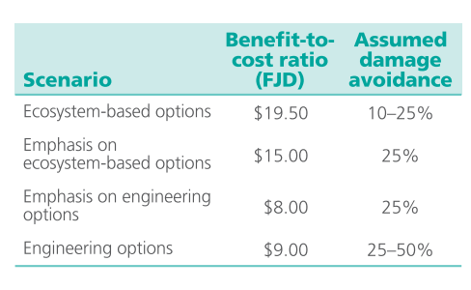
Select best alternative strategy
Question: Which strategy would you use?

Slide 29
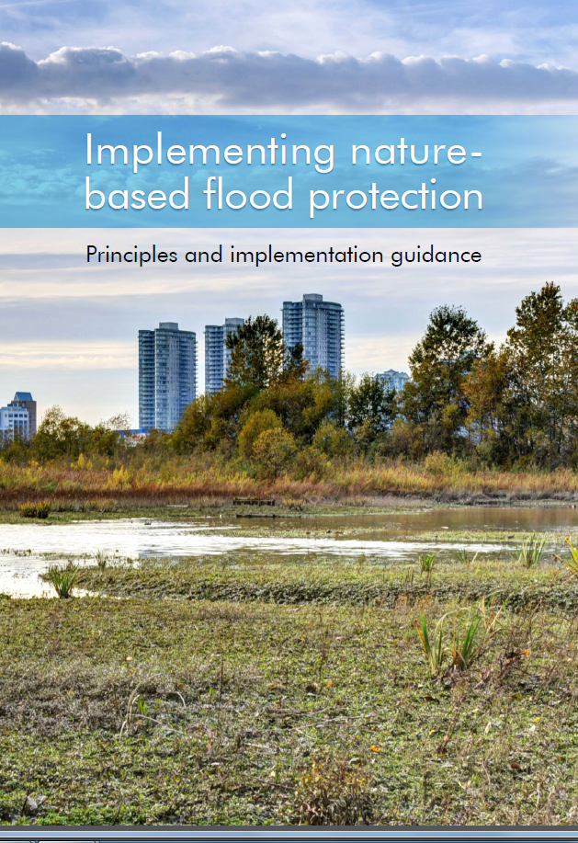
Principles and guidelines for implementation
>25 organisations
>70 people

Slide 30

Five principles
System-scale perspective
Risk and benefit assessment
Standardized performance evaluation
Integration with ecosystem conservation and restoration
Adaptive management

Slide 31
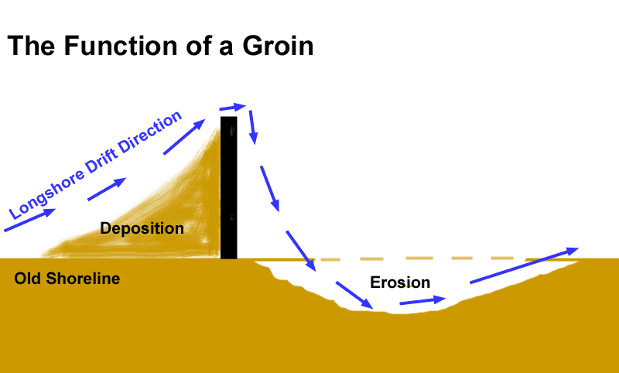
Principle 1: System-scale perspective

Slide 32
Principle 1: System-scale perspective
Addressing nature-based solutions for climate change adaptation and disaster risk reduction should start with a system-wide analysis of the local socio-economic, environmental, and institutional conditions.

Slide 33
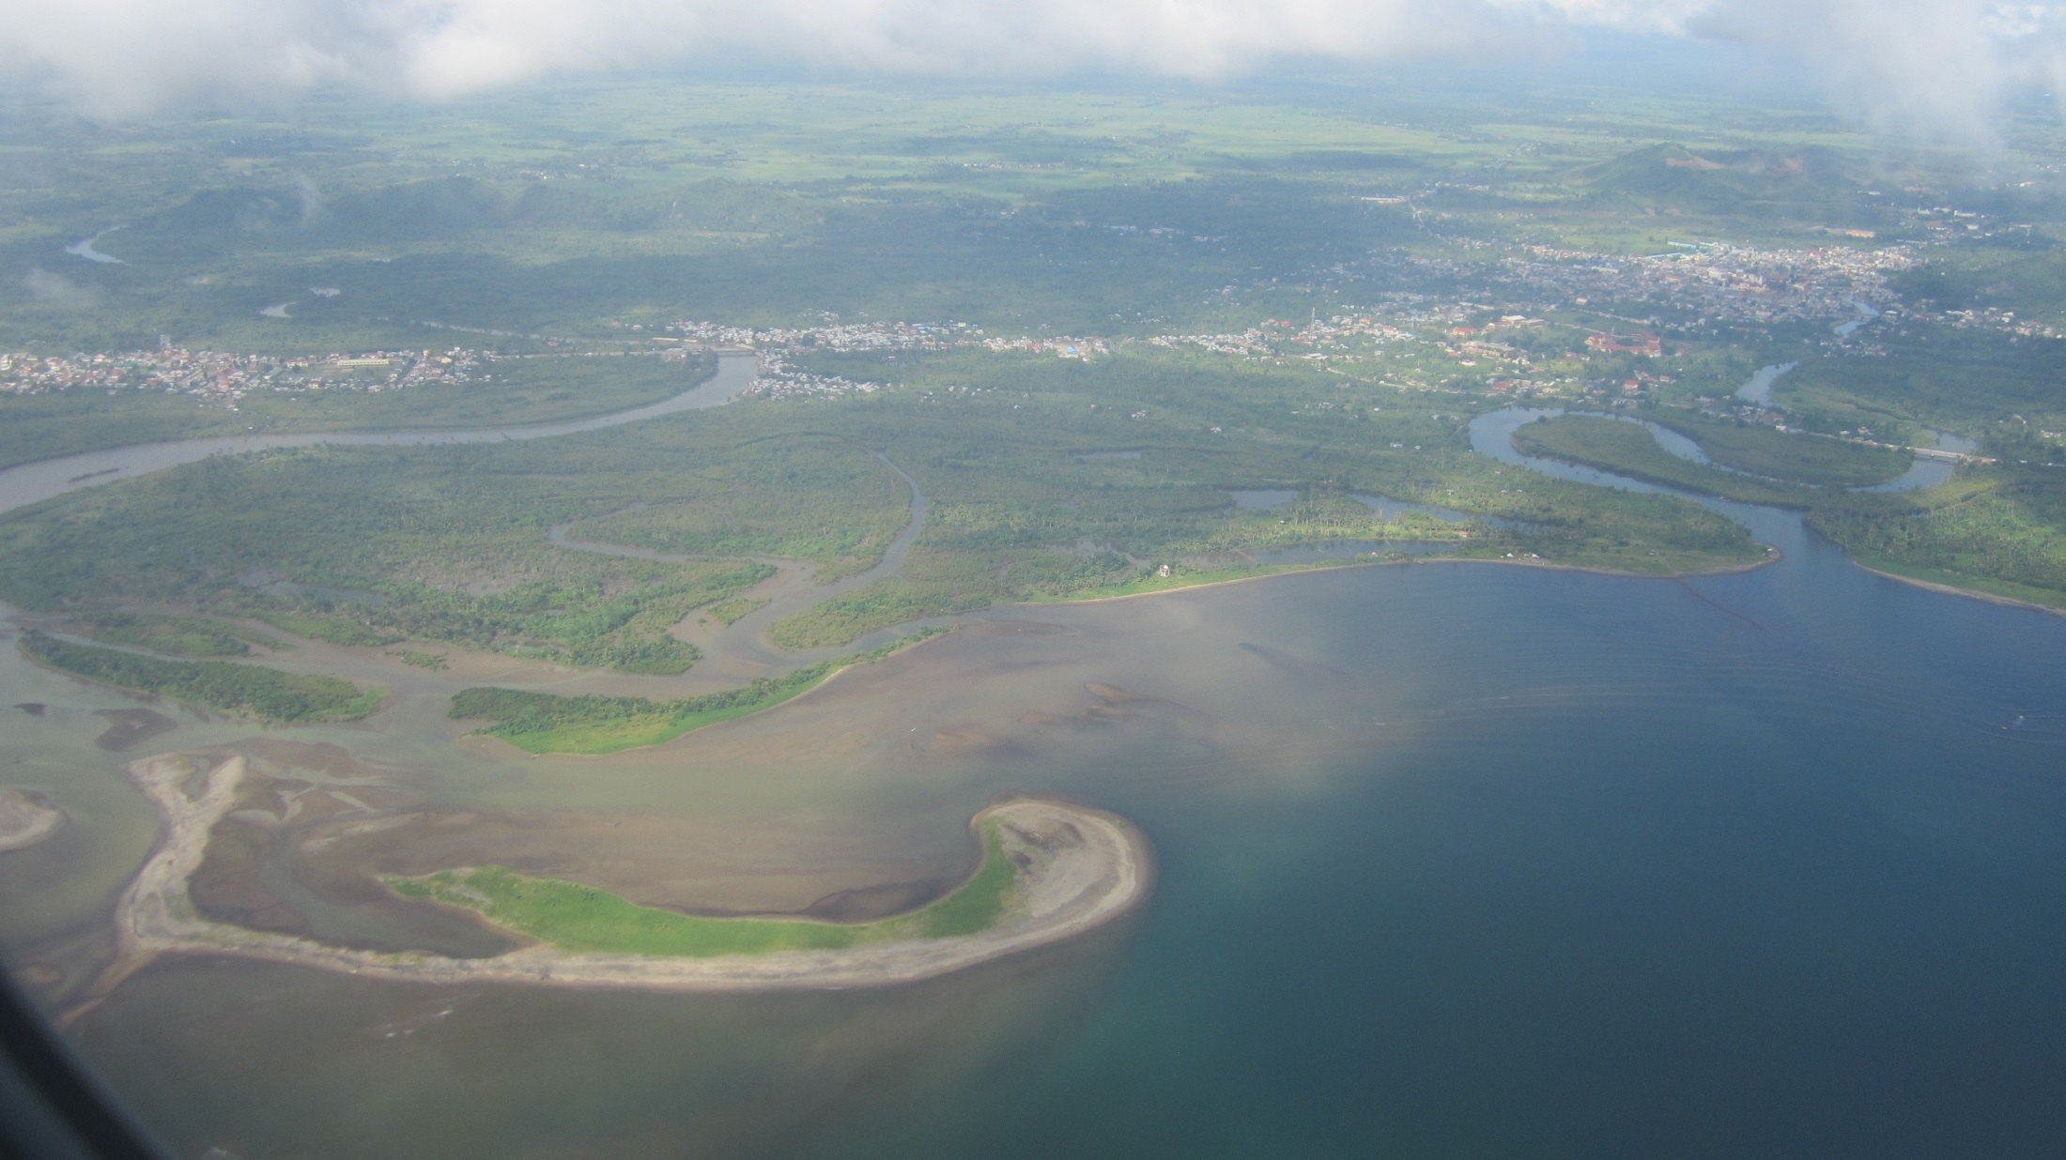
System-scale perspective

Slide 34
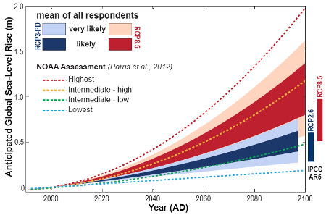
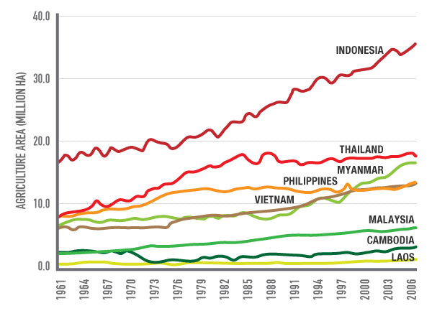
Long-term perspective

Slide 35
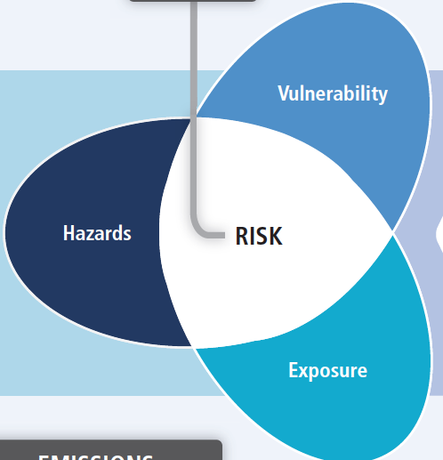
Principle 2: Risk and benefit assessment of full range of solutions

Slide 36
Principle 2: Risk and benefit assessment of full range of solutions
A thorough assessment of risks and benefits of the full range of possible measures should be conducted, covering risk reduction benefits as well as social and environmental effects.

Slide 37
Evaluation of measures
Initial
risk
Wetlands
Levees/
Flood walls
Building codes/
zoning
Early warning/
Evacuation plans
Residual risk
Cumulative interventions
Spalding et al. 2014

Slide 38
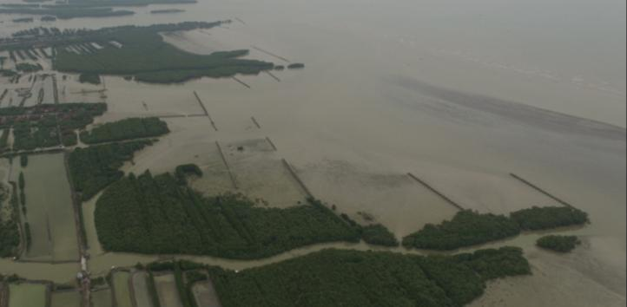
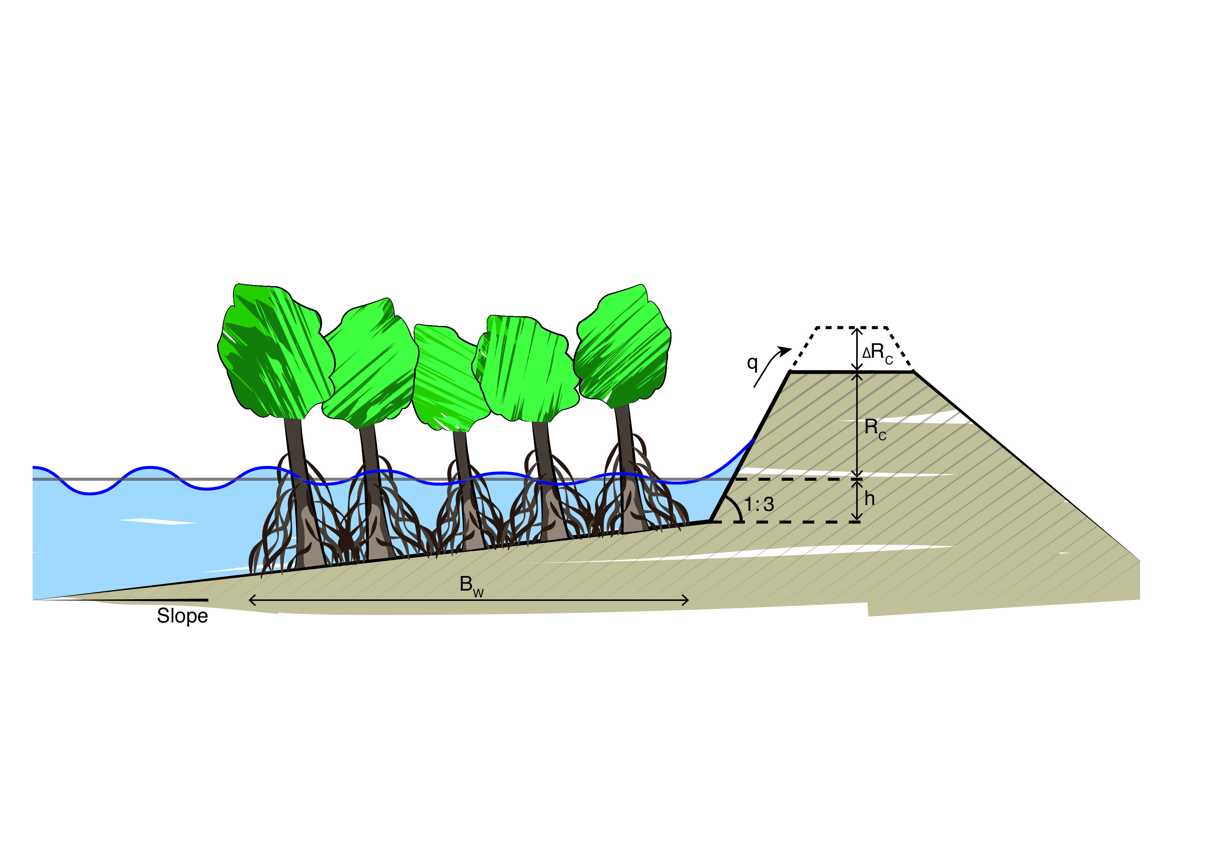
Principle 3: Standardized performance evaluation

Slide 39
Principle 3: Standardized performance evaluation
Nature-based solutions for flood risk management need to be tested, designed, and evaluated using quantitative criteria.

Slide 40
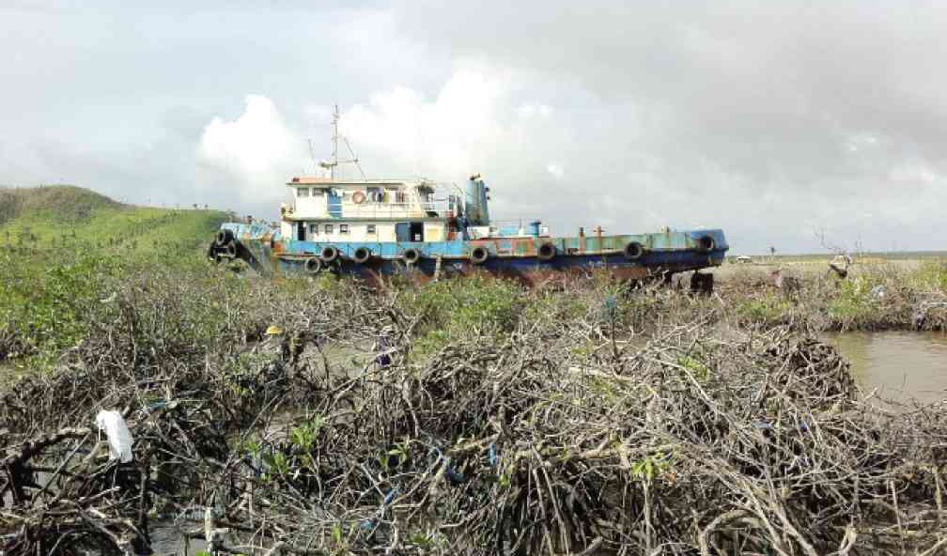
Performance under extremes

Slide 41
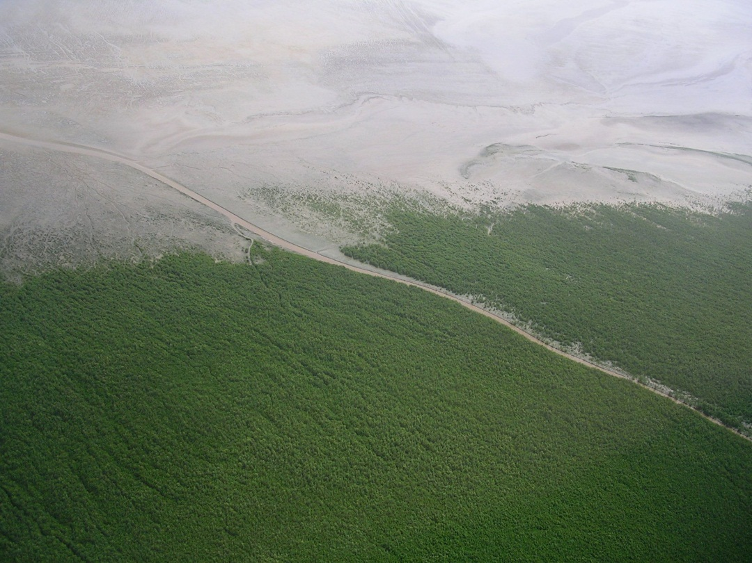
On longer time-scales

Slide 42
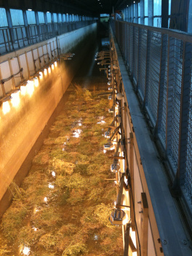
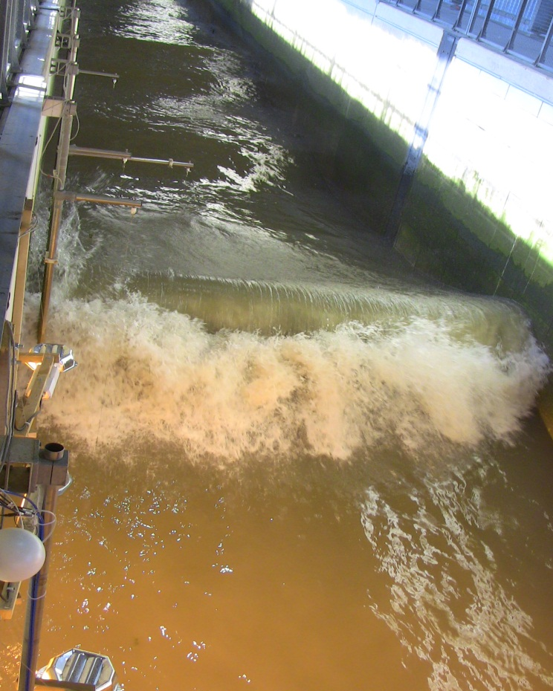
Performance under extremes

Slide 43
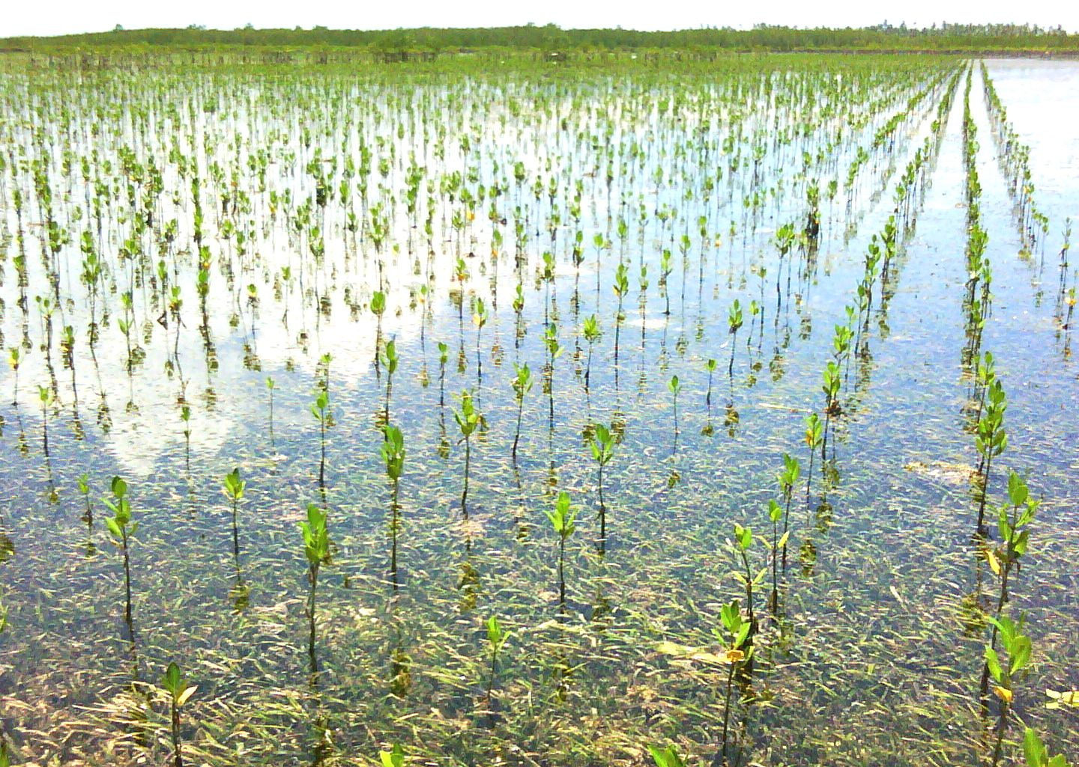
Principle 4: Integration with ecosystem conservation and restoration

Slide 44
Principle 4: Integration with ecosystem conservation and restoration
Nature-based solutions for flood risk management should make use of existing ecosystems, native species, and comply with basic principles of ecological restoration and conservation.

Slide 45
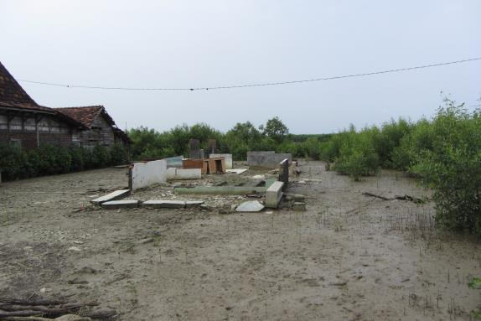
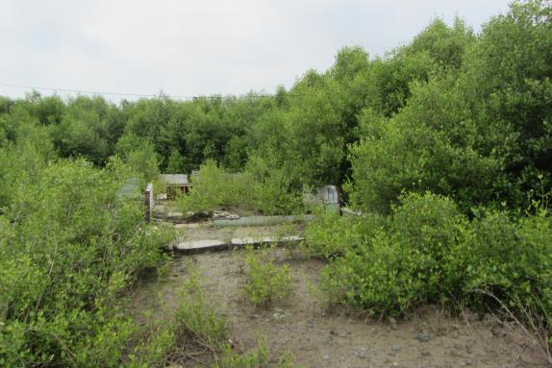
Protect, manage and restore

Slide 46
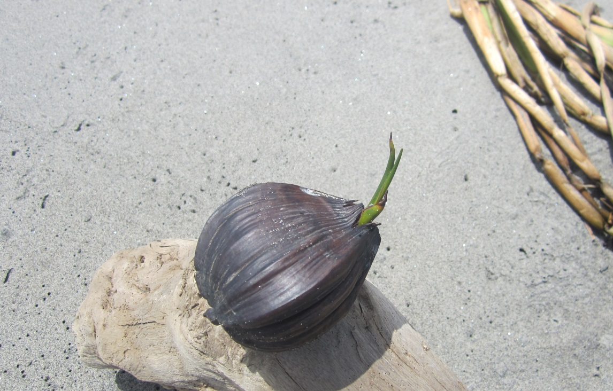
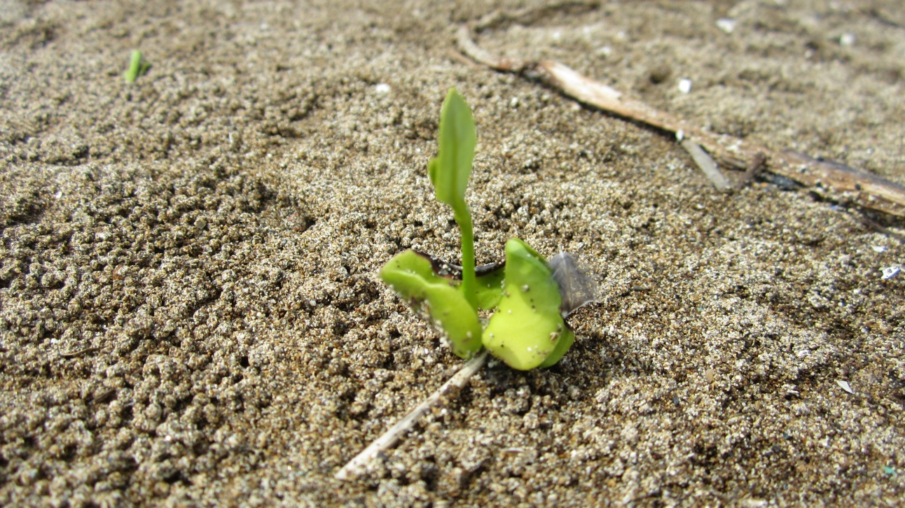
Restore abiotic conditions
Hydrology and drainage
Increase elevation and sediment input
Decrease hydrodynamic impact
Make space for mangroves in the back (realign)
Check seed availability

Slide 47
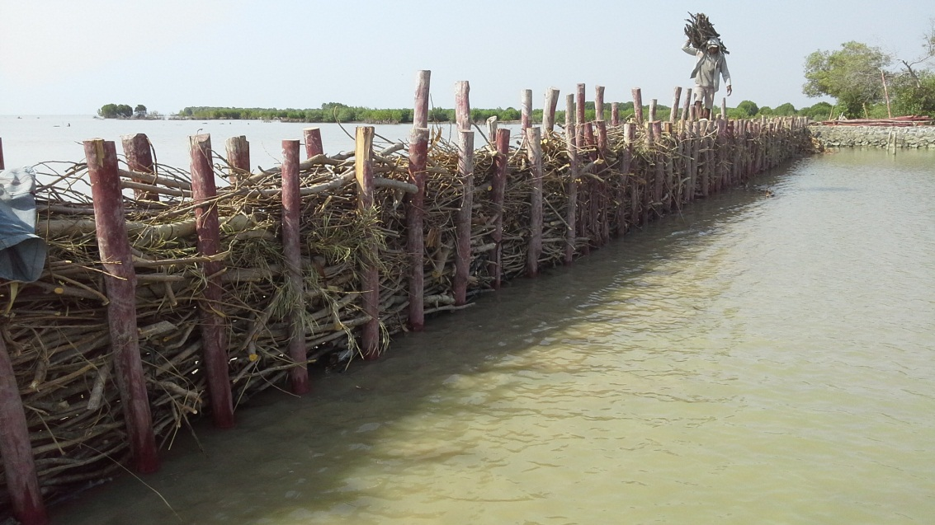
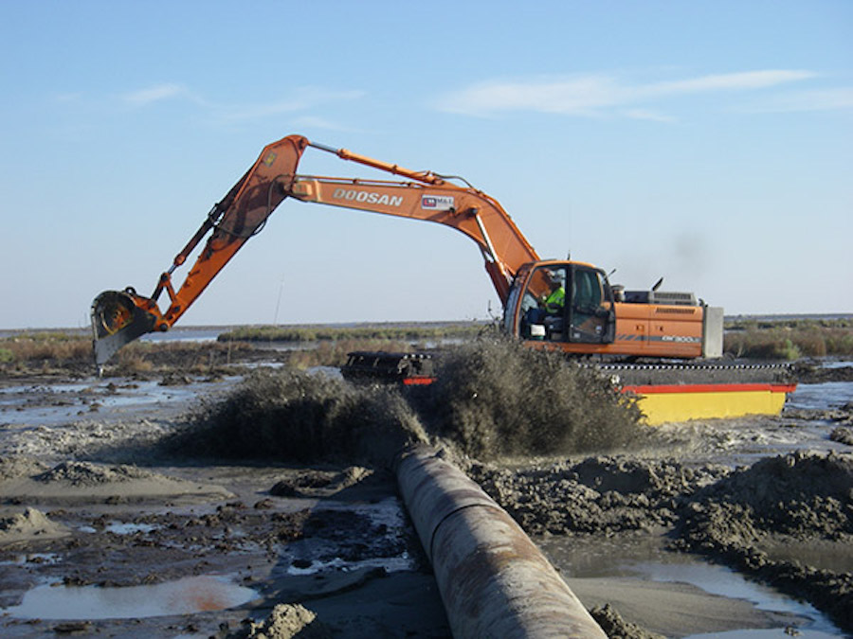
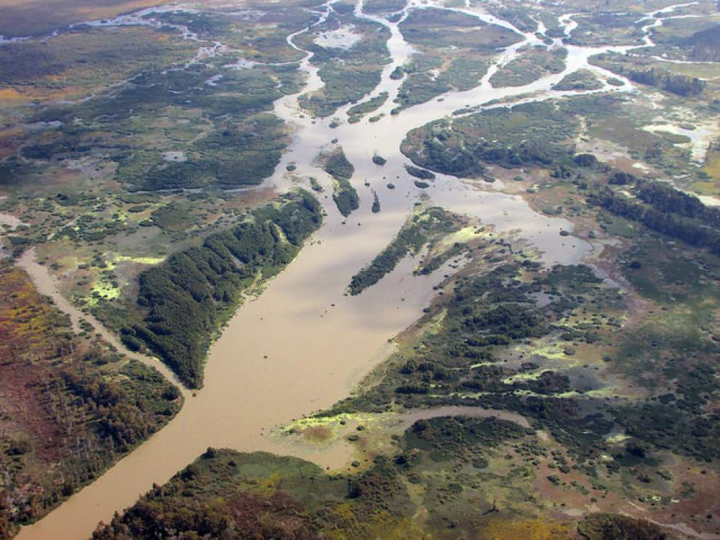
Restoration of abiotic conditions
Januari 2012

Slide 48

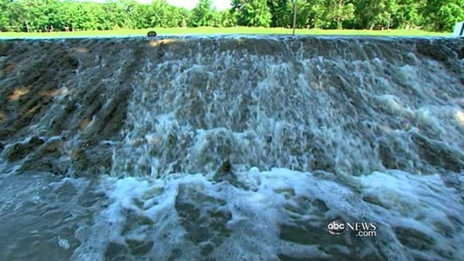
Principle 5: Adaptive management

Slide 49
Principle 5: Adaptive management
Nature-based solutions for flood risk management need adaptive management based on long-term monitoring. This ensures their sustainable performance.

Slide 50
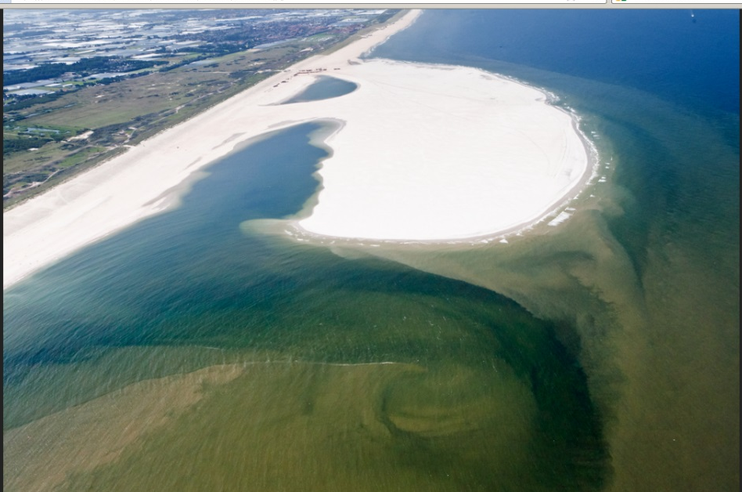
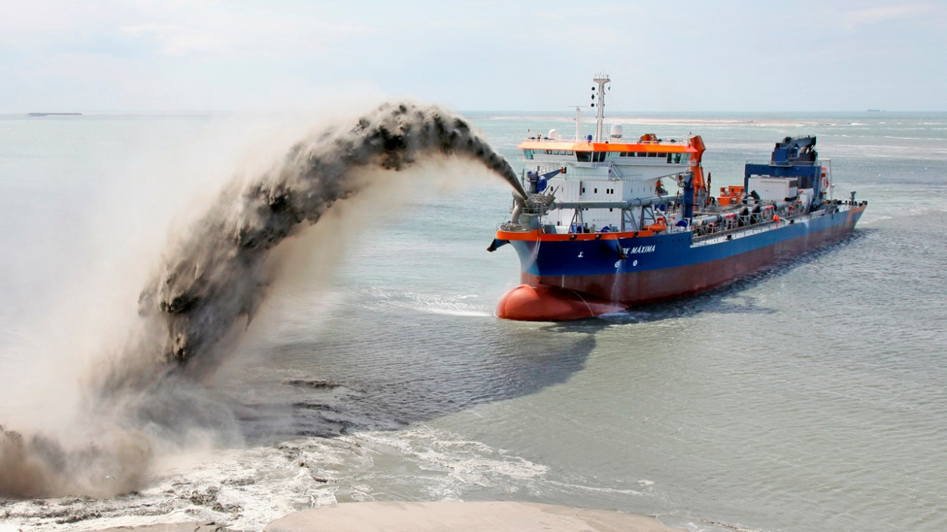
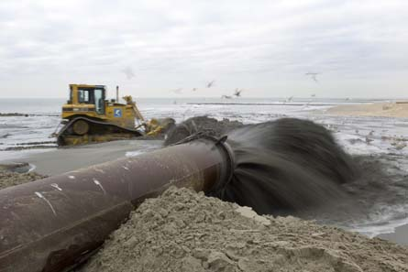
Manage: adaptive management
Monitor
Evaluate
Adapt

