Slide 1









Building with Nature Indonesia
Construction phase
Tom Wilms
25 January 2018, Semarang

Slide 2

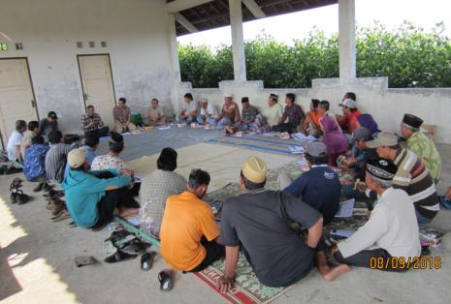
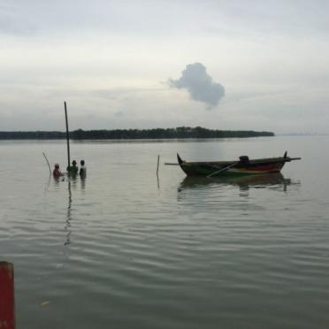
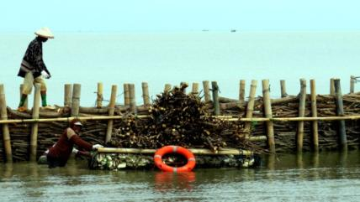
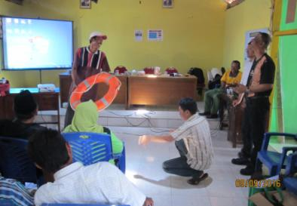
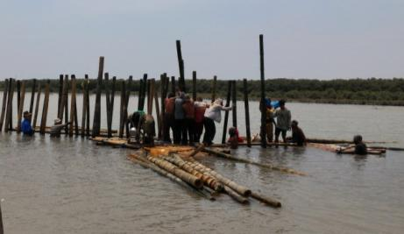
Technical Training – Construction phase (1 hr)
Recapitulation (5 m)
What do you want to learn? (5 m)
  Design (spatial plan and structures)
  Stakeholder involvement
  Permits (environmental)
  Site visit and preparation
  Tender of construction (supervision)
  Training for construction
  Construction (and supervision)
  Monitoring and maintenance
  Lessons learnt (5 m)
  Evaluation (10 m)
2

Slide 3
Recapitulation
BwN principles
Functional Design
Spatial design
Structural Design
3

Slide 4
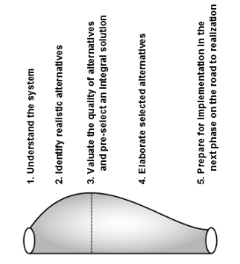
Recapitulation
BwN principles
Functional Design
Spatial design
Structural Design
4

Slide 5
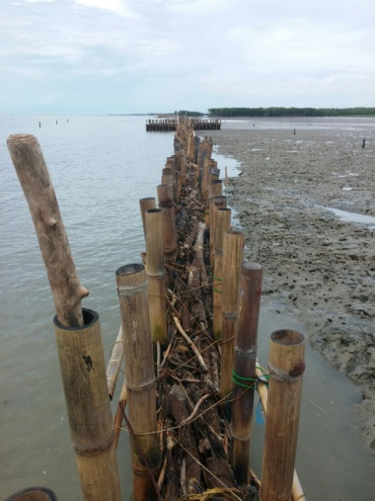
Recapitulation
BwN principles
Functional Design
Spatial design
Structural Design
5

Slide 6
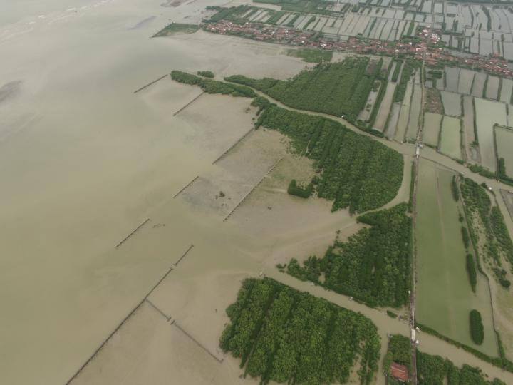
Recapitulation
BwN principles
Functional Design
Spatial design
Structural Design
6

Slide 7
Recapitulation
BwN principles
Functional Design
Spatial design
Structural Design
What do you want to learn?
7

Slide 8
Construction phase
8

Slide 9
Construction phase
  Design (spatial plan and structures)
  Stakeholder involvement
  Permits (environmental)
  Site visit and preparation
  Tender of construction (supervision)
  Training for construction
  Construction (and supervision)
  Monitoring and maintenance
9

Slide 10
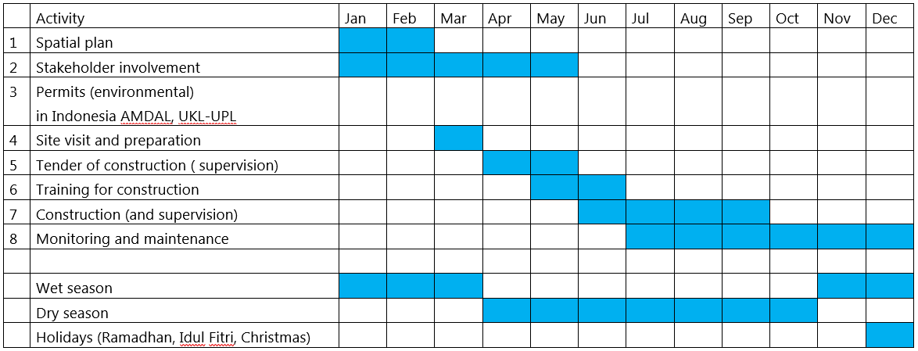
Construction phase
  Spatial plan
  Stakeholder involvement
  Permits (environmental)
  Site visit and preparation
  Tender of construction (supervision)
  Training for construction
  Construction (and supervision)
  Monitoring and maintenance
10

Slide 11
Construction phase
  Design (spatial plan and structures) – already discussed
  Stakeholder involvement:
  Sosialisasi
  Land tenure
  Involve governmental agencies
  Permits (environmental)
  AMDAL
  UKL-UPL
11

Slide 12
Construction phase
  Site visit and preparation:
  Discuss design with community
  Visit location:
    Make benchmark
    Measure depths (soft and stiff layer)
    Place end-markers
12

Slide 13
Construction phase
  Tender of construction (supervision):
  Tender documents
  Invitation for tender
  Pre-tender meeting
  Site visit
  Clarification meeting
  Award construction
13

Slide 14
Construction phase
  Tender of construction (supervision):
  Tender documents:
    Requirements like:
    technical, legal, time, financial, quality
    Drawings
    Bill of Quantities (and Owner Estimate)
14

Slide 15
Construction phase
  Tender of construction (supervision):
  Quality:
  Social security
  Sustainability:
    Location of purchase, transport distance, carbon footprint.
    Effect of other usages.
    Effects on biodiversity and native flora (FSC).
    Availability of the materials and potential influence on market.
    The application of other low-tech measures to increase the durability.
15

Slide 16
Construction phase
  Tender of construction (supervision):
  Cost:
  Life cycle cost
  Construction/m: 1-1.5 mIDR
    Purchase of material and transport
    Construction costs
    Profit for the contractor (approximately 10%)
    Tax (approximately 10%)
    Contingency, uncertainty (approximately 20%, not a fixed)
    Unforeseen (approximately 10%)
  Maintenance/m: 0.4-0.7 mIDR
16

Slide 17
Construction phase
  Tender of construction (supervision):
  Training for construction:
    Training of Trainers
    Practical
    general introduction to project
    BwN approach
    Quality
    Construction process
    Monitoring and maintenance
    Health, Safety and Environment (HSE)
  Construction (and supervision)
  Monitoring and maintenance
17

Slide 18
Construction phase
  Stop working during unsafe working conditions (storm, waves, currents)
  Provide sufficient drinking water.
  Provide and check protection against the sun.
  Provide and check personal protection equipment (PPE), life buoy, life vests, boots, gloves.
  Work in teams of preferably 3 or more people; of which half of them can swim (always more than 2 people).
  Provide and check save working procedures, equipment and materials.
  Provide first aid kits.
  Have transportation available to get to a safe location unsafe conditions
  Maintain communication and leadership in the group.
18

Slide 19
Construction phase
  Tender of construction (supervision):
  Construction (and supervision)
    Transport
    Stockpiling (construction, maintenance)
    Labour, small machinery
    6-8 workers: 4 m/ 8 hours
    Check other projects in area
    Administration, quality
    With or without contractor
19

Slide 20
Construction phase
  Tender of construction (supervision):
  Construction (and supervision)
    Placement vertical poles (jumping, auger)
    Tie horizontal beams
    Place nets
    Place fill material
      First layer
      Bundles
      Compact
    Tie wire
20

Slide 21
Construction phase
  Tender of construction (supervision):
  Monitoring
    Landscape (spatial):
      Sediment
      Flora and fauna
    Structure:
      Poles
      Horizontal beams
      Fill and wire
  Maintenance
21

Slide 22
Lessons learnt
  All steps are important.
  Spend enough time to each step.
  Involve all relevant stakeholders as early as possible.
  This learning by doing
  Adaptive planning cycle needed by all participants
22

Slide 23
Evaluation – wrap up
What do you want to learn?
The permeable structure:
  Design (spatial plan and structures)
  Stakeholder involvement
  Permits (environmental)
  Site visit and preparation
  Tender of construction (supervision)
  Training for construction
  Construction (and supervision)
  Monitoring and maintenance
23

Slide 24
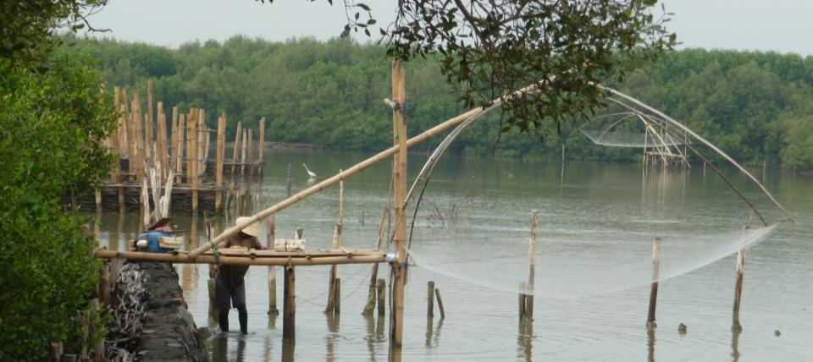
www.witteveenbos.com
www.ecoshape.nl

