Slide 1
Parameterization of a RIBASIM model and the network lumping approach
Practical application of RIBASIM
Delft, 2023-11-28
Harm Nomden

Slide 2
Practical application of RIBASIM
Harm Nomden
Consultant Hydrology at Sweco (Netherlands)
Background:
  10 yrs international projects and automatisation (python)
  Since 2022 working in the Netherlands
For the TKI project on RIBASIM:
We have been working on a python toolbox ribasim-lumping focusing on generation of RIBASIM-model
Content → Challenges / Questions:
RIBASIM in general:
  What do they mean with ‘basins’?
  At which resolution do you want to calculate?
Setup modelling schematisation:
  How can I create/define ‘basins’?
  How do I fill required settings with data?
Comparison results:
  Are the modelling results good (enough)?
  What are the calculation times?

Slide 3
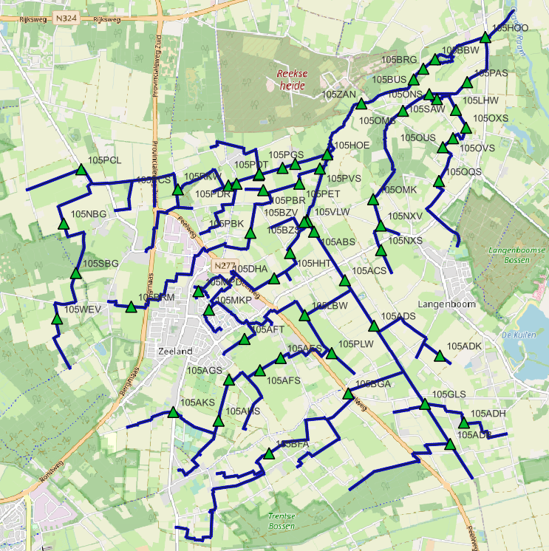
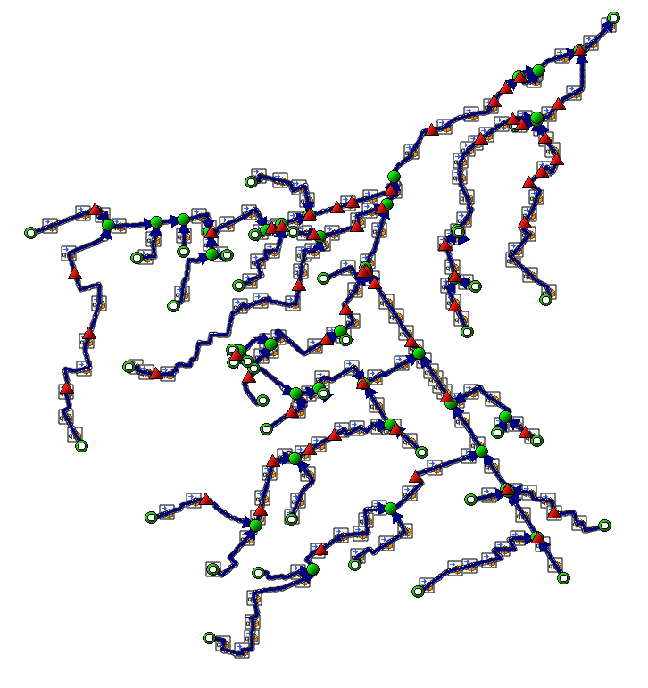
RIBASIM-lumping: Pilot De Hooge Raam (Aa en Maas)
Detailed D-HYDRO model available with 2500 calculation points

Slide 4
RIBASIM-lumping: Network lumping
1
2
1
2
1
2
1
1
2
1
2
2
1
2
1
2
1
2
3
2
3
Definition
split-locations
(split_nodes)
3
3
Conversiontable split-locations → Ribasim-nodes
3
3
Typical split-locations are weirs or pumping stations, culverts, orifices or other structures or open water connections
4
4
4

Slide 5
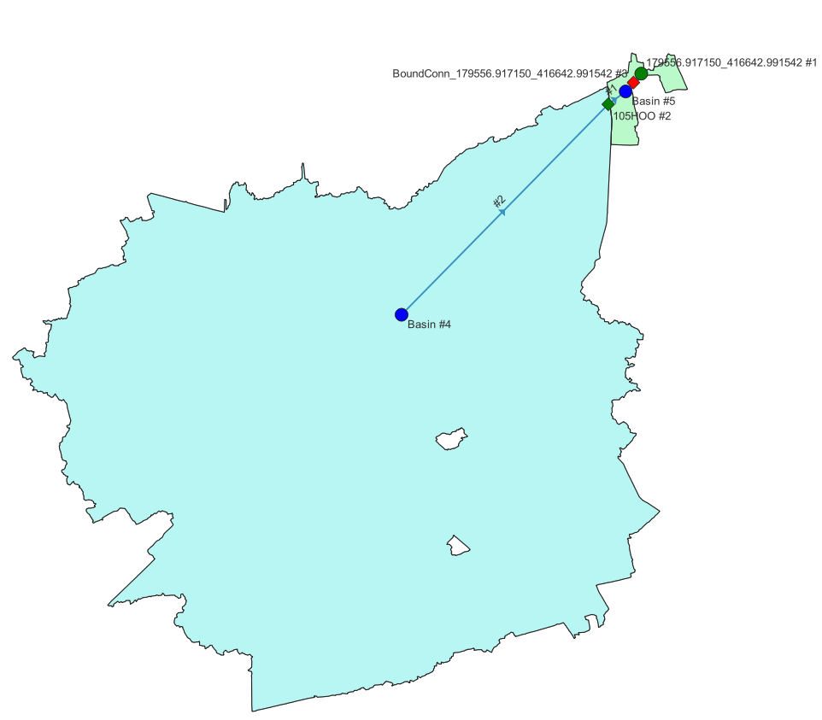
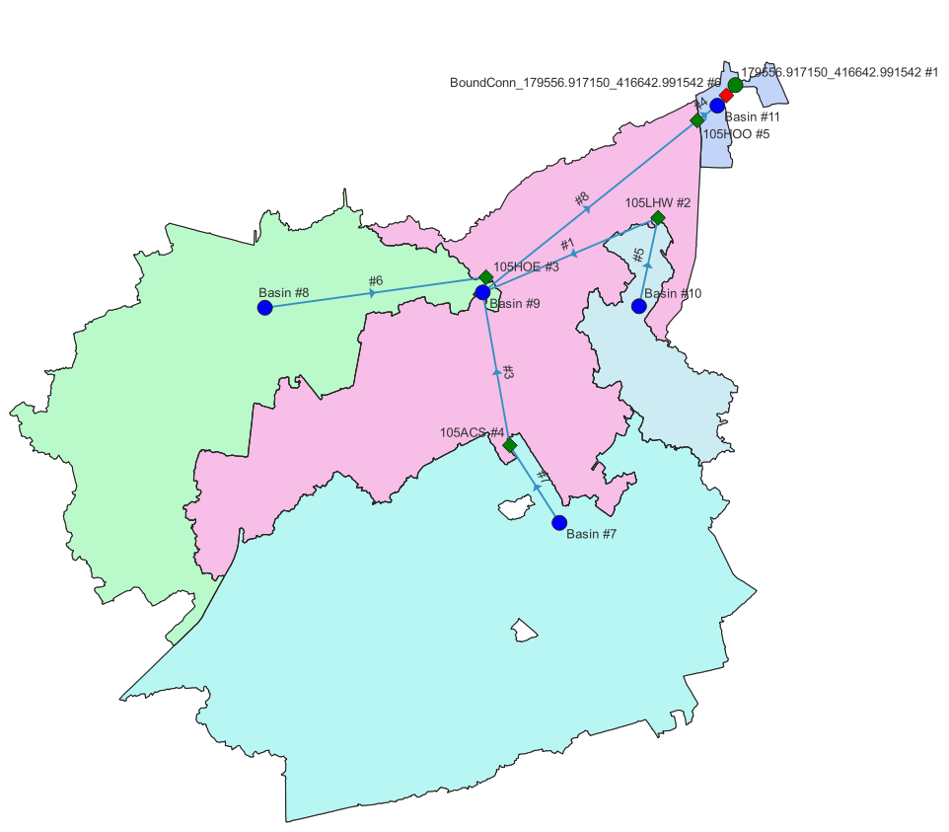
split nodes: 1 weir > 2 basins

Slide 6
split nodes: 4 weirs - 5 basins

Slide 7
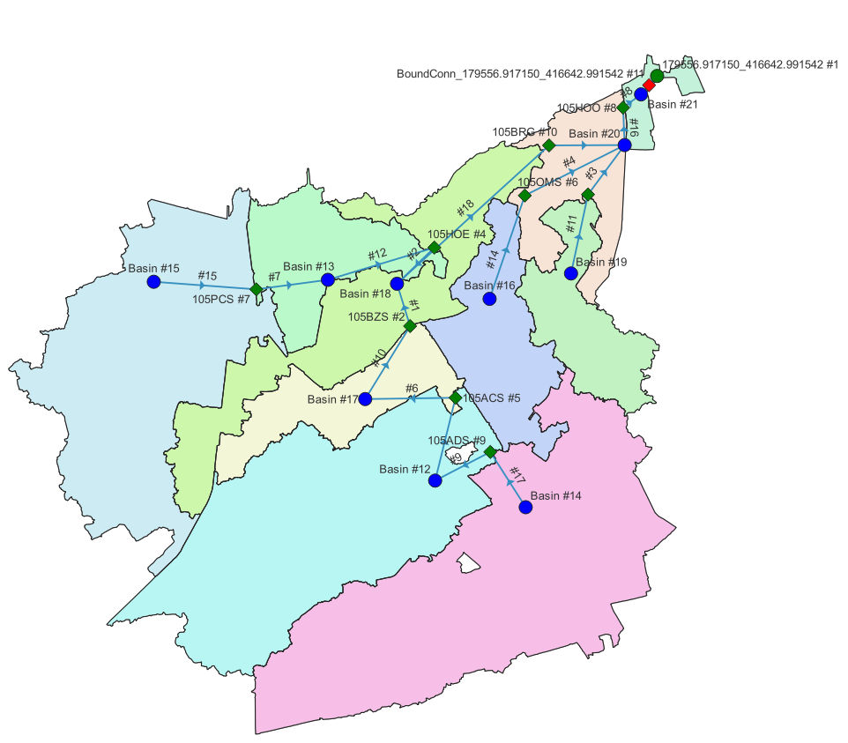
split nodes: 9 weirs - 10 basins

Slide 8
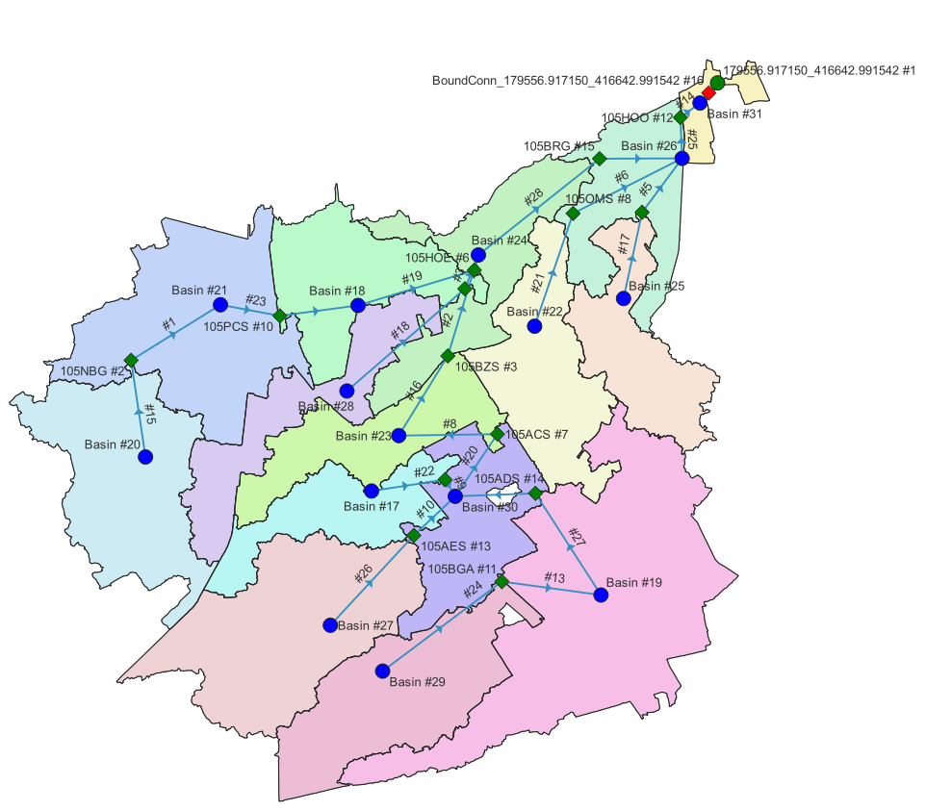
split nodes: 14 weirs - 15 basins

Slide 9
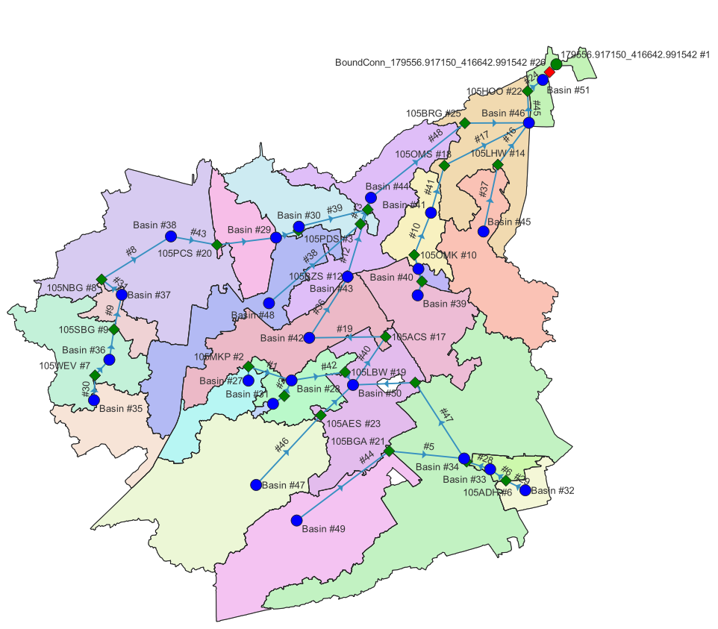
split nodes: 24 weirs - 25 basins

Slide 10
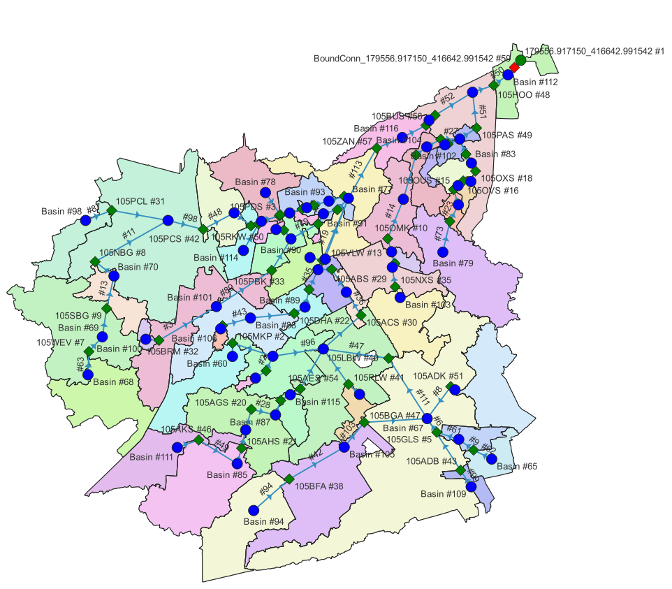
split nodes: 57 weirs - 58 basins

Slide 11
1 weir
4 weirs
9 weirs
14 weirs
24 weirs
57 weirs

Slide 12
RIBASIM-lumping: Deriving relations
Model/Data
Openwater connections: Exchange based on waterlevel difference – Manning-node
Level controlled areas: Horizontal water level in basin – Pump/Outlet
Sloping area / free flowing: Backwatercurve – TabulatedRatingCurve
H-H relation: Waterlevel-Waterlevel – Water level basin versus water level within basin
V-H relation: Volume-Waterlevel – Storage curve basin
Q-H relation: Discharge-Waterlevel – Outflow from basin to other basin
discharge area units
reference point basin
network
stuw
Basin area
RIBASIM
Basin
TabulatedRatingCurve

Slide 13
RIBASIM-lumping: Deriving input relations
Model/Data
H-H relation
discharge area units
reference point basin
network
stuw
Basin area
weir height
RIBASIM
Basin
weir
reference point basin
distance [m]
TabulatedRatingCurve

Slide 14
RIBASIM-lumping: Deriving input relations
Model/Data
H-H relation
discharge area units
Modelling results:
0,05xMA tot 2,00xMA
reference point basin
network
stuw
Basin area
weir height
RIBASIM
Add x additional profiles based on vertical interpolation
Basin
weir
reference point basin
distance [m]
TabulatedRatingCurve

Slide 15
RIBASIM-lumping: Deriving input relations
V-H relation
Q-H relation
H-H relation
H_{weir,upstream}
H_{weir,upstream}
Modelling results:
0,05xMA tot 2,00xMA
m+NAP
m+NAP
Storage curve based on model results
Q-H relation based on model results
weir height
Add x additional profiles based on vertical interpolation
V_{basin}
Q_{weir}
0
m³
0
m³/s
weir
reference point basin
distance [m]

Slide 16
RIBASIM-lumping: Deriving input relations
V-H relation
Q-H relation
H-H relation
H_{reference} _{point, basin}
H_{reference} _{point, basin}
H_{weir,upstream}
H_{stuw,upstream}
Translation to reference point
m+NAP
m+NAP
weir height
V_{basin}
Q_{basin}
0
m³
0
m³/s
weir
reference point basin
distance [m]

Slide 17
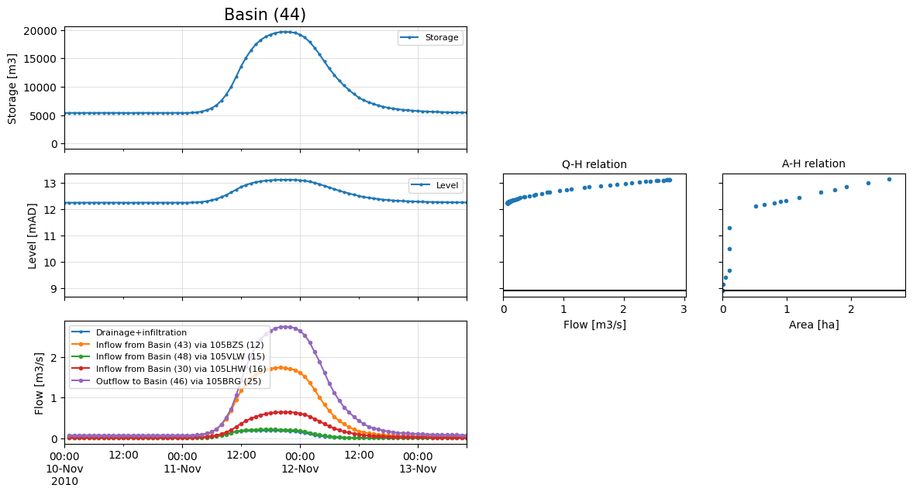
Output RIBASIM

Slide 18
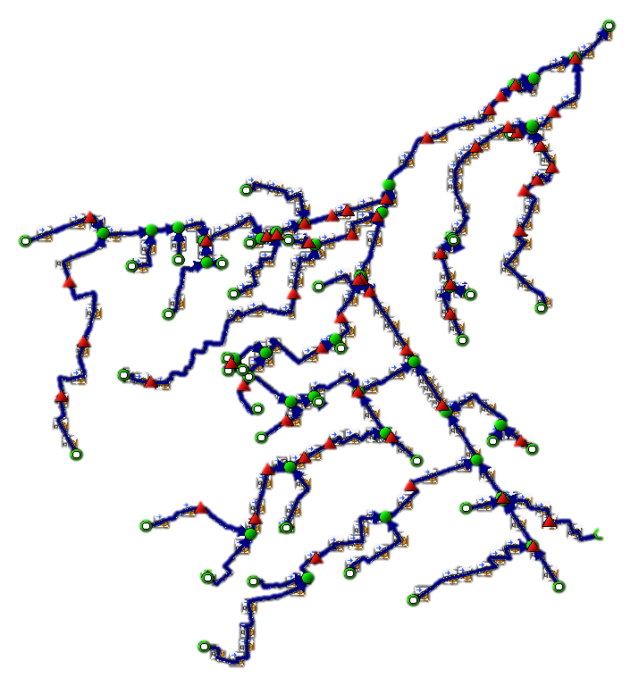
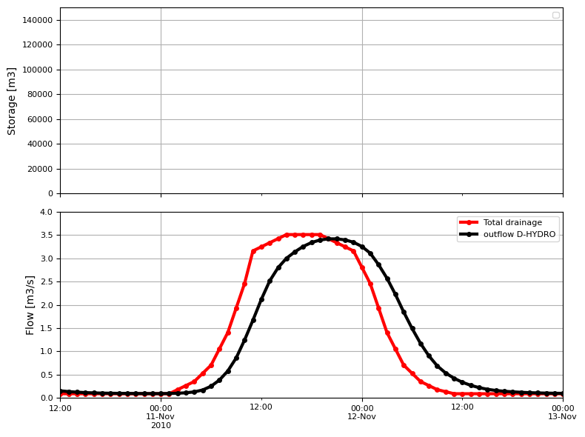
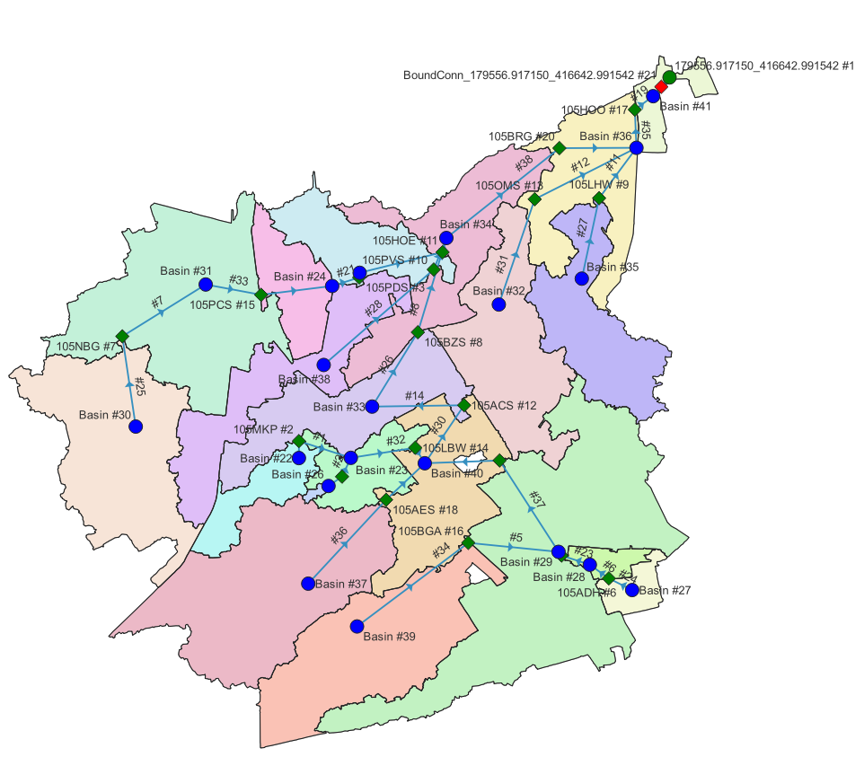
Comparison output D-HYDRO vs RIBASIM

Slide 19
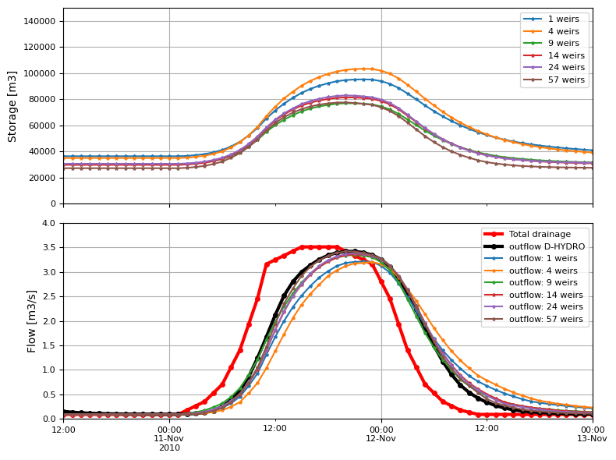
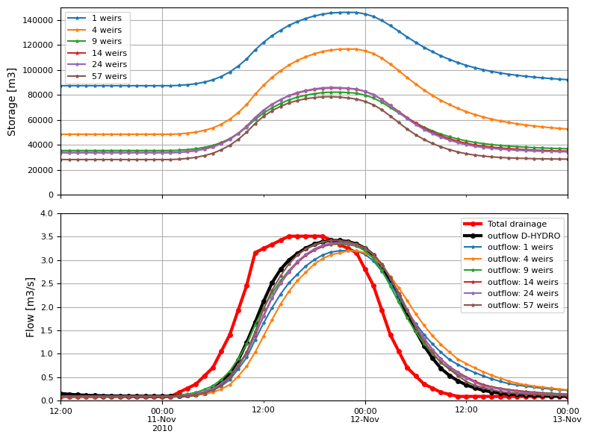
Comparison output D-HYDRO vs RIBASIM
Simulation results are comparable for every number of basins, because we used a spatially averaged drainage
More spatial variability: rainfall, altitude, slope, soil, landuse → higher detail and more basins

Slide 20
Practical application of RIBASIM
Open source python package to set-up
a schematisation: github → ribasim_lumping
Content → Challenges / Questions:
RIBASIM in general:
  What do they mean with ‘basins’?
  At which resolution do you want to calculate?
Setup modelling schematisation:
  How can I create/define ‘basins’?
  How do I fill required settings with data?
Comparison results:
  Are the modelling results good (enough)?
  What are the calculation times?
Solutions / Answers:
water system/network divided in parts
Resolution is dynamic (user-specified) or
Definition of split nodes (generates a RIBASIM network using tooling)
Data from database or from stationary modelling results
Discharge and waterlevels comparable with D-HYDRO model
Simulation length | D-HYDRO | RIBASIM
Peak discharge 3 days | 29 minutes | 10 basins | 9 seconds
 |  | 58 basins | 12 seconds
1 year | ?? | 58 basins | 53 seconds

