Slide 3
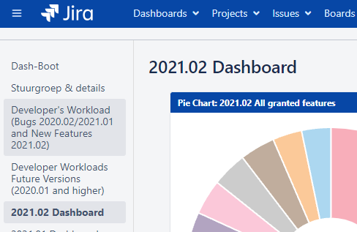


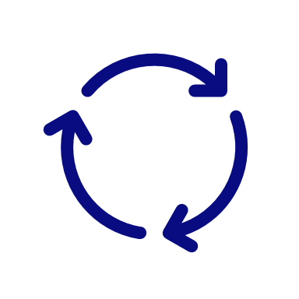










Delft-FEWS 2021.02 Benchmarks
142 new features
6 new data transformations
283* bugs repaired
9 new features in the FEWS Explorer
13 new import modules
6 new export modules
18 new features in FEWS-webservices
5 improvements to the open archive
6 improvements to the admin interface
1 new display
6 new features in timeseries display
1 improved/matured concept (CF)
(*majority of bugs found and resolved during testing)
Release Notes
Notes:
Just some benchmarks of the Delft-FEWS 2021.02 release…

Slide 4


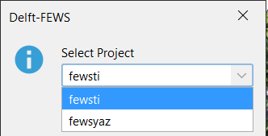
Datastore
A single time series with more than 20164 time steps can now be stored in a single blob
TableLocalModificationTimes table is now a memory optimized table
Support of Azure SQLServer Managed instances
It is now possible to have multiple FEWS schemas/systems in a single (managed) database instance
Notes:
FEWS-26413: The run length compression is taken into account to fill the blob with a single time series to 256kB
In many cases a rainfall series with millions of time steps will now be stored in a single blob due the many zero in the series.
Multiple time series are merged into a single blob but only when a single imported/amalgamated time series is not stored over multiple blobs (20164 time steps in 2021.02 or before)
FEWS-22054: In 2022.01, the TableLocalModificationTimes has been optimized and made into a memory optimized table in SQLServer.
https://publicwiki.deltares.nl/display/FEWSDOC/SQLServer+index+rebuild+scripts+should+skip+table+TableLocalModificationTimes+-+2022.01+and+later
FEWS-24309: Database creation script for SQL Server is more flexible and contains the option to install an Azure managed instance of SQL server
FEWS-26477: It is now possible to have multiple FEWS schemas/systems in a single (managed) database instance. By this you only need a single database and you can use a single OC/CM shortcut to access multiple FEWS systems. When the database contains multiple FEWS schemas and the schema is not specified in the URL the OC/CM user gets automatically a pop-up to select the desired FEWS schema.
https://publicwiki.deltares.nl/display/FEWSDOC/Launching+Delft-FEWS+-+2018.02+and+later (TODO: new screenshot/picture should be added)

Slide 5


System - Continuous Deployment
Use Azure pipelines to roll out complete FEWS system in Kubernetes:
Create FEWS schema in PostgresQL database
Create Docker image with MC/AI/FSS software
Configure MC and AI with database connection
Upload selected Delft-FEWS configuration via AI-API
Upload MC-FSS settings for Delft-FEWS configuration via AI-API
Remove entire MC system from Kubernetes
Notes:
FEWS-26465 (and subtasks) System - Continuous Deployment
FEWS-26473 Upload selected FEWS Config via AI API
FEWS-26768: WhatIfs are ignored during mc config upload / download

Slide 6

Delft-FEWS Stable 2022.01
New features
Delft-FEWS NL - Gebruikersdagen 2022
Delft-FEWS Product Management
Marcel Ververs and Gerben Boot
Naam Achternaam
Notes:
On behalf op Delft-FEWS Product Management I will start this presentation, Maarten and Gerben will take over later.

Slide 7
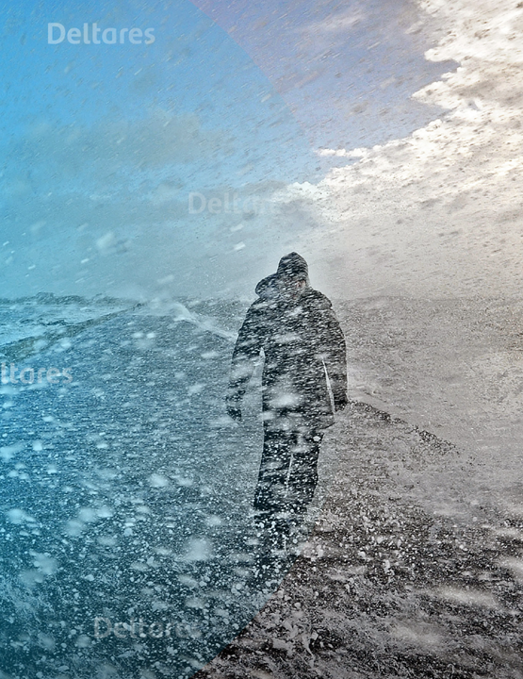
Introduction…
Welcome
What’s new in 2022.01?
  Operator Client – different displays
  Configuration
  Transformation and other modules
  Webservices
  Archive
Roadmap update 2022
Documentation and software maintenance
Outlook to 2022.02
As usual: Links for more info
Notes:
Like every year also this year we ill provide information about the new features in Delft-FEWS.

Slide 8









Delft-FEWS Ecosystem
web
operator
client
master
controller
datastore
webservice
internet
external data sources
UI
operator
client
import
alerting
general
adapter
archive
other…
Notes:
This presentation will be based on the structure of the picture of the Delft-FEWS EcoSystem with all it’s components (as presented in the Delft-FEWS 2025 vision)
We can't predict the future. However, we believe we can adapt to change by developing highly modular and open software in which data handling and easy connections are key. The open and modular software approach of Delft-FEWS makes it possible to deliver solutions tailored to the end-user needs. Those solutions can vary from a simple data viewer to an end-to-end forecasting system. This is the Delft-FEWS ecosystem.

Slide 9
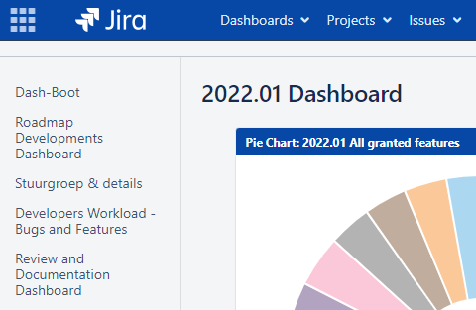

Delft-FEWS 2022.01 Benchmarks
104 new features (implemented)
4 new data transformations
220 bugs reported (166 fixed)
9 new features in the FEWS explorer
6 new import modules
8 new export modules
10 new features in FEWS-webservices
14 improvements to the open archive
1 webservice: National Register (NL)
1 new display
6 new features in timeseries display
4 improvements to WhatifEditor
Release Notes
Notes:
NOG UPDATEN (STATUS TEN TIJDE VAN NEW FEATURES WEBINAR BEGIN APRIL 2022)
104 new features have been implemented. Only a selection of this will be covered in this presentation. This slide contains a link to the general release notes wiki page.

Slide 10
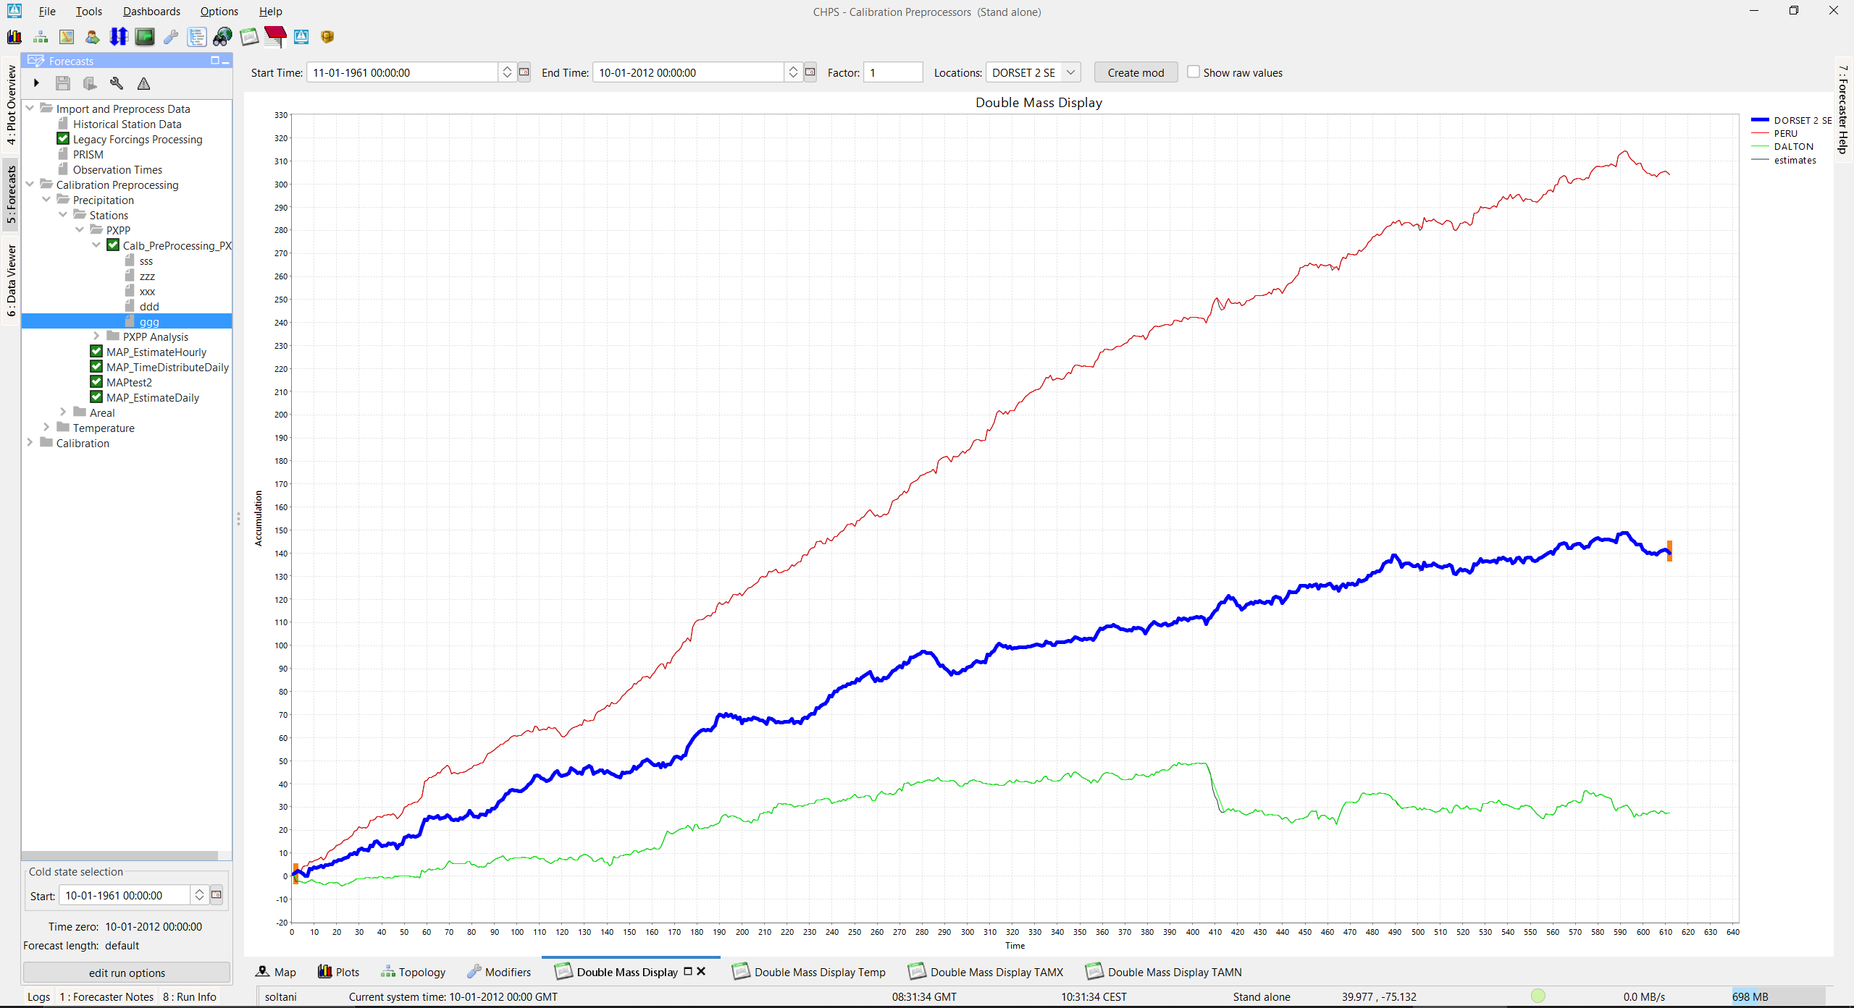
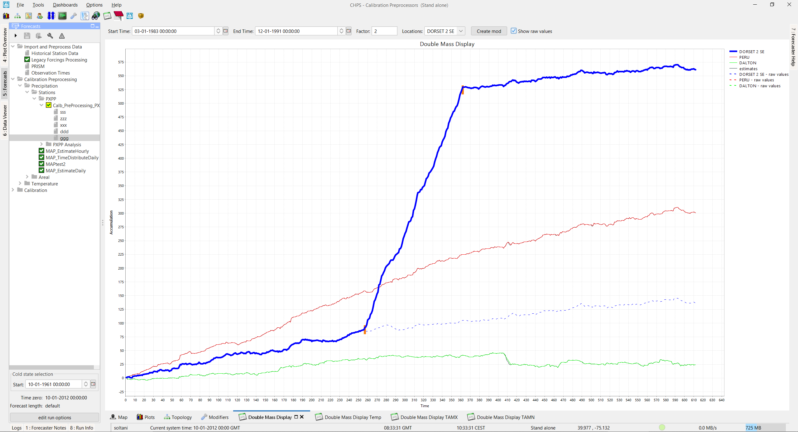
Client – Interactive Double Mass Display
UI
Notes:
FEWS-17000 Interactive Double Mass Display
https://publicwiki.deltares.nl/display/FEWSDOC/32.+IDMA+Display
Interactive Double Mass Analysis (IDMA) was implemented for NWS
Double mass analysis is a commonly used technique to determine corrections to hydrometeorological data (P and T time series) if station location or instrumentation changed. The Interactive Double Mass Analysis (IDMA) display provides users a nice GUI to effectively assess data consistency and produce correction factors if necessary. The double mass plots display accumulated station data against a group base. If the double mass line is consistent it should be relatively straight over the period of analysis. Breaks in slope may suggest a station move, changed instruments, or some other alteration of data collection (e.g. tree cover inhibiting gage catch). The IDMA tool allows users to modifiers where slope changes significantly and manually draw reference lines over base periods of “good” data to which other periods will be corrected.

Slide 11
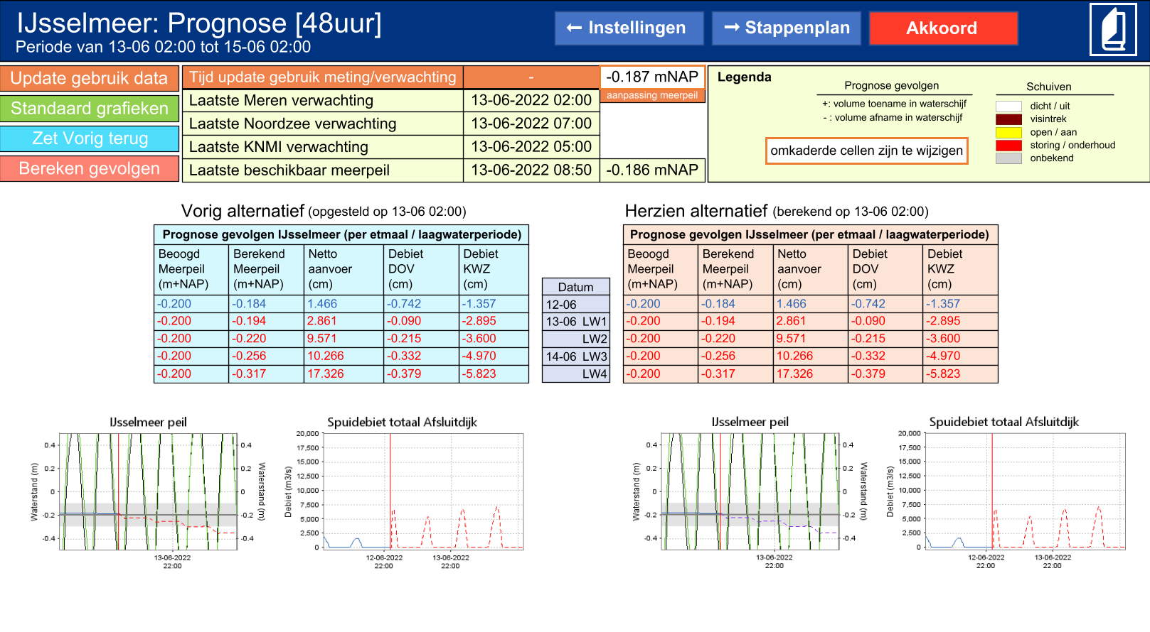
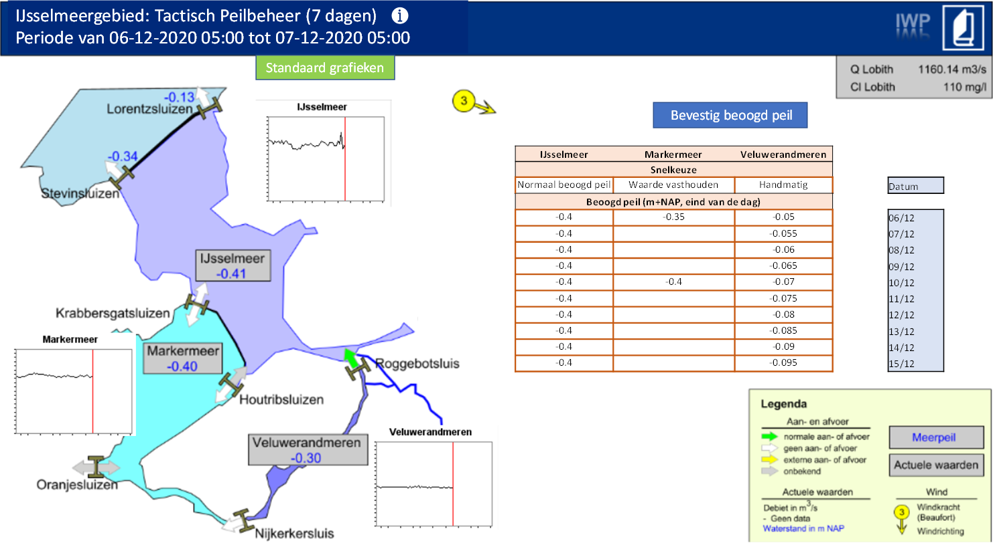
Client – Thumbnails in Schematic Status Display
UI
Notes:
FEWS-25193 In the Schematic Status Display you can add small interactive graphs (like on the main map) which update with changing systemtime/timeslider.
As the Thumbnails in the plotoverview with y-axis information as in the chartlayer.
https://publicwiki.deltares.nl/pages/viewpage.action?pageId=8684020#id-15SchematicStatusDisplay(formerlyScadaDisplay)-chartComponentBehaviourDefinition

Slide 12
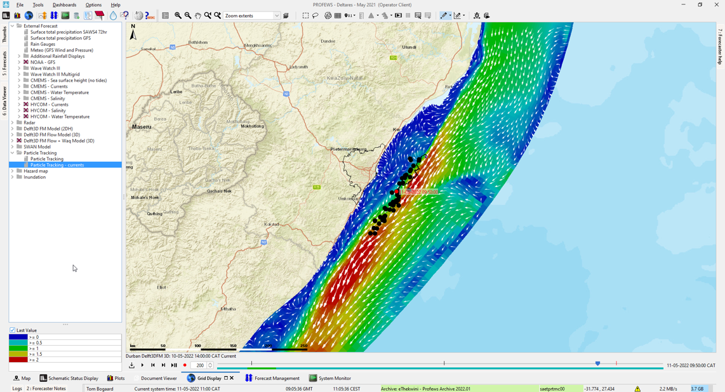
Client – Spatial Display
UI
Notes:
FEWS-23741 Improvements Particle tracking Spatial Display
https://publicwiki.deltares.nl/display/FEWSDOC/01+Grid+Display#id-01GridDisplay-trackLayer
The track layers in the spatial display are now more suitable to show floating particles. Extra config options: Dot color, dot fill color, onlyShowDotForCurrentTime. The valueTimeSeriesSet is no longer required.

Slide 13
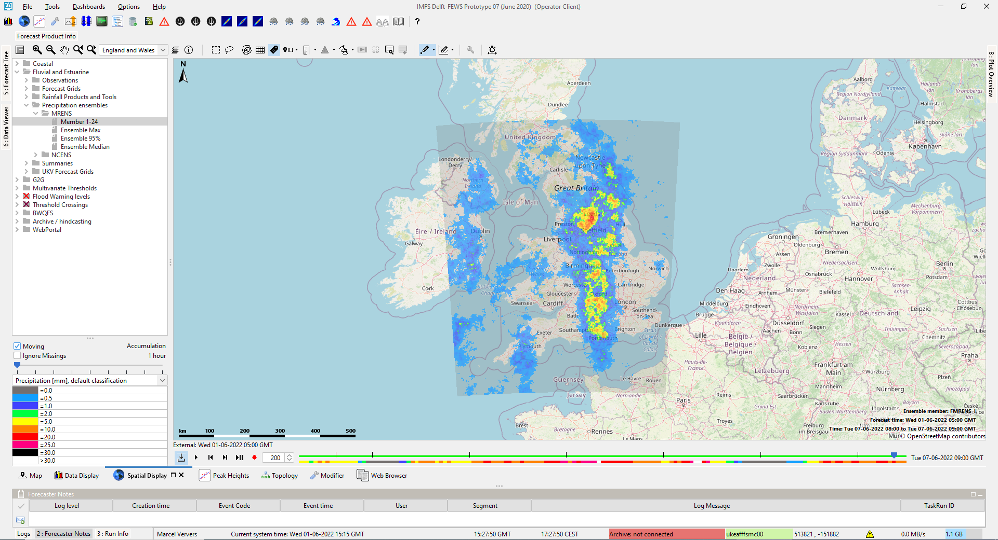
Client – Spatial Display
UI
Notes:
FEWS-25792 Spatial Display - pre download all timesteps (OC)
https://publicwiki.deltares.nl/display/FEWSDOC/05+Spatial+Display#id-05SpatialDisplay-TimeSliderToolbar
Since the 2019.02 the grids are downloaded on the fly. With the preload button the grids for all time steps are downloaded in the background to have a smooth animation without pauzes. A green line in the time slider shows the progress of the download

Slide 14
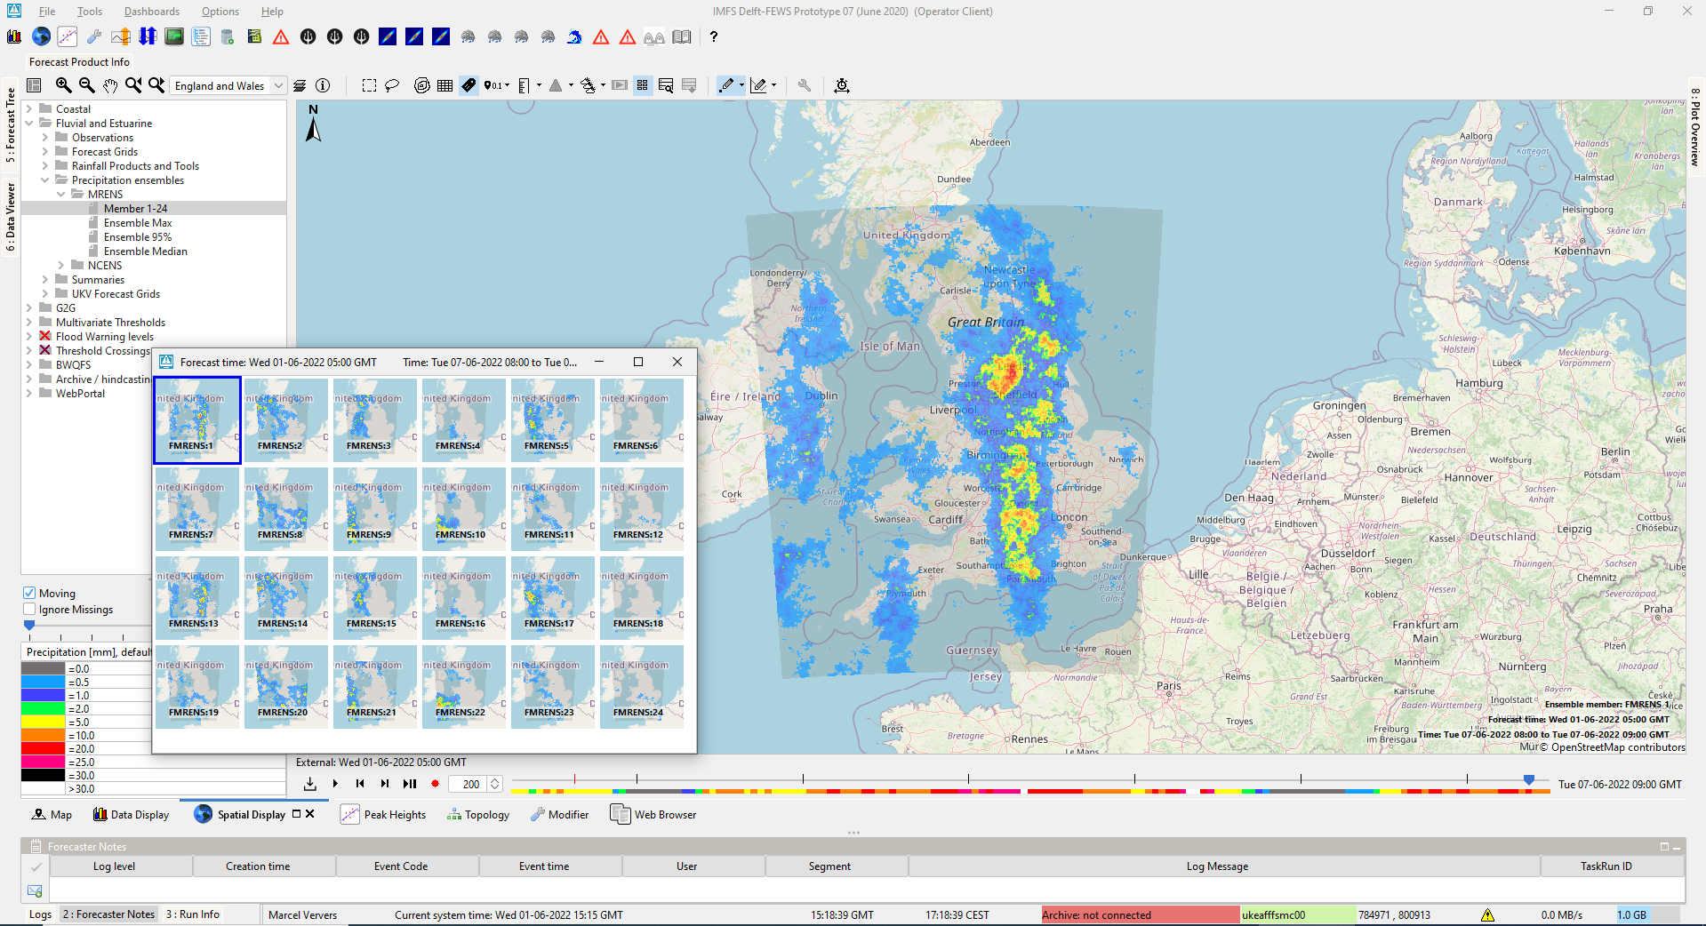
Client – Spatial Display
UI
Notes:
FEWS-26068: Spatial Display open ensemble thumbnails automatically
https://publicwiki.deltares.nl/display/FEWSDOC/05+Spatial+Display#id-05SpatialDisplay-Selectingdifferentensemblemembers
The spatial ensemble thumbnails window can now be configured to automatically open when the grid plot with ensembles is selected via <openEnsembleThumbnailsWindowWhenSelected>true

Slide 15
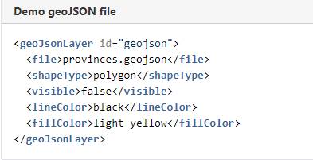
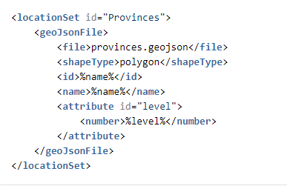
Client – Spatial/Map Display
UI
Use a geoJSON files instead of shape files for your maps
Support geoJSON for defining LocationSets
Notes:
FEWS-26624: From version 2022.01 you can use a geoJSON files instead of shape files. When the geoJSON file contains multiple shape types you can use the same geoJSON file in multiple layers with different types (options: point, line, polygon)
https://publicwiki.deltares.nl/display/FEWSDOC/28+GeoMap#id-28GeoMap-geoJSonLayer
FEWS-26623 Besides reading Locations from DBF or CSV files it is now also to get locations from a geoJSON file
Define file, shapetype, id, name and attributes
https://publicwiki.deltares.nl/display/FEWSDOC/22+Locations+and+attributes+defined+in+CSV+files%2C+Shape-DBF+files+or+external+tables#id-22LocationsandattributesdefinedinCSVfiles,ShapeDBFfilesorexternaltables-locationSetsfromgeoJSONfile

Slide 16
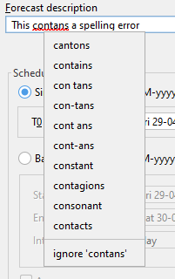
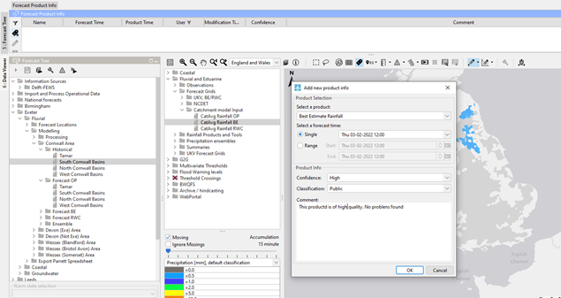
Client – Spell checker added to various panels
UI
Spelling checker functionality has been added to: Annotation panel, Forecast Product Info panel, Data search panel, Manual Forecast dialog and Timeseries Dialog (comment editor) and is available for Dutch, English (UK, US, AUS), Spanish and French.
Notes:
FEWS-26067
A spell check is applied to the entry box in the Forecast Product Info panel, any free text should be spell checked to avoid mistakes in customer product. Red lines appear when words are not recognized.
For German, the spell-check library is available but licence-wise this cannot be distributed with Delft-FEWS but should be downloaded separately
https://github.com/LibreOffice/dictionaries/tree/master/de and follow the WIKI link under the ? (top right)

Slide 17
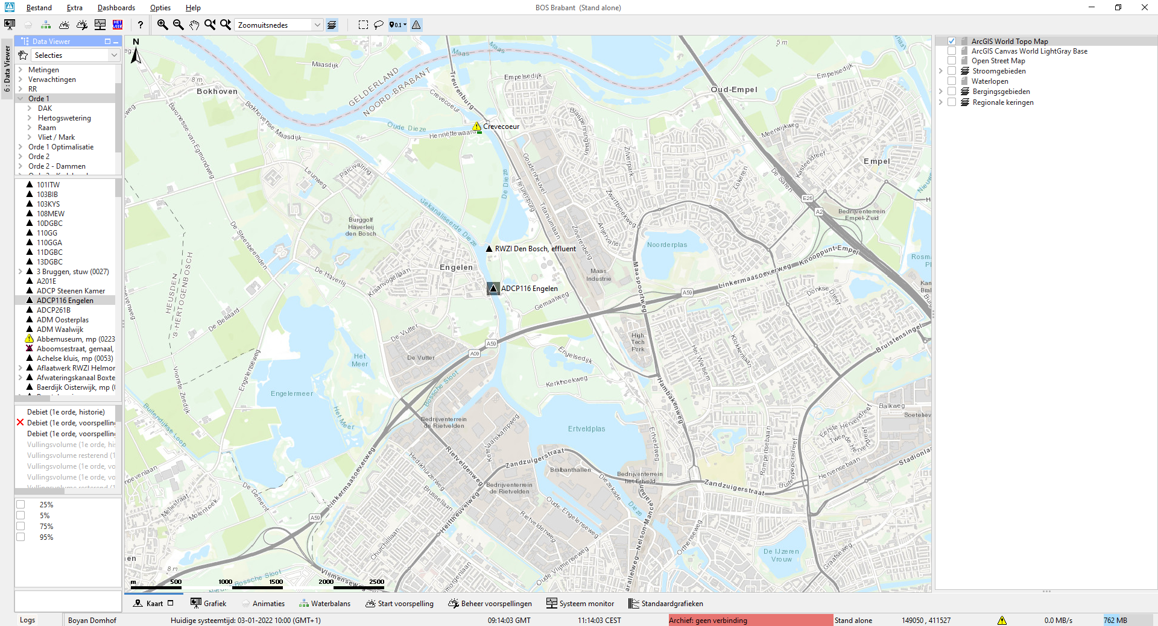
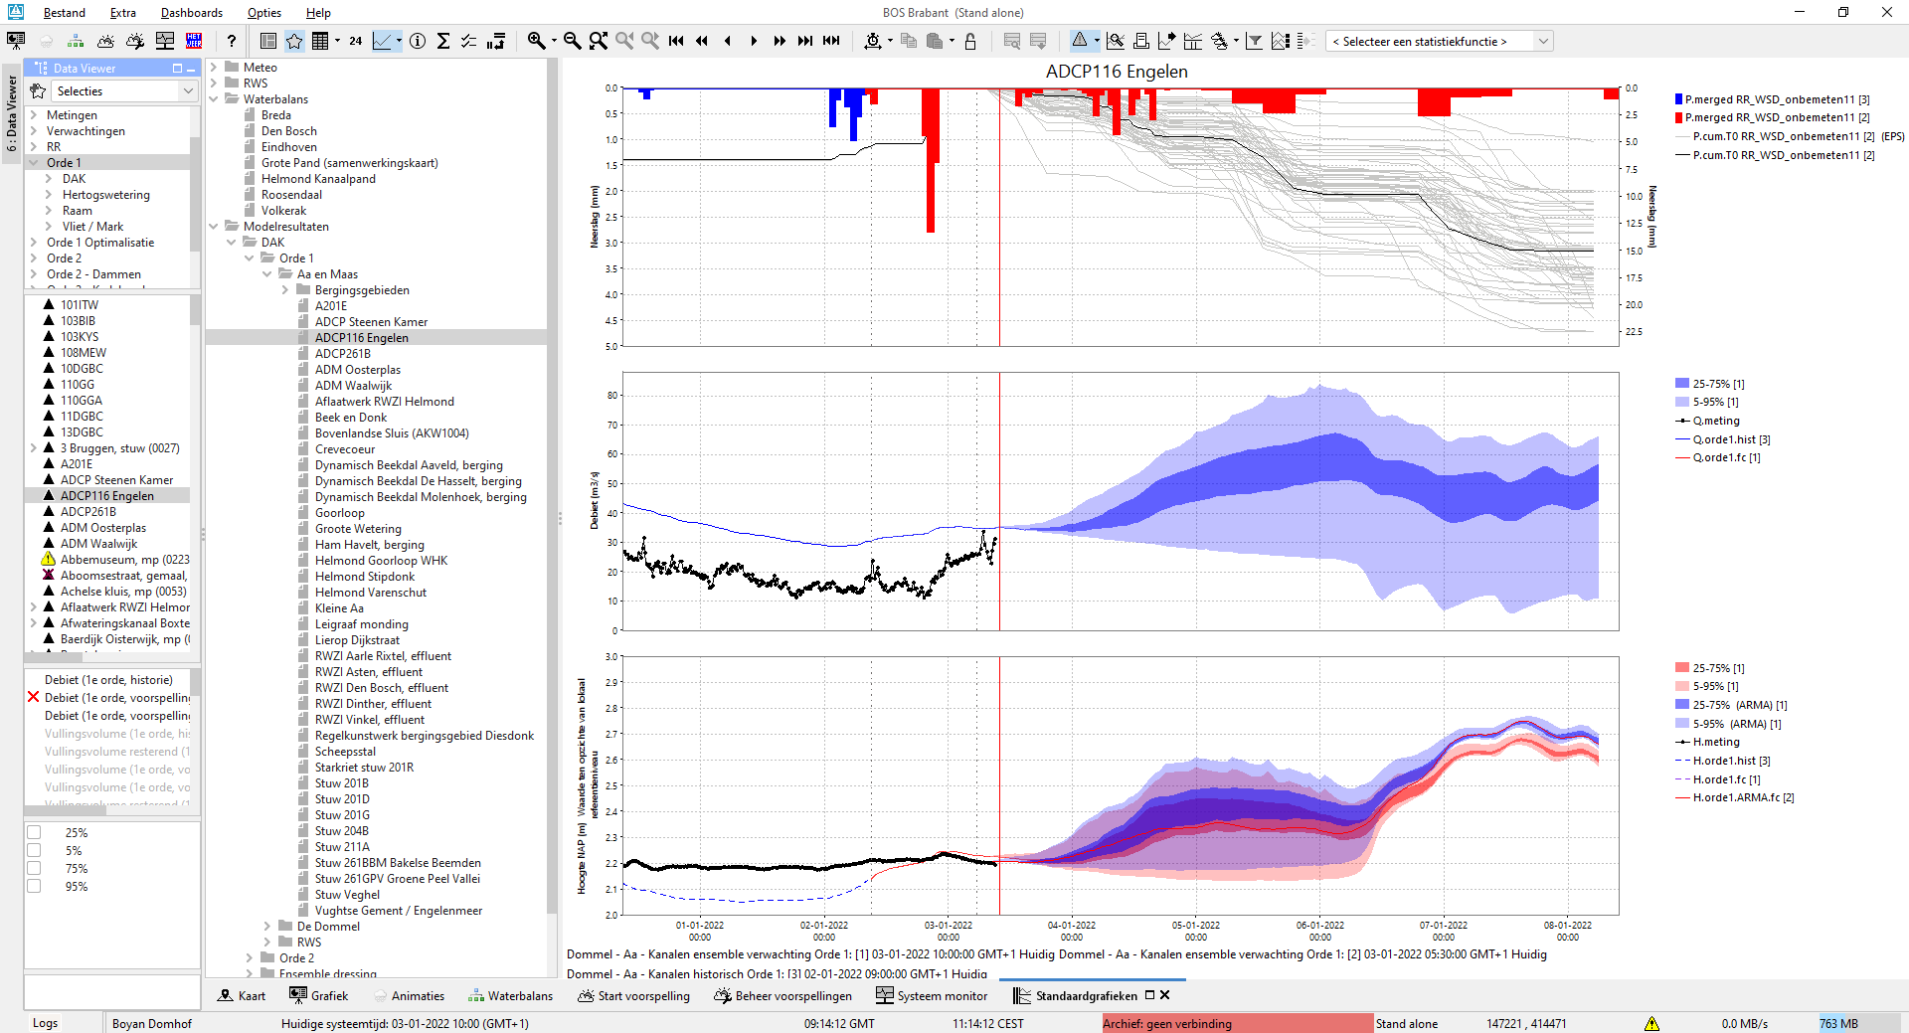

Double-click on location in map or list opens chart
UI
New option “doubleClickLocationEnabled” in displayGroups.xml
Notes:
FEWS-17991
Doubleclick functionality
Doubleclicking on a location in the dataviewer will open the ‘shortcuts’ with the relevant display from that list
When double clicked at a location at the map or in the list, all the explorerTasks with this option set to true are started. The location is selected before the tasks are started, so you can for example start the time series dialog (TSD) and jump to the shortcut chart of the clicked location.
Specific for TSD with the argument "Shortcuts" :
TSD with the argument "Shortcuts" will open to the shortcut chart that is configured in DisplayGroups.xml. By default the first chart that contains the clicked location will open. To open a specific shortcut chart, an ‘explorerLocationId’ and/or ‘explorerfilterId’ can be configured in this shortcut chart and the chart will open if the same location is double clicked at the map or in the list. If explorerFilterId is configured, also the selected filter should match .

Slide 18
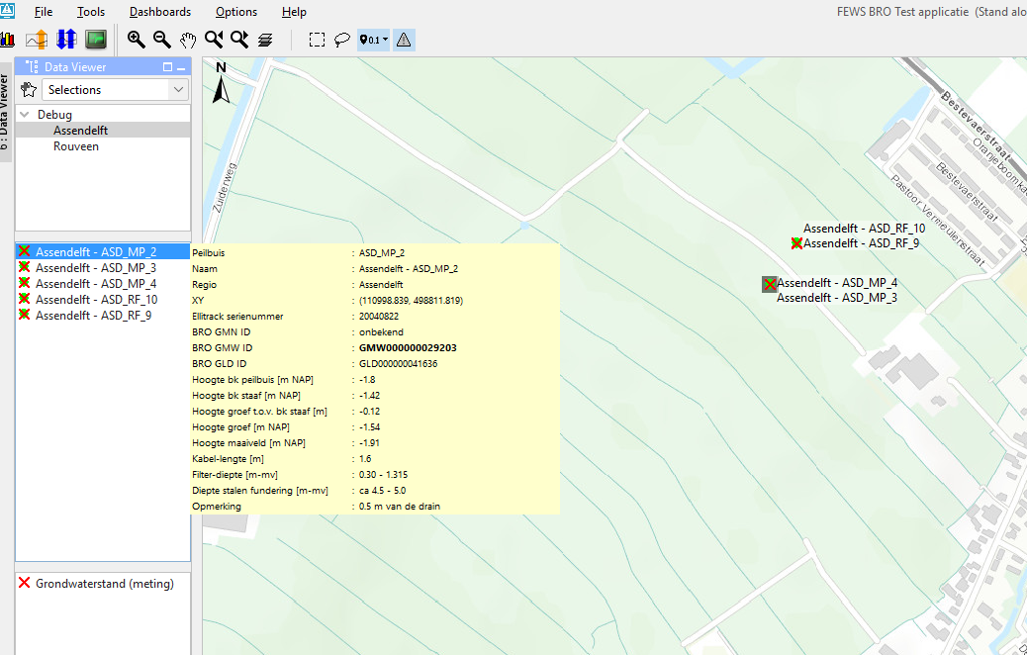
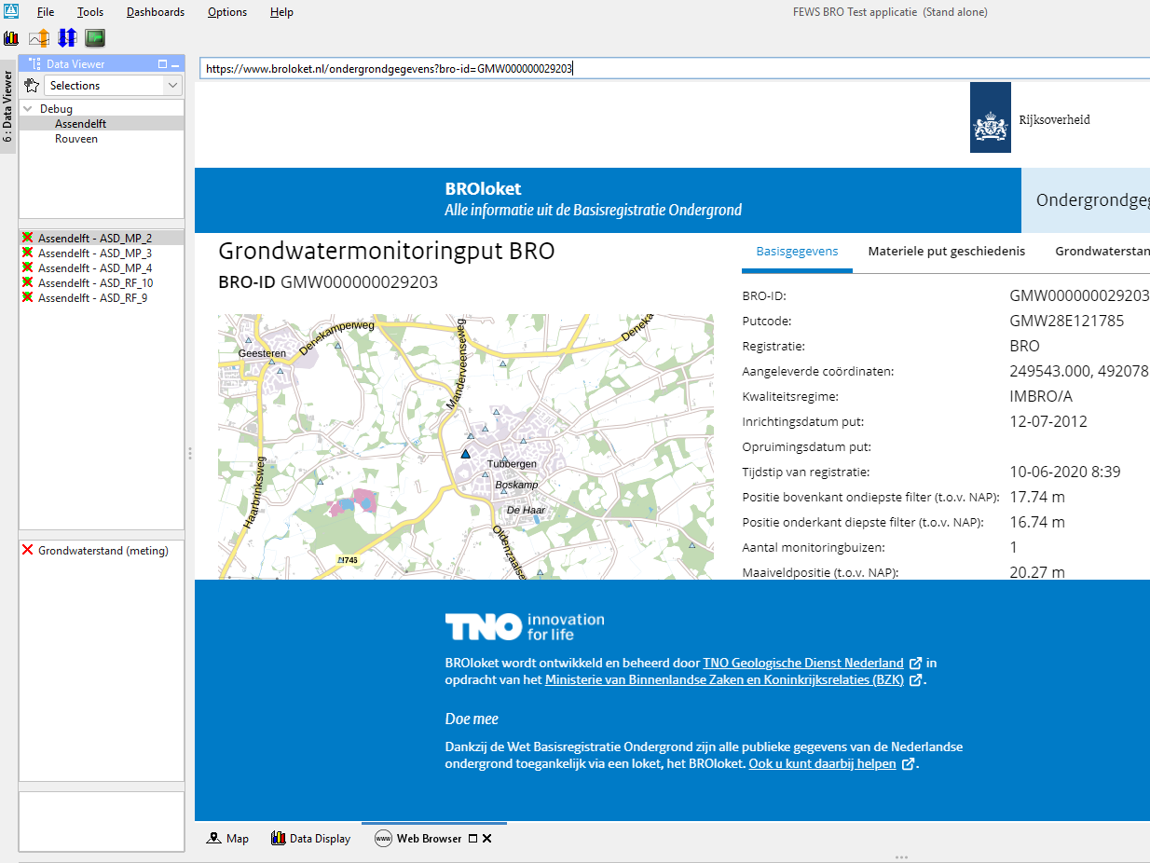
Client – Display hyperlinks in tooltips in embedded Web browser
UI
Hyperlink can be included in a location tooltip. The href (url) configured there can be opened in the default/internal Web Browser Display. Web Browser Display must be configured for this, including some settings must be specified.
Notes:
FEWS-24432
Hyperlink can be included in a location tooltip. The href (url) configured there can be opened in the default/internal Web Browser Display. Web Browser Display must be configured for this, including some settings must be specified.

Slide 19
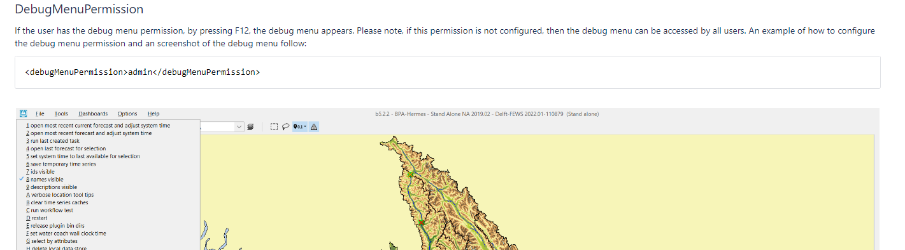
Client - <F12> menu now permission-aware
UI
Enable <F12> menu if the user has debugMenuPermission. If this is not configured, then the F12 menu is accessible by everyone.
Notes:
FEWS-22528
Enable F12 menu if the user has debugMenuPermission. If this is not configured, then the F12 menu is accessible by everyone. This will allow you to disable F12 menu for specific user groups.

Slide 20
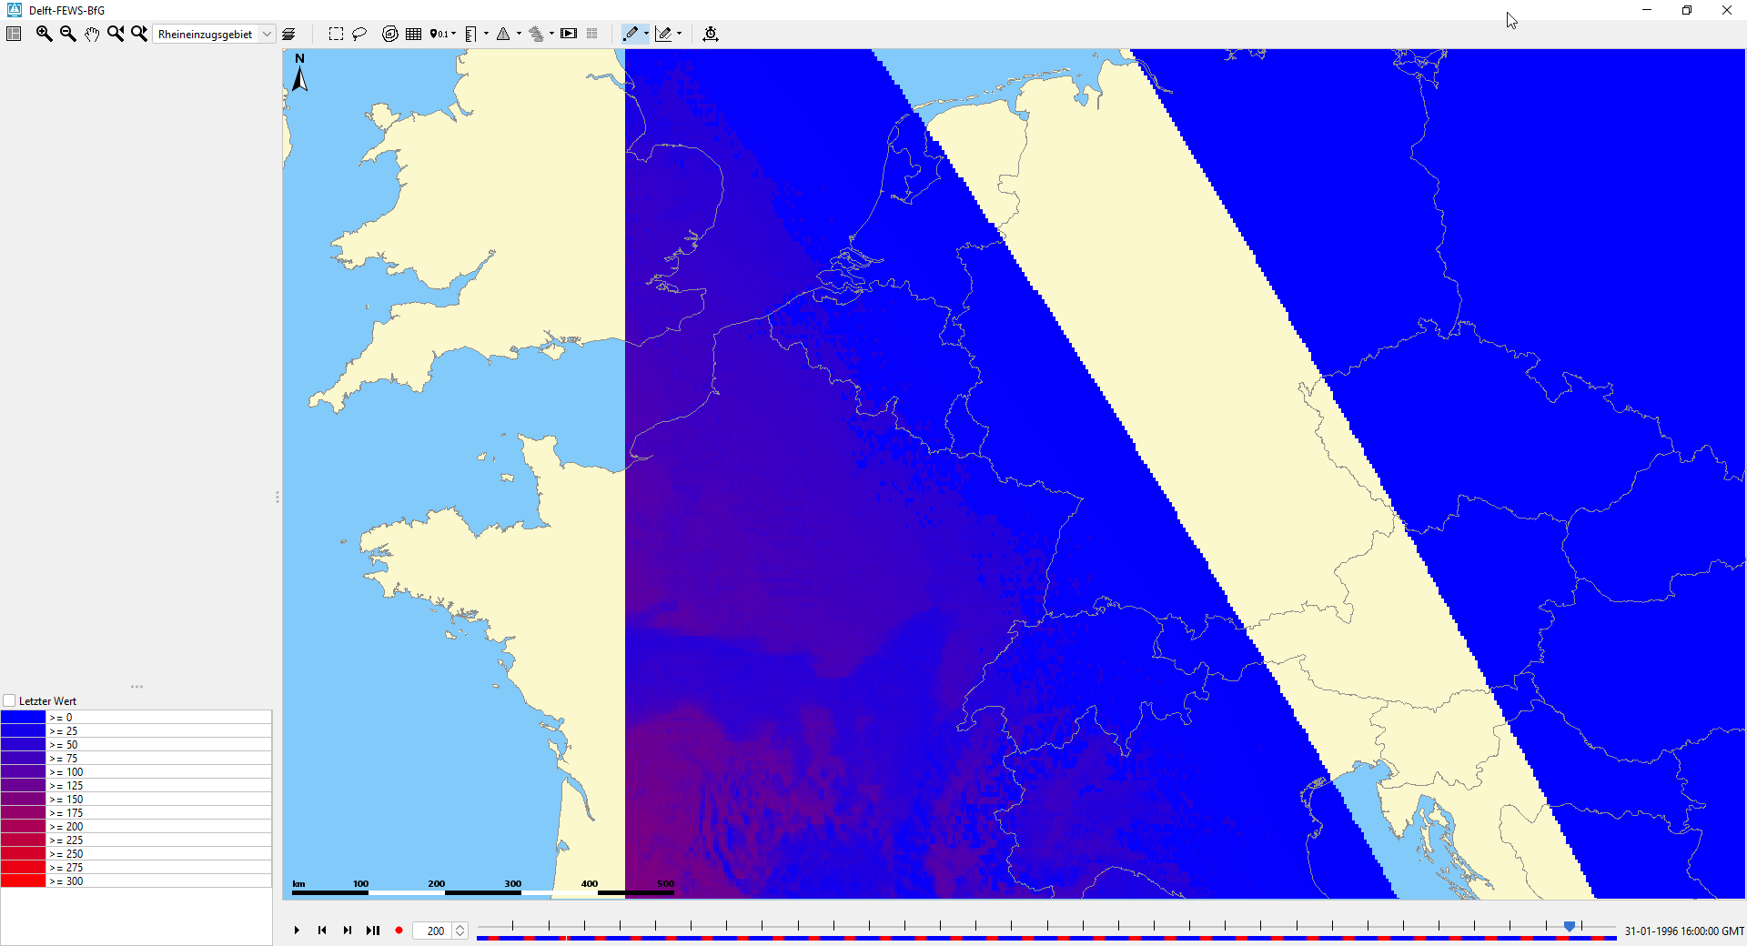
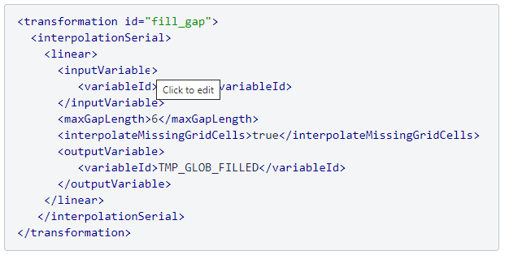
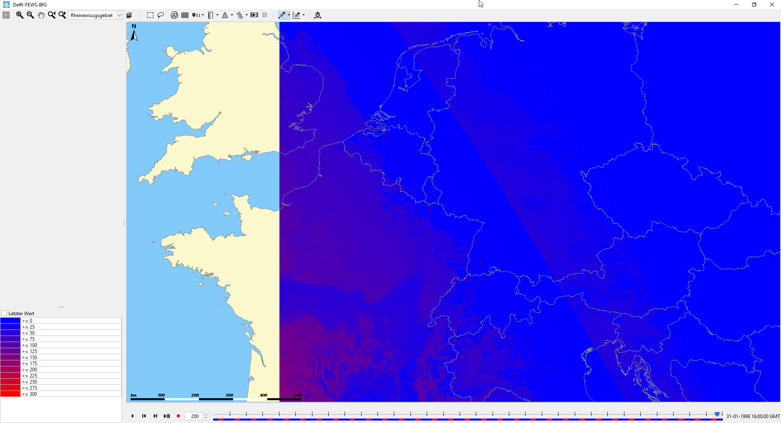
Transformation: InterpolationSerial Linear for grids
Besides filling full grid ‘gaps’ in time, you can now also interpolate missing single pixel by linear interpolation between values before and after the time of the missing data.
Notes:
FEWS-26335
InterpolationSerial Linear transformation extended
A new option was added to the InterpolationSerial Linear transformation of grids that allows interpolating missing pixels by interpolation between the pixels for previous and next timesteps. (Before, only grids that are completely missing for some time step could be interpolated; so now also per grid cell).

Slide 21
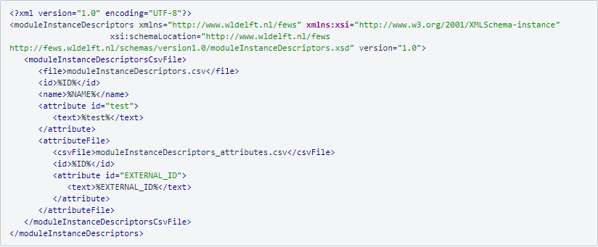
Configuration – Load moduleInstances from CSV (with possibility to add extra attributes)
Attributes can be used as metadata in netCDF exports (see Exports slide)
Notes:
FEWS-25757
Besides locations, parameters and qualifiers it now also possible to list the module instance descriptors in a csv file. You can now also add attributes to the module instance descriptors that can be used in the netcdf metadata.
https://publicwiki.deltares.nl/display/FEWSDOC/12+ModuleInstanceDescriptors

Slide 22
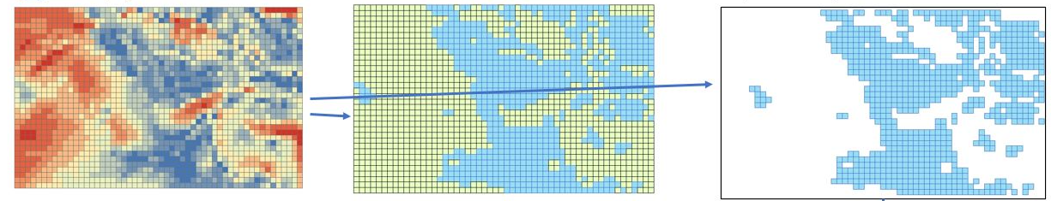
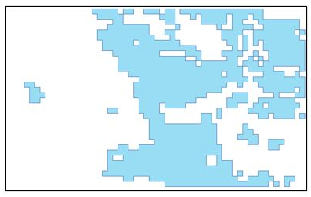
Transformation: Convert (regular) grid cells to polygons based on certain class breaks
Create (and export) nice polygon shape files (incl. prj) based on gridded data, e.g. flood extent. The polygons are created on the basis of class breaks which can be configured
Notes:
FEWS-26388
New spatial interpolation transformation to convert (regular) grid cells to polygons for certain class breaks
Create (and export) nice polygons shape files based on gridded data, e.g. flood extent. The polygons are created on the basis of class breaks which can be configured

Slide 23
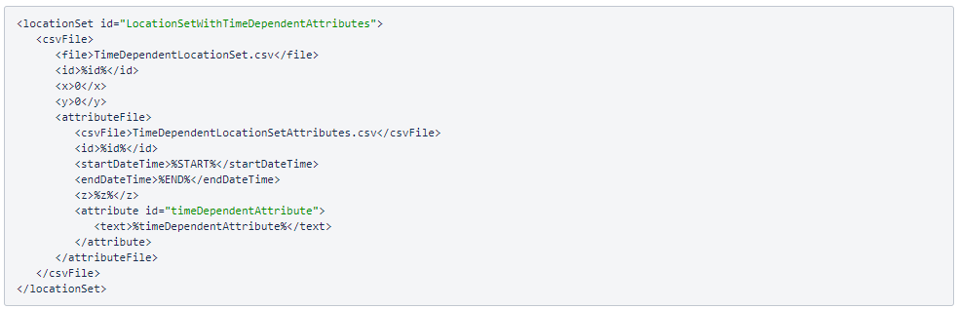
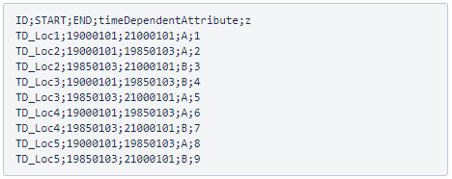
Time dependent locations (datum)
UI
Long term (observed) timeseries may change in datum (z).
To assess the timeseries as one, the settings ‘before’ and ‘after’ this change (date) can be configured.
Notes:
FEWS-26041
Time dependent datums (z)
The location z can now be time dependent. The z is used when converting a local datum to a global datum

Slide 24
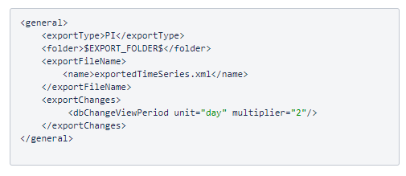
Export module: configuration option to export changes
A new option has been added to the export timeseries module to only export changes in a configured period.
Use the configuration option <exportChanges>
Notes:
FEWS-26579
New option ‘exportChanges’
A new option in the export timeseries module to only export changes in a configured period.

Slide 25
Export module: other features
Improvements to CAP exports (CAP= Common Alerting Protocol)
Shape file exports
  PRJ file added
  Add configurable attribute table
NetCDF file export
  Delft-FEWS attributes can be exported as metadata of a NetCDF file

Slide 26

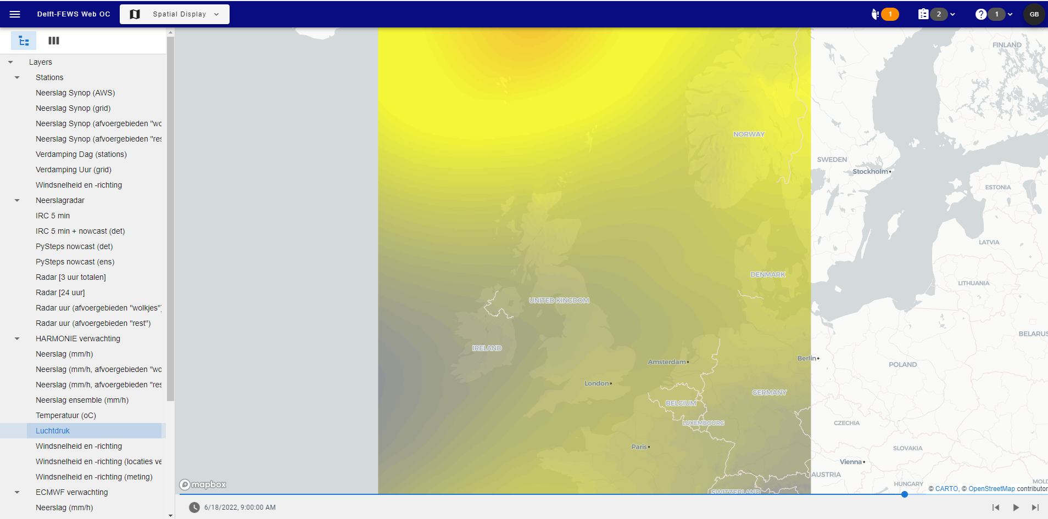
Delft-FEWS Webservices
Calling “getMap” is now much easier since a default time is returned for external historical and external forecasting timeseries. By default the last timestep is returned.
Security improvements by enabling support for Open ID Connect to authorize API requests. It’s also possible to integrate Delft-FEWS User Groups & Permissions configurations with Open ID Connect.
Source: web oc test client (Deltares)
Notes:
FEWS-23921
WMS Service GetCapabilies support for default time
The GetCapabilities request returns the last timestep as default time for external historical and external forecasting. Calling the getMap is now much easier with this default time.
FEWS-26115
Support Open ID Connect to authorize API requests
Possibility to configure / integrate the FEWS Web Service with OIDC (Open ID Connect). It is also possible to integrate the Delft-FEWS Groups and Permissions configurations with OIDC.

Slide 27
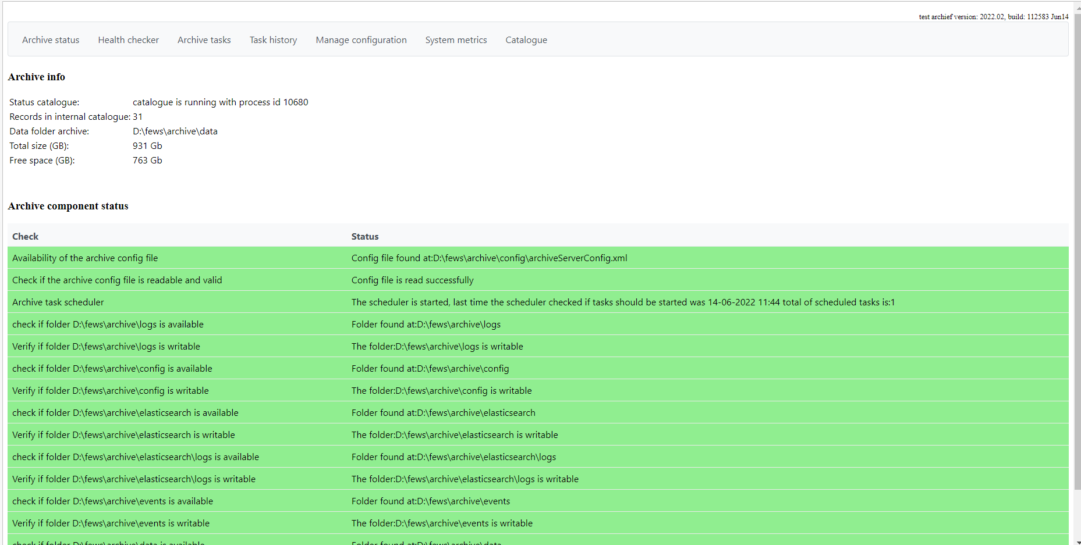
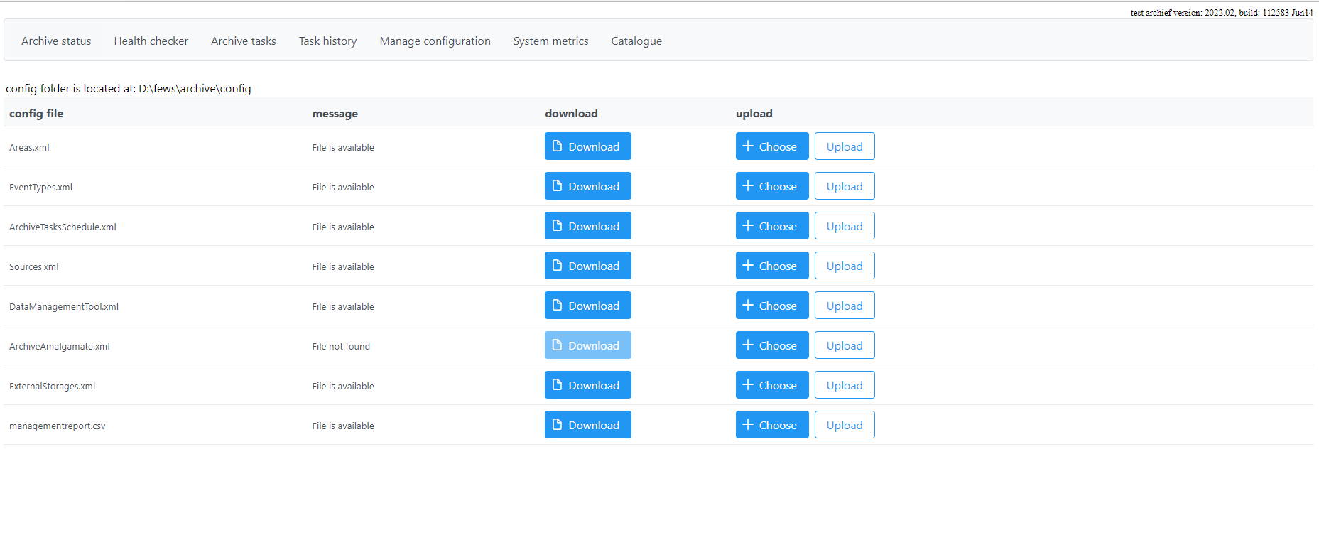
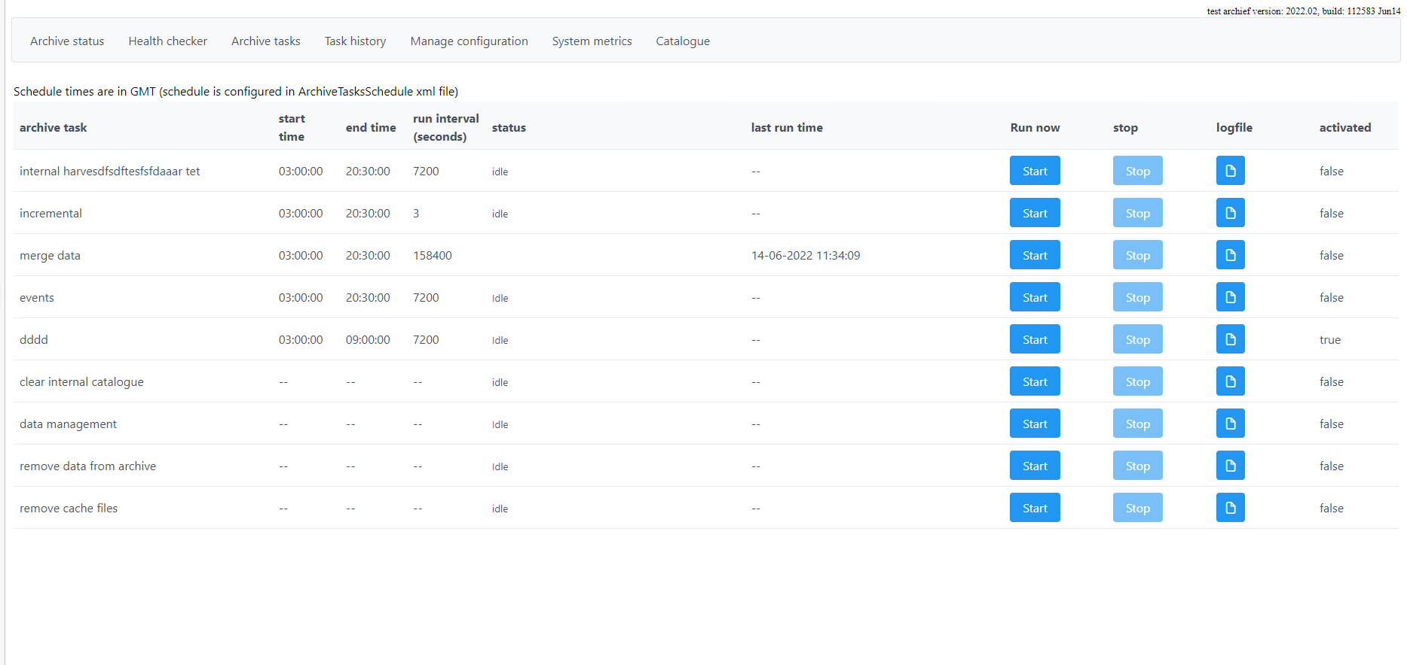
Open Archive
MongoDB + Seamless integration (improved Open Archive database API)
Search options improved with custom-IDs (provided at export) to be used as filters
Import datasets from Archive into client-server system is possible (but default off)
Direct download (via Archive display, Archive catalogue) without OpenDAP
Look & feel (Archive admin console)
Notes:
CONTEXT SAMEN MET PETER/ANDRE AFSTEMMEN
FEWS-25810, NWM
Implement new Archive endpoint: URLs to be imported by FSS (PG)
FEWS-25811
Enabled URL download without OpenDAP in Archive Server (PG)
++
FEWS-23669
Implement seamless integration with Open Archive Database REST API (geen commits, misschien op ander nummer gedaan)
TVA
++ NOG TESTEN, DOCUMENTEREN, (Maarten SM)
FEWS-25839
Enabled exporting of simulated series as self-describing NetCDF files for the external NetCDF storage
FEWS-25840
Enabled importing of simulated timeseries from an External NetCDF Storage
FEWS-25886
Improved the Open Archive harvester: ability to harvest simulated timeseries produced by Delft-FEWS located on an External NetCDF Storage
++
FEWS-25059 (more bugfix)
Exporting to archive: messaging while verifying exported time series
+++ Orshi/Andre: zoeken op what-if attributen. PG
+++TOM (2022.02?)
Documentation version based
Maintenance: additional system health checks and notifications

Slide 28
Workflow Test Runner
Internal module (originally meant for testing purposes) to run workflows automatically (and logs about it)…
New feature: output of this Workflow Test Runner can be written in Junit XML → allows for integration with common tooling for CI/CD and automated testing (Azure DevOps)
Purpose
To automatically assess the effect of changed configuration…
(results should be the same)
Notes:
FEWS-26604
Workflow Test Runner can generate test report in JUnit XML format
https://publicwiki.deltares.nl/display/FEWSDOC/Workflow+Test+Runner+in+Azure+Devops

Slide 29

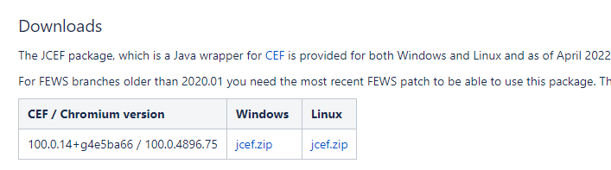
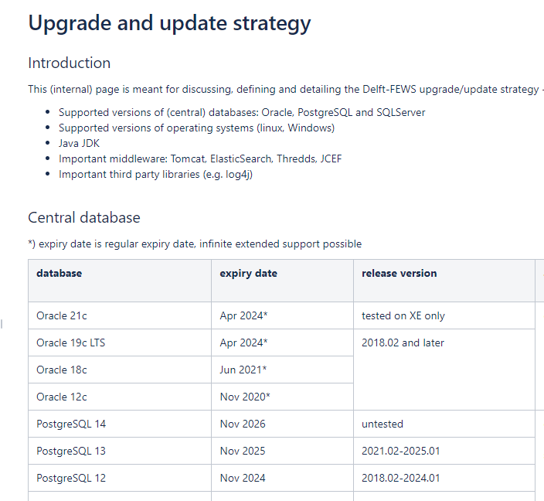
Third Party Library upgrades
NetCDF libraries have been upgraded to version 5.5.2 (and supporting NetCDF-C library to 4.8)
Chromium browser (JCEF package) for Web Browser Display: one version supports all Delft-FEWS versions. One download required for Windows or LINUX
Notes:
FEWS-25228
Upgrade of the NetCDF library
The NetCDF libraries are upgraded to 5.5.2 and its supporting NetCDF-C library to 4.8
FEWS-26874
Updated JCEF package
For all (supported) Delft-FEWS versions you need the same (OS specific) updated JCEF version in case you want to use the Web Browser Display

Slide 30
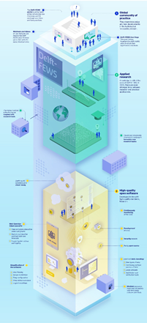
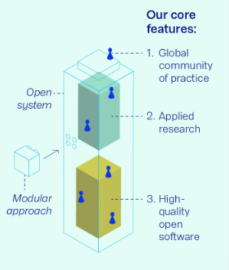



Delft-FEWS Vision 2025…
Delft-FEWS Vision 2025 core features
  Global Community of Practice
  Applied Research
  High quality open software
Show and tell…story, presentations and infographic
  Delft-FEWS portal: vision and roadmaps
  Video
  User Days / Events
  Updates to the CSB
Notes:
Vision 2025 - Context and highlights
With this slide I would like to bring everyone on the same page with respect to our vision and roadmaps.
Presented a few times already but this is the high level summary and timeline
We have our Delft-FEWS Vision 2025 in place, consisting of the 3 main core features
Global community of Practice
Applied research
High quality open software
We also have more information and visuals: see our infographic on the right and the clickable sources to the portal, videos and other presentations.
Last but not least, our international community strategy board has been involved from the start.
So over a five year period with 2 releases per year we are implementing this.
Mainly through annual roadmaps and we are connecting to ongoing projects as much as possible.
Besides that, Deltares also makes a substantial investment in order to make the objectives true! It’s good to stress this.

Slide 31
Roadmap 2022 - update
To realise the Delft-FEWS vision for 2025, we set goals in annual roadmaps.
The focus of a roadmap is to keep the quality of the software components (client-side, server-side, web service, archive) up-to-date.
Focal points are:
High-quality open software
  Code clean-up
  Code quality
  Release process and Test automation
  Security aspects & cloud developments
Web-based Operator Client
Computational Framework
Notes:
Roadmap approach
Highlights van de thema’s
Code Clean Up
Security
Cloud
Automated Release Testing
Code Quality
Web OC
Computational Framework
Documentation

Slide 32
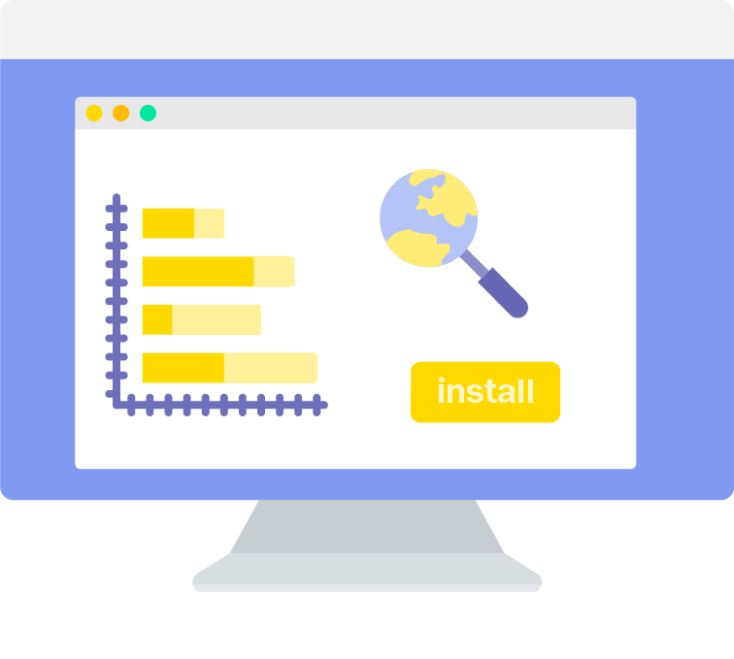
Roadmap 2022 – High Quality Open Software
Code clean-up
“To keep the code clean and maintainable, we have identified outdated and end-of-life modules and displays”
A wiki page is kept up-to-date to share our latest plans (what components are removed by when) and our progress. The <F12> check in your application is aligned with this WIKI page.
Expected effort in 2022: ±35 days
Main contact for this roadmap theme is: Marc van Dijk
Continue the work from 2021
<F12> option is always up-to-date
Important third party library updates
Notes:
Roadmap approach
Highlights van de thema’s
Code Clean Up
Security
Cloud
Automated Release Testing
Code Quality
Web OC
Computational Framework
Documentation

Slide 33
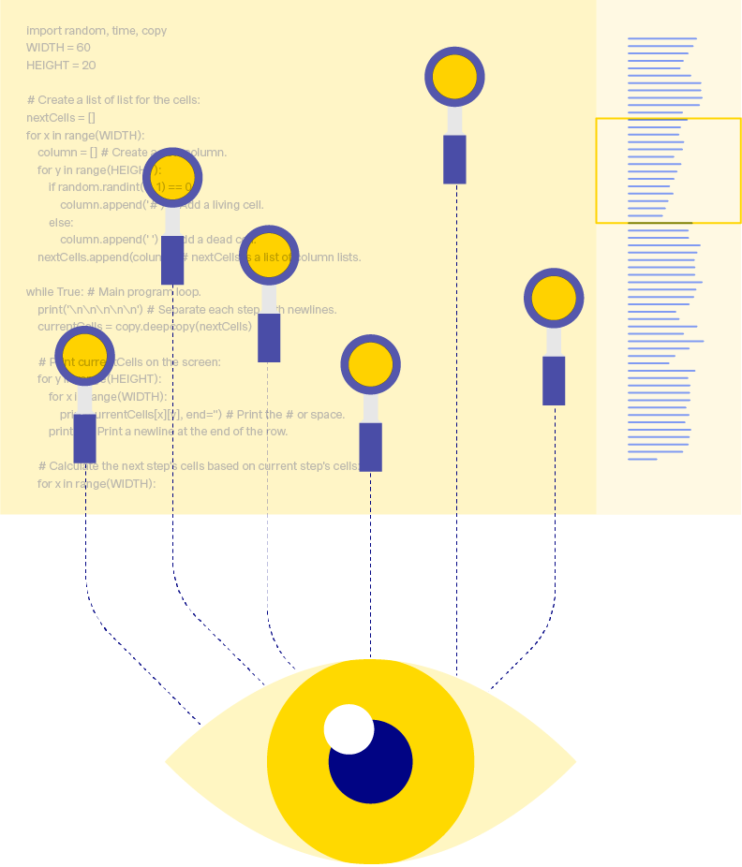
Roadmap 2022 – High Quality Open Software
Code quality
“Our code quality is constantly monitored and all code commits are checked against the latest java coding rules”
Besides that we will actively maintain the (newly structured) Delft-FEWS hard and software requirements page and will launch a Delft-FEWS update strategy page. The latter contains an overview of all supported versions of relevant operating systems, database types and third-party libraries, java and middleware like Tomcat per Delft-FEWS version and by when this will change.
Expected effort in 2022: ±40 days
Main contact for this roadmap theme is: Gerben Boot
SonarQube code commit analysis
DevOps pilot
Increase unit test coverage %
Transparant reporting
Notes:
Roadmap approach
Highlights van de thema’s
Code Clean Up
Security
Cloud
Automated Release Testing
Code Quality
Web OC
Computational Framework
Documentation

Slide 34
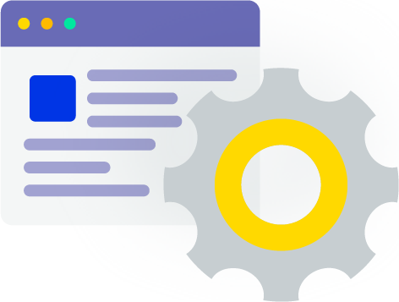
Roadmap 2022 – High Quality Open Software
Release process and test automation
“We are continuously improving our release process to deliver high quality and well-tested releases“
Separating GUI code and business logic is also on our radar this year and we will further complete our Master Test Plan to easily derive the our Release Specific Test Plans.
Expected effort in 2022: ±20 days
Main contact for this roadmap theme is: Marcel Ververs
Product Risk Analysis
Release Retrospective
Test scripts transferable
Increase automatic tests (Docker)
Notes:
Roadmap approach
Highlights van de thema’s
Code Clean Up
Security
Cloud
Automated Release Testing
Code Quality
Web OC
Computational Framework
Documentation

Slide 35

Roadmap 2022 – High Quality Open Software
Security aspects and cloud developments
“For Delft-FEWS a security matrix is available to visualize all security options per Delft-FEWS component”
We also respond quickly to our daily checks with respect to OWASP messages (OWASP=Open Web Application Security Project) which runs on our build & test environment (TeamCity)
Expected effort in 2022: ±40 days
Main contact for this roadmap theme is: Gert-Jan Schotmeijer
Documents are available in draft but available on request (and WIKI – Admin Pages)
Available for questions/discussion (MS Teams)
Network Security
Access Management
Threat Protection
Information Protection
Data (encrypted storage)
Notes:
Roadmap approach
Highlights van de thema’s
Code Clean Up
Security
Cloud
Automated Release Testing
Code Quality
Web OC
Computational Framework
Documentation

Slide 36

Roadmap 2022 – High Quality Open Software
Security aspects and cloud developments
“Delft-FEWS is cloud agnostic and Deltares is willing to support you to make effective and efficient choices migrating Delft-FEWS to a cloud-environment”
In 2022, we continue learning from our ongoing cloud (migration) projects. These projects are focusing on the up- and downscaling of computational cores using docker containers and switching components on/off from a financial perspective.
From a knowledge sharing perspective we will capture these experiences in our documentation WIKI and we will complete the documentation based on the material(s) we previously shared in the "Delft-FEWS in the cloud" webinar (from January 2022).
Main contact for this roadmap theme is: Gert-Jan Schotmeijer
Incorporate cloud services in Delft-FEWS components
Sharing knowledge for migrating to the cloud
Notes:
Roadmap approach
Highlights van de thema’s
Code Clean Up
Security
Cloud
Automated Release Testing
Code Quality
Web OC
Computational Framework
Documentation

Slide 37

Roadmap 2022 – Web Operator Client
End of 2021 / early 2022: development & innovation sprints
  Improve the underlying FEWS webservices
  Organize the development process and tooling
  Investigate and experience integration of Web OC components in other web-based systems
Expected effort in 2022: ±140 days
Main contacts for this roadmap theme are: Daniel Twigt and Tom Bogaard
Deliver Web OC MVP in 2022
Involve (potential) users in UX/UI design
Approach external stakeholders for co-creation
Notes:
Roadmap approach
Highlights van de thema’s
Code Clean Up
Security
Cloud
Automated Release Testing
Code Quality
Web OC
Computational Framework
Documentation

Slide 38

Roadmap 2022 – Computational Framework
The Computational Framework is the mode of Delft-FEWS to run scenarios which are not strictly connected to the 'here & now' like in operational forecasting systems. You can define and run scenarios in the (far) past or future, visualize, compare and manage them.
Expected effort in 2022: ±55 days
Main contact for this roadmap theme is: Peter Gijsbers
What-If Editor and What-if Template functionality fully available, also for Client-Server systems
Interaction with Open Archive for storing and searching scenarios
Exchange of scenarios between users
Deliver blueprints for Deltares models
Notes:
Roadmap approach
Highlights van de thema’s
Code Clean Up
Security
Cloud
Automated Release Testing
Code Quality
Web OC
Computational Framework
Documentation

Slide 39
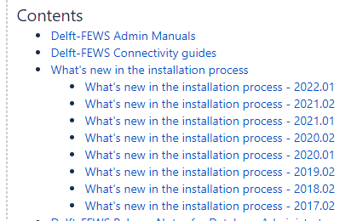
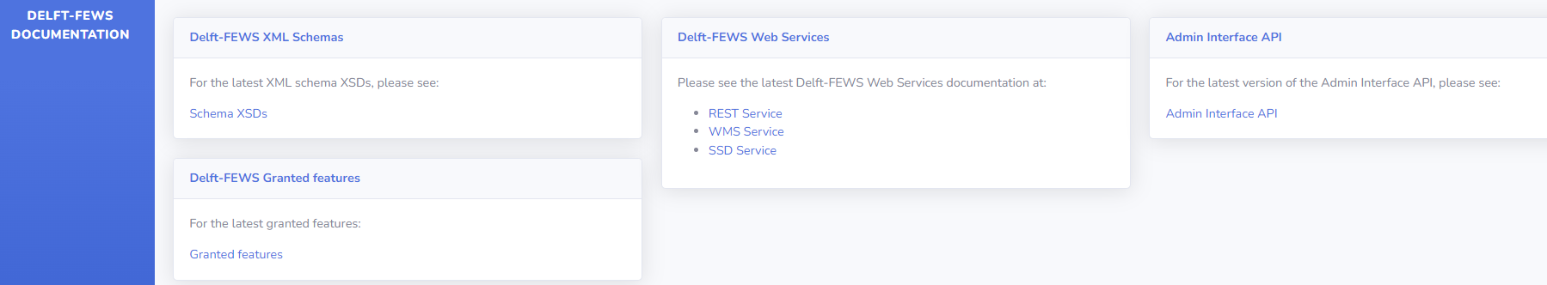
Documentation
Improvements
  Stable version based pages for installing and upgrading Delft-FEWS
  Stable version based pages for installing and upgrading the Open Archive
  Stable version based pages for hardware and software requirements
  Easier to update, maintain and understand
Extended – dynamic and generated content: https://fewsdocs.deltares.nl/
  Delft-FEWS schemas (XSD)
  Granted features for future versions
  Delft-FEWS webservices (Open API style)
  Admin Interface API (Open API style)
  To be added: Release Notes (!) → currently in test, aimed for 2022.02
Notes:
Improved, version-based documentation pages
New version-based WIKI page structure for installation, upgrade and hardware/software requirements pages
Fewsdocs.deltares.nl

Slide 40
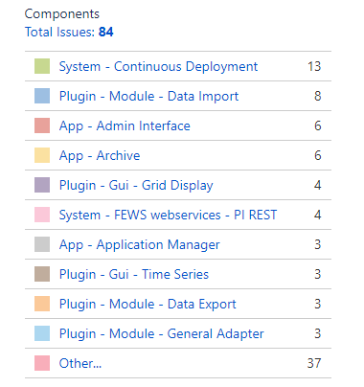
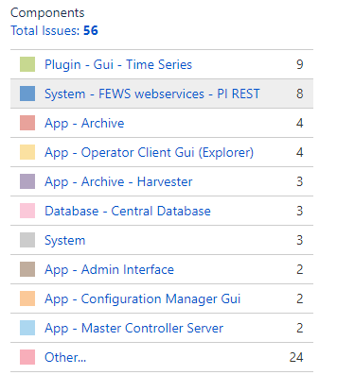
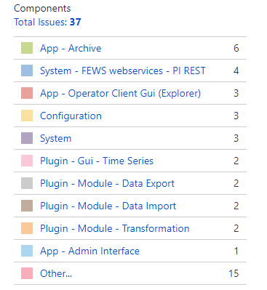
Outlook 2022.02 Features
Granted features (daily updates) via https://fewsdocs.deltares.nl/jira/fews-jira/
Estimated & granted (84)
Estimated & on-hold (56)
Not estimated & on-hold (37)

Slide 41
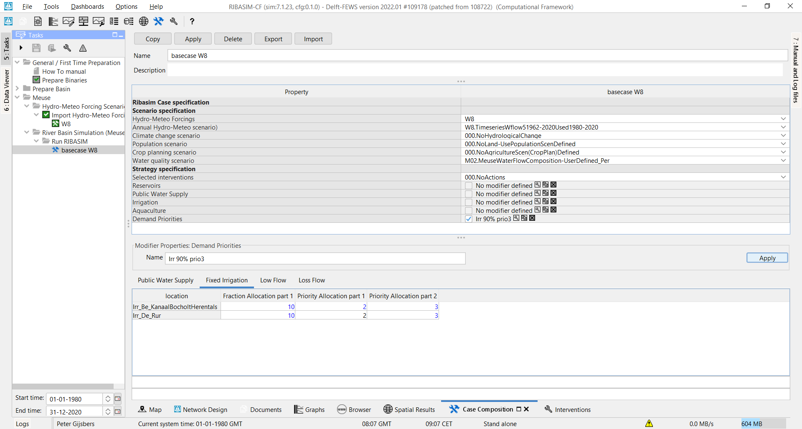
Computational Framework
Difference functionality (TSD) now also works longitudinal profiles
Multi-value attribute modifier
Typical Profile Modifier (to be finalized) → client-server context (last missing piece)
  Works with synchronizing and DDA clients
Modifier editing panel embedded in Whatif-Editor (screenshot)
<F12> option to get warning in case of ‘old what-if’ usage detected or present
Notes:
FEWS-26693
Before migrating to the new what-if templates the old what-ifs should be deleted from the (central) database.

Slide 42
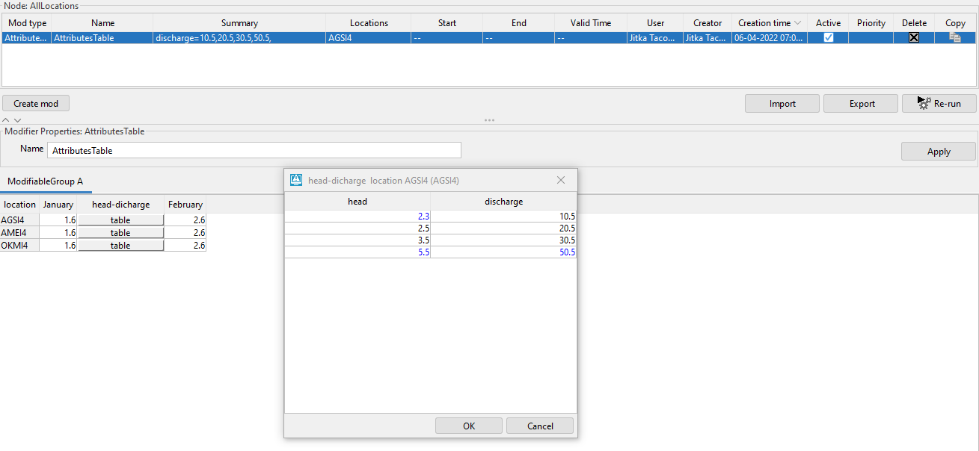
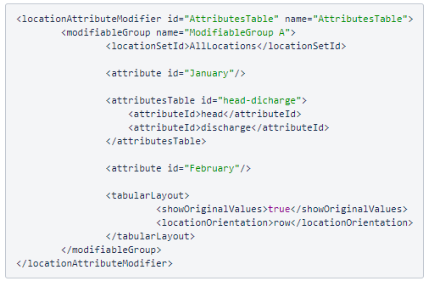
Modifiers: introducing a multi-value attribute
A multi-value attribute modifier is intended to modify multiple location attributes in one go. E.g. both ‘head’ and ‘discharge’ of a pump curve.
Notes:
FEWS-26446
Introduction of a multi-value (location) attribute modifier
A multi-value attribute modifier is intended to modify multiple location attributes in one go. E.g. both ‘head’ and ‘discharge’ of a pump curve.
FEWS-26201
Smart expiry times of modifiers
If a modifier still contains a value (at a specific date/time) which is after the default or configured expiry time, the modifier expiry time will be extended.

Slide 43
Contact
www.delft-fews.com
@DelftFEWS
linkedin.com/company/deltares
fews-pm@deltares.nl
@deltares
facebook.com/deltaresNL
facebook.com/deltaresNL
linkedin.com/company/deltares
@deltares
@deltaresNL

