Slide 3
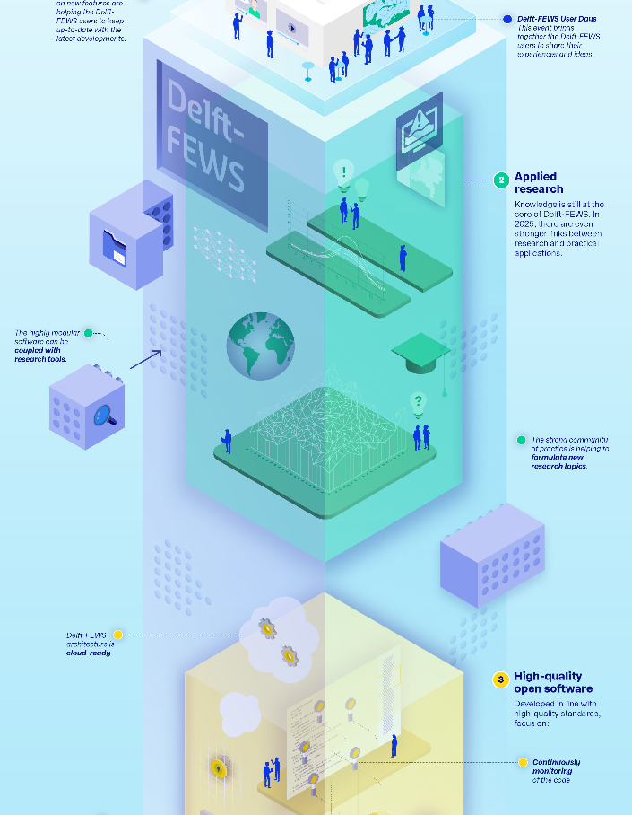
Delft-FEWS Vision & Roadmap
Update
Delft-FEWS Anwendertreffen
20.06.2022
Delft-FEWS Product Management
Marcel Ververs and Gerben Boot
Naam Achternaam

Slide 4
Introduction…
Welcome!
Everyone on the same page
Timeline
Roadmap 2022 Update
As usual: Links for more info

Slide 5

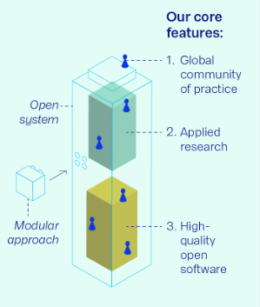



Delft-FEWS Vision 2025…
Delft-FEWS Vision 2025 core features
  Global Community of Practice
  Applied Research
  High quality open software
Show and tell…story, presentations and infographic
  Delft-FEWS portal: vision and roadmaps
  Video
  User Days / Events
  Updates to the CSB
Notes:
Vision 2025 - Context and highlights
With this slide I would like to bring everyone on the same page with respect to our vision and roadmaps.
Presented a few times already but this is the high level summary and timeline
We have our Delft-FEWS Vision 2025 in place, consisting of the 3 main core features
Global community of Practice
Applied research
High quality open software
We also have more information and visuals: see our infographic on the right and the clickable sources to the portal, videos and other presentations.
Last but not least, our international community strategy board has been involved from the start.
So over a five year period with 2 releases per year we are implementing this.
Mainly through annual roadmaps and we are connecting to ongoing projects as much as possible.
Besides that, Deltares also makes a substantial investment in order to make the objectives true! It’s good to stress this.

Slide 6

Delft-FEWS Vision 2025: timeline
Delft-FEWS
Vision 2025 + roadmap 2020
Retrospective + outlook
Delft-FEWS
Vision 2025 + roadmap 2021
Retrospective + outlook
Delft-FEWS
2021.01
Delft-FEWS
2020.01
Jan
2021
DSD-INT
Nov 2019
July
2020
DSD-INT
Nov 2020
DSD-INT
Nov 2021
Delft-FEWS
2020.02
Delft-FEWS
Vision 2025
Presented
Delft-FEWS
Vision 2025 + roadmap 2021
Updates
Delft-FEWS
2021.02
DFUDA
DSD-NL
Anwender-
treffen
May - July
2021
Notes:
NOG UPDATEN
Timeline so far looked like this, we are now in the red part. Informing you about our progress and what’s coming up?
This ‘rhythm’ will repeat itself in 2022 and so on.
Feel free to contact us on this. We are trying to share updates in our Newsletters etc as much as possible, but of-course outside these user events we are happy to receive your comments and feedback!

Slide 7
Delft-FEWS Vision 2025: timeline
Delft-FEWS
2022.01
Delft-FEWS
Vision 2025 + roadmap 2022
Retrospective + outlook
Delft-FEWS
Vision 2025 + roadmap 2023
Updates
July
2020
DSD-INT
Nov 2022
Delft-FEWS
Vision 2025 + roadmap 2022
Updates
Delft-FEWS
2022.02
Delft-FEWS
2023.01
Anwender-
Treffen
DSD-NL
DFUDA
Jun - Aug
2022
Notes:
NOG UPDATEN
Timeline so far looked like this, we are now in the red part. Informing you about our progress and what’s coming up?
This ‘rhythm’ will repeat itself in 2022 and so on.
Feel free to contact us on this. We are trying to share updates in our Newsletters etc as much as possible, but of-course outside these user events we are happy to receive your comments and feedback!

Slide 8
Roadmap 2022 - update
To realise the Delft-FEWS vision for 2025, we set goals in annual roadmaps.
The focus of a roadmap is to keep the quality of the software components (client-side, server-side, web service, archive) up-to-date.
Focal points are:
High-quality open software
  Code clean-up
  Code quality
  Release process and Test automation
  Security aspects & cloud developments
Web-based Operator Client
Computational Framework
Notes:
Roadmap approach
Highlights van de thema’s
Code Clean Up
Security
Cloud
Automated Release Testing
Code Quality
Web OC
Computational Framework
Documentation

Slide 9
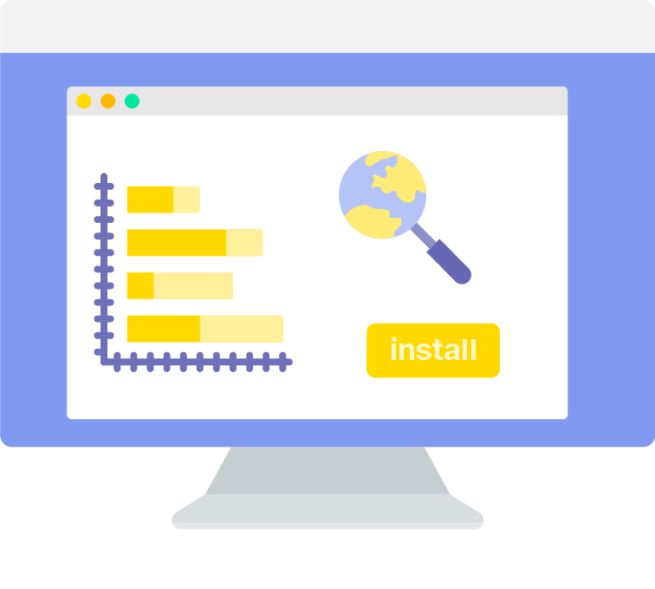
Roadmap 2022 – High Quality Open Software
Code clean-up
“To keep the code clean and maintainable, we have identified outdated and end-of-life modules and displays”
A wiki page is kept up-to-date to share our latest plans (what components are removed by when) and our progress. The <F12> check in your application is aligned with this WIKI page.
Expected effort in 2022: ±35 days
Main contact for this roadmap theme is: Marc van Dijk
Continue the work from 2021
<F12> option is always up-to-date
Important third party library updates
Notes:
Roadmap approach
Highlights van de thema’s
Code Clean Up
Security
Cloud
Automated Release Testing
Code Quality
Web OC
Computational Framework
Documentation

Slide 10
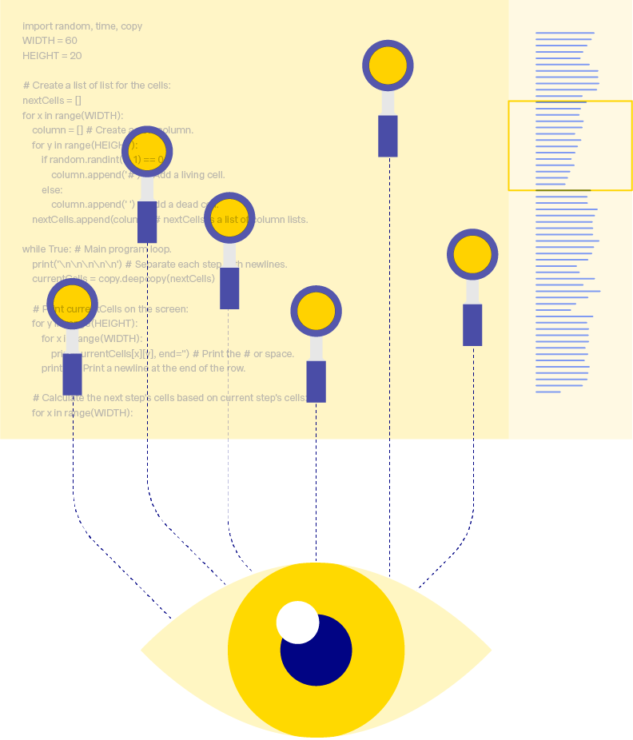
Roadmap 2022 – High Quality Open Software
Code quality
“Our code quality is constantly monitored and all code commits are checked against the latest java coding rules”
Besides that we will actively maintain the (newly structured) Delft-FEWS hard and software requirements page and will launch a Delft-FEWS update strategy page. The latter contains an overview of all supported versions of relevant operating systems, database types and third-party libraries, java and middleware like Tomcat per Delft-FEWS version and by when this will change.
Expected effort in 2022: ±40 days
Main contact for this roadmap theme is: Gerben Boot
SonarQube code commit analysis
DevOps pilot
Increase unit test coverage %
Transparant reporting
Notes:
Roadmap approach
Highlights van de thema’s
Code Clean Up
Security
Cloud
Automated Release Testing
Code Quality
Web OC
Computational Framework
Documentation

Slide 11

Roadmap 2022 – High Quality Open Software
Release process and test automation
“We are continuously improving our release process to deliver high quality and well-tested releases“
Separating GUI code and business logic is also on our radar this year and we will further complete our Master Test Plan to easily derive the our Release Specific Test Plans.
Expected effort in 2022: ±20 days
Main contact for this roadmap theme is: Marcel Ververs
Product Risk Analysis
Release Retrospective
Test scripts transferable
Increase automatic tests (Docker)
Notes:
Roadmap approach
Highlights van de thema’s
Code Clean Up
Security
Cloud
Automated Release Testing
Code Quality
Web OC
Computational Framework
Documentation

Slide 12

Roadmap 2022 – High Quality Open Software
Security aspects and cloud developments
“For Delft-FEWS a security matrix is available to visualize all security options per Delft-FEWS component”
We also respond quickly to our daily checks with respect to OWASP messages (OWASP=Open Web Application Security Project) which runs on our build & test environment (TeamCity)
Expected effort in 2022: ±40 days
Main contact for this roadmap theme is: Gert-Jan Schotmeijer
Documents are available in draft but available on request (and WIKI – Admin Pages)
Available for questions/discussion (MS Teams)
Network Security
Access Management
Threat Protection
Information Protection
Data (encrypted storage)
Notes:
Roadmap approach
Highlights van de thema’s
Code Clean Up
Security
Cloud
Automated Release Testing
Code Quality
Web OC
Computational Framework
Documentation

Slide 13

Roadmap 2022 – High Quality Open Software
Security aspects and cloud developments
“Delft-FEWS is cloud agnostic and Deltares is willing to support you to make effective and efficient choices migrating Delft-FEWS to a cloud-environment”
In 2022, we continue learning from our ongoing cloud (migration) projects. These projects are focusing on the up- and downscaling of computational cores using docker containers and switching components on/off from a financial perspective.
From a knowledge sharing perspective we will capture these experiences in our documentation WIKI and we will complete the documentation based on the material(s) we previously shared in the "Delft-FEWS in the cloud" webinar (from January 2022).
Main contact for this roadmap theme is: Gert-Jan Schotmeijer
Incorporate cloud services in Delft-FEWS components
Sharing knowledge for migrating to the cloud
Notes:
Roadmap approach
Highlights van de thema’s
Code Clean Up
Security
Cloud
Automated Release Testing
Code Quality
Web OC
Computational Framework
Documentation

Slide 14

Roadmap 2022 – Web Operator Client
End of 2021 / early 2022: development & innovation sprints
  Improve the underlying FEWS webservices
  Organize the development process and tooling
  Investigate and experience integration of Web OC components in other web-based systems
Expected effort in 2022: ±140 days
Main contacts for this roadmap theme are: Daniel Twigt and Tom Bogaard
Deliver Web OC MVP in 2022
Involve (potential) users in UX/UI design
Approach external stakeholders for co-creation
Notes:
Roadmap approach
Highlights van de thema’s
Code Clean Up
Security
Cloud
Automated Release Testing
Code Quality
Web OC
Computational Framework
Documentation

Slide 15

Roadmap 2022 – Computational Framework
The Computational Framework is the mode of Delft-FEWS to run scenarios which are not strictly connected to the 'here & now' like in operational forecasting systems. You can define and run scenarios in the (far) past or future, visualize, compare and manage them.
Expected effort in 2022: ±55 days
Main contact for this roadmap theme is: Peter Gijsbers
What-If Editor and What-if Template functionality fully available, also for Client-Server systems
Interaction with Open Archive for storing and searching scenarios
Exchange of scenarios between users
Deliver blueprints for Deltares models
Notes:
Roadmap approach
Highlights van de thema’s
Code Clean Up
Security
Cloud
Automated Release Testing
Code Quality
Web OC
Computational Framework
Documentation

Slide 17
Contact
www.delft-fews.com
@DelftFEWS
linkedin.com/company/deltares
fews-pm@deltares.nl
@deltares
facebook.com/deltaresNL
facebook.com/deltaresNL
linkedin.com/company/deltares
@deltares
@deltaresNL

