Slide 1
OpenGIS, standards & OpenEarth software stack
Fedor Baart
Gerrit Hendriksen
Kees den Heijer
Gerben de Boer
Frank Keppel

Slide 2
Agenda
Time | Event
09:00 - 09:30 | Welcome, OGC data standards & the OpenEarth software stack: Fedor Baart
09:30 - 10:00 | Grids: kickstarter: creating your CF compliant, netCDF files: Kees den Heijer, Bas Hoonhout
10:00 - 10:45 | 45 min. hands-on exercise
10:45 - 11:15 | Coffee/Tea break
11:15 - 11:45 | Grids: netCDF-CF-OPeNDAP, OGC WMS & WCS, THREDDS and KNMI ADAGUC: Gerben de Boer
11:45 - 12:30 | 45 min. hands-on exercise with internet browser, WebGIS, viewers, Google Earth or GIS GUIs (QGIS)
12:30 - 13:00 | Lunch
13:00 - 13:30 | Vector data: spatial queries in PostGIS and ETL tools (SPOON): Gerrit Hendriksen & Frank Keppel
13:30 - 14:30 | 60 min. hands-on exercise with scripting languages (Python, Matlab, R) or GIS GUIs (QGIS)
14:30 - 15:00 | Coffee/Tea break
15:00 - 15:30 | Vector data & Catalogues: geoserver, catalogue services: Gerrit Hendriksen & Fedor Baart, Deltares
15:30 - 16:30 | 60 min. hands-on exercise with internet browser
16:30 – 17:00 | Plenary wrap up/Conclusion
17:00 – 18:00 | Drinks

Slide 3
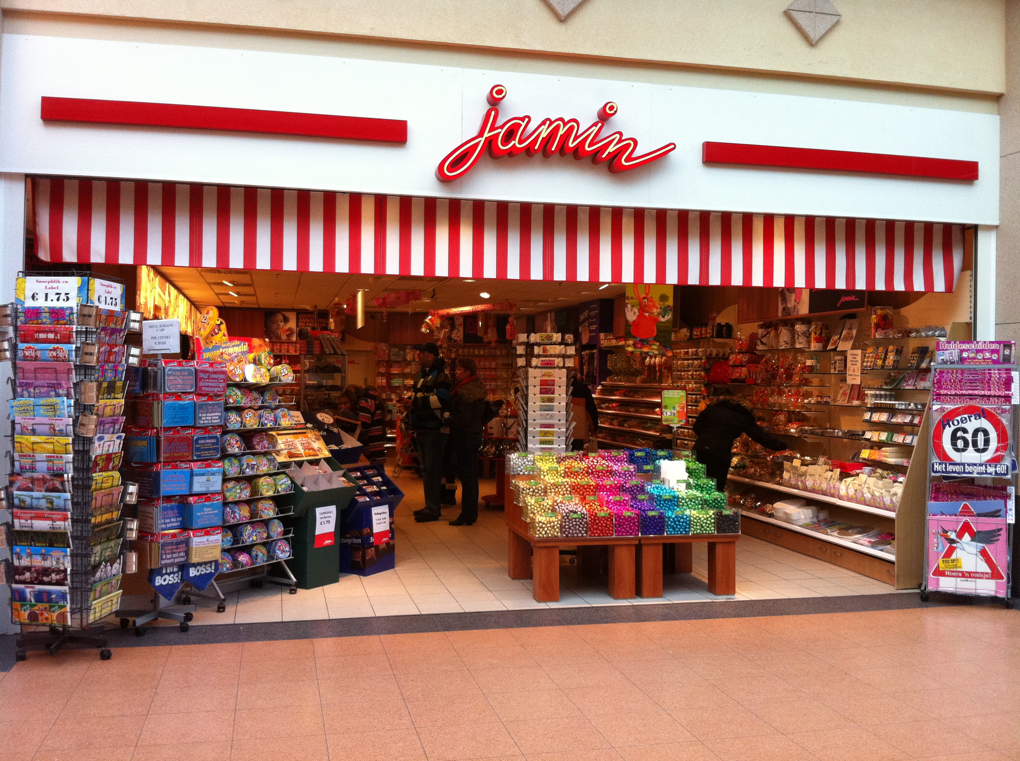
The data candystore

Slide 4
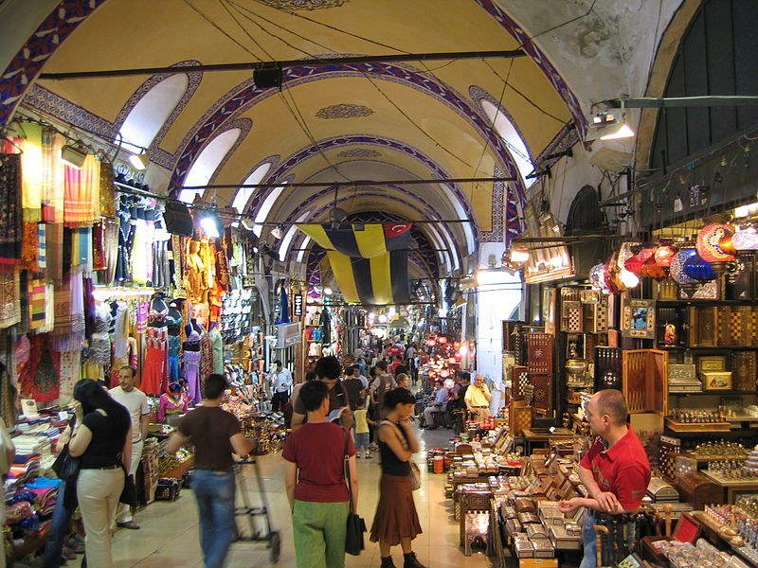
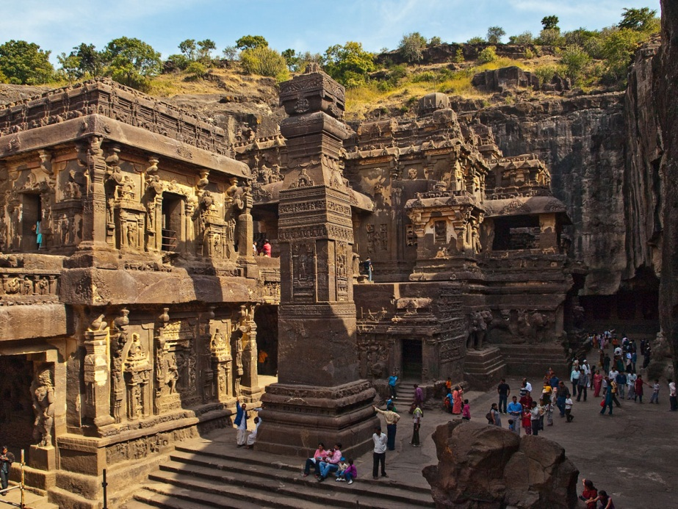
OpenGIS
OpenGIS approach
Commercial GIS approach

Slide 5
Tools
Transforming data: osr, proj4, ogr, gdal, nco, cdo
Catalogues: CKAN, Geoserver
Processes: PyWPS, 52N WPS
Caching & Tiling: GeoWebCache
Rendering: Mapnik, TileMill
Features: GeoServer
Maps: MapServer
WebClient: OpenLayers, Leaflet
Databases: PostGIS, netCDF/OPeNDAP
Analysis: Grass, R
Scripting: Python
Gui: Qgis, Udig

Slide 6












OpenEarth Stack
scientists
professionals
smart phone & tablet users
work done
on client
catalogue
of data
graphics
of data
…
tailored
data
> OGC KML
…
standard
data
> OGC WxS
…
raw
data
> ISO SQL-
PostGIS
> OGC netCDF- CF
OPeNDAP
what
where
when
who
why
how
…
data URLs
SubVersion
…
work done
on server

Slide 7
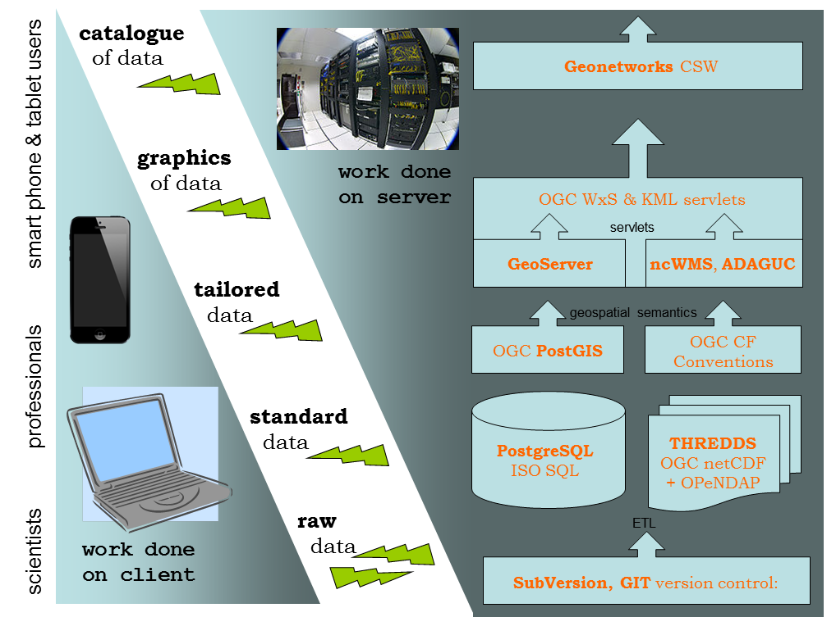
OpenEarth Stack

Slide 8
Version control
https://www.youtube.com/watch?v=pYO5H-GDFa4

Slide 9
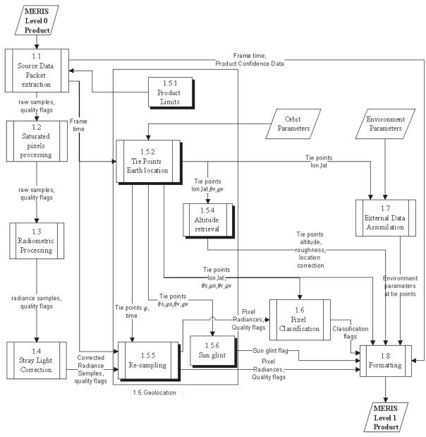
Data = Raw data + software
data product =
raw data:
volts
counts
+ software

Slide 10
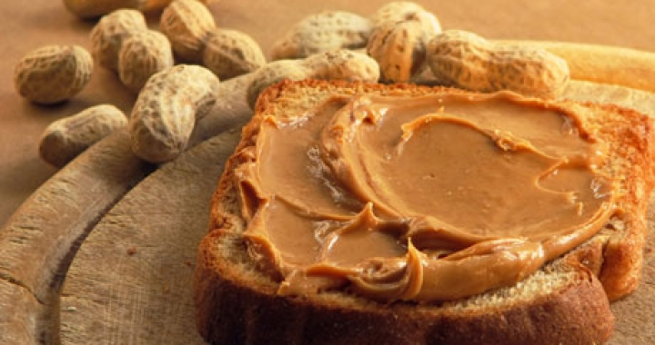
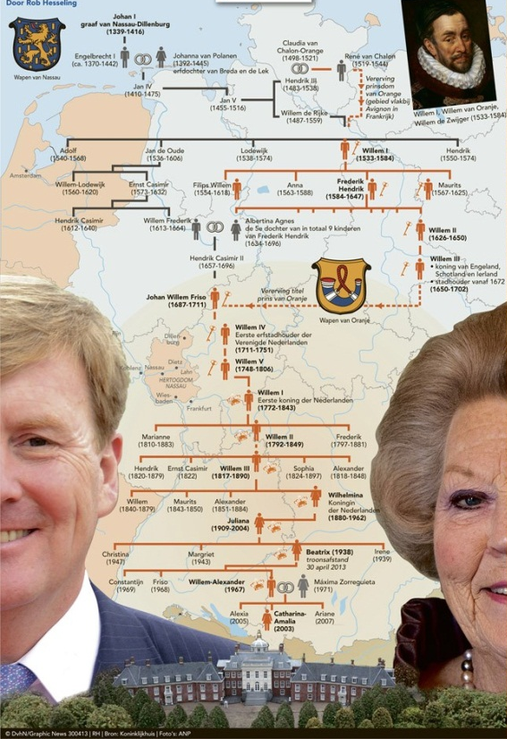
Lineage

Slide 11
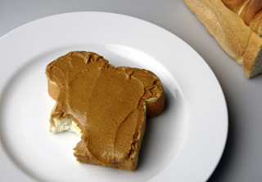
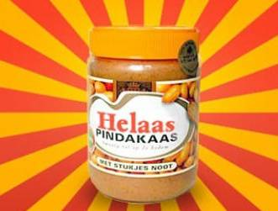
Peanut butter principle
http://www.food-info.net/nl/national/ww-pindakaas_clip_image001.jpg
http://www.knups.nl/leuk_plaatje/56/Helaas_pindakaas.html

Slide 12
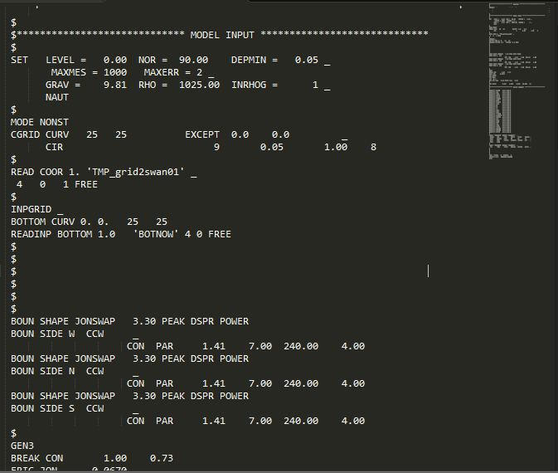
Standards

Slide 13
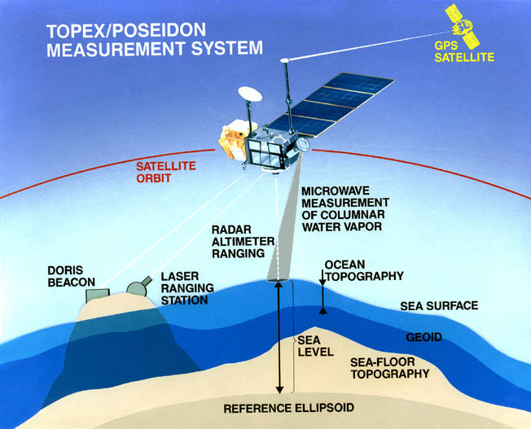
Semantics
a
b
c
d
e
f
Sea surface topography
Geoid
Sea floor
Reference ellipsoid
Which arrow represents sea-surface altitude?

Slide 14
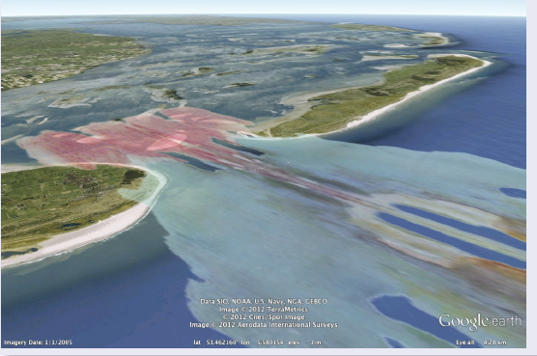
Which quantity is presented?

Slide 15
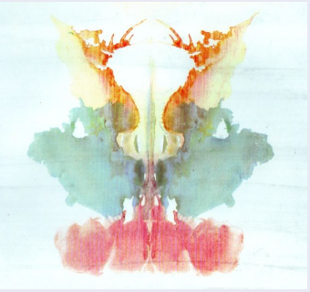
Rorschach card 9

Slide 16
Errors of the week

Slide 17
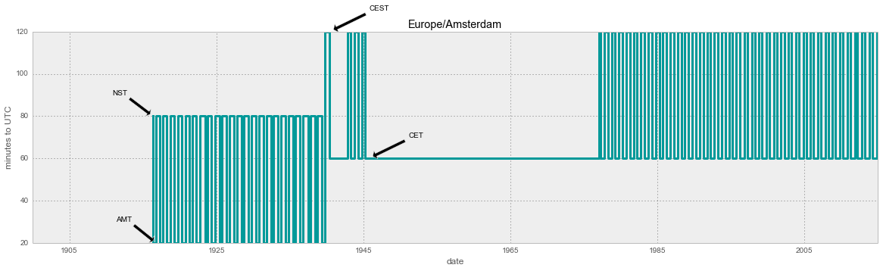
Standards: Timezone

Slide 18
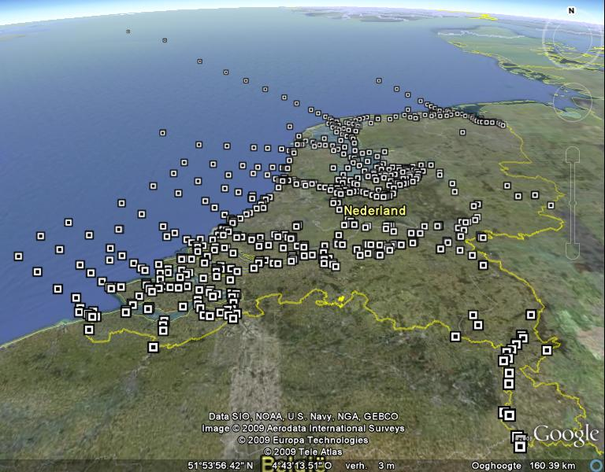
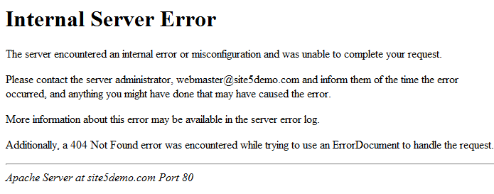
Services: Vectors
N04
NO4

Slide 19
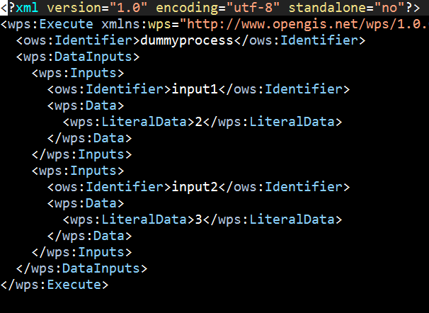

Services: tidal predict

Slide 20
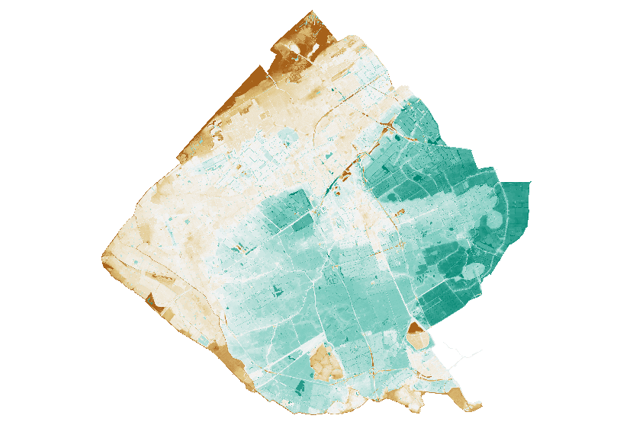
Metadata: Subgrid topography

Slide 21
Standards

Slide 22
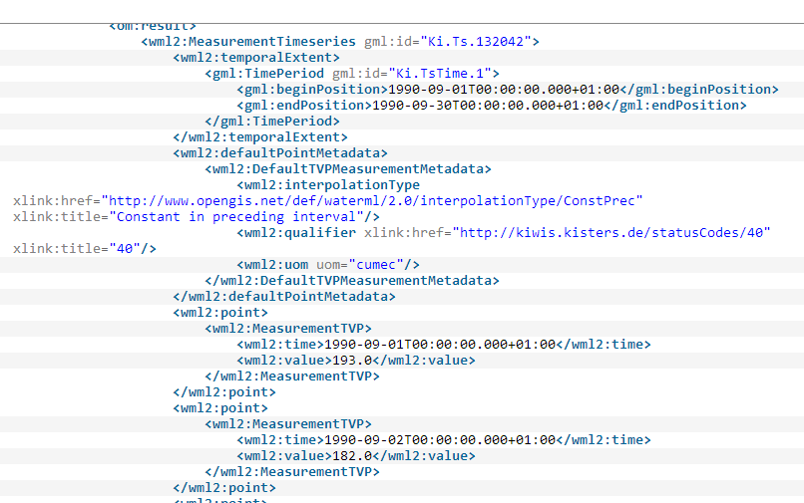
Example: WaterML 2
a) CSIRO
b) San Diego Supercomputer Center
c) Australian Bureau of Meteorology
d) KISTERS AG
e) USGS
f) NOAA
g) Service Centre Information Technology of the BMVBS (DLZ-IT BMVBS)
h) disy Informationssysteme GmbH
i) German Federal Institute of Hydrology
j) Office International de L'eau- Sandre
k) Deltares
l) Geological Survey of Canada, Natural Resources Canada

Slide 23
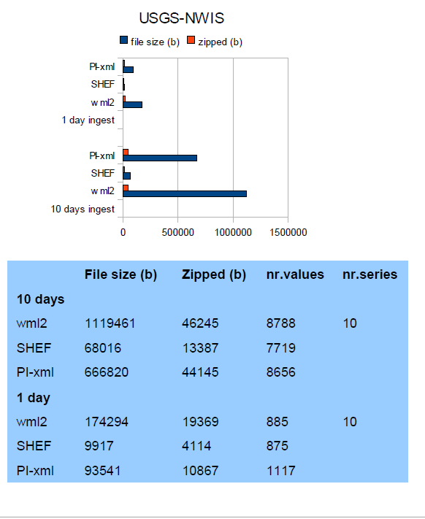
Example: WaterML 2
Gijsbers & Rooij, performance of WaterML @ OpenWater symposium

Slide 24

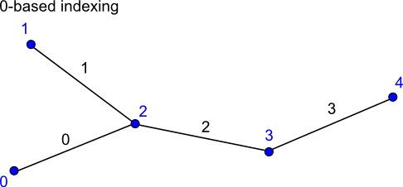
Example: UGrid
Jagers & others, data standard for unstructured 1d, 2d, 3d grids.
https://github.com/ugrid-conventions/ugrid-conventions

Slide 25
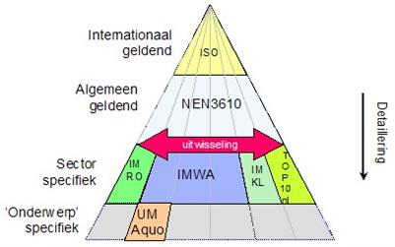
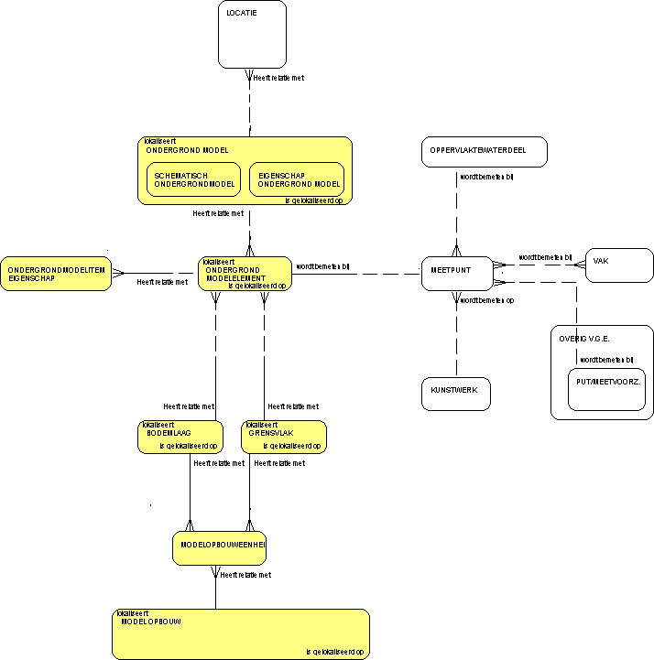
Example: Aquo
Standard for exchanging water related data.
Marc van Dijk & Klaas Jan van Heeringen

Slide 26
Example: NetCDF
Coupling through in memory netCDF
https://github.com/SiggyF/netcdf-c
Used for exchanging rain with subgridf90.

Slide 27
Extract Transform Load

Slide 28
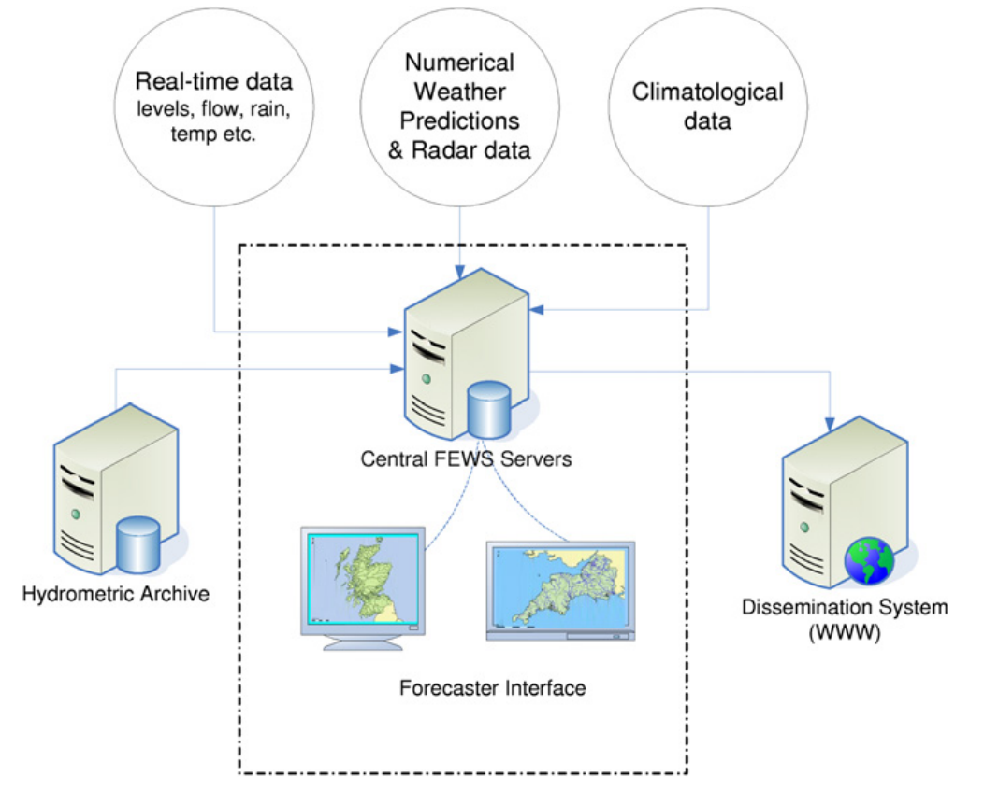
Example: FEWS

Slide 29
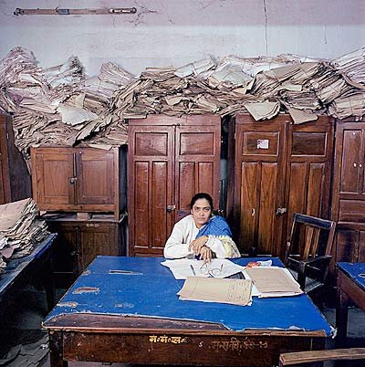
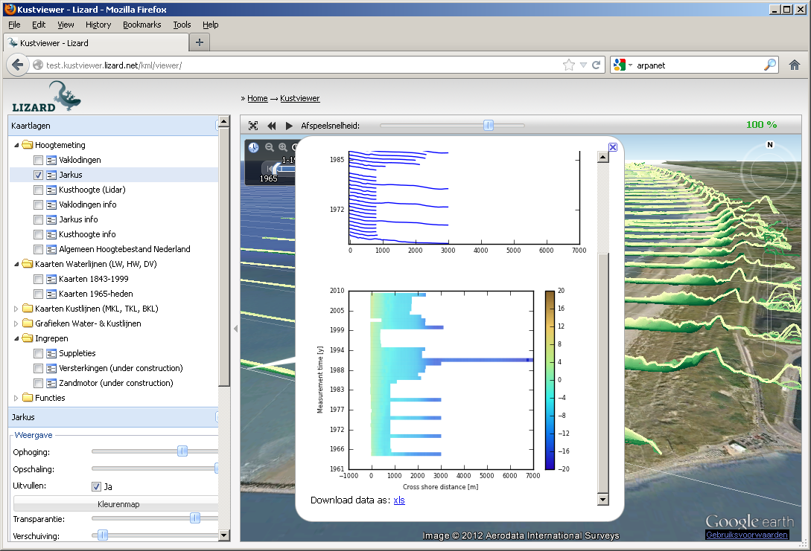
Example: ETL
Processed data
Raw data

Slide 30
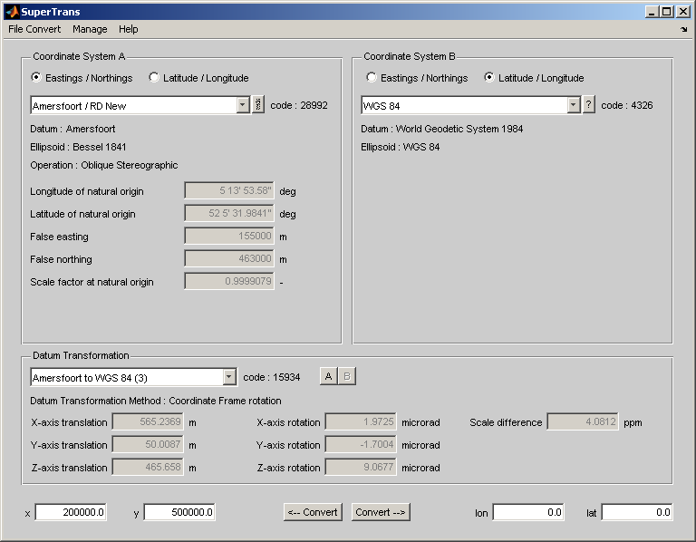
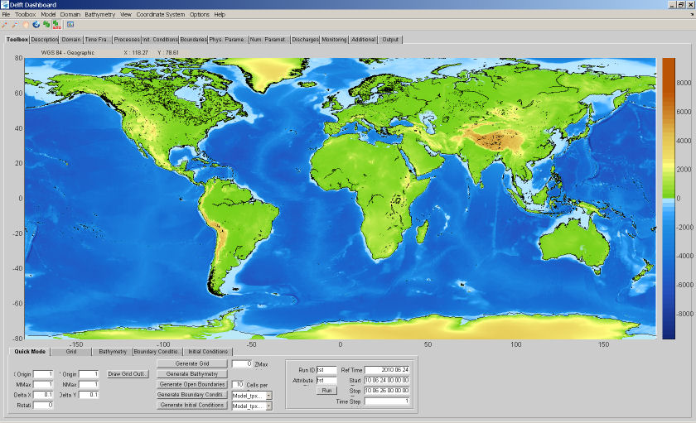
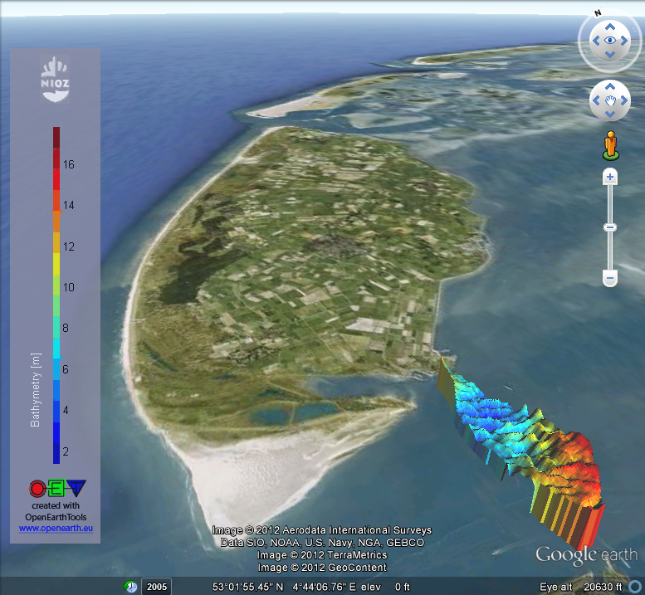
OpenEarthTools

Slide 31
Split

Slide 32
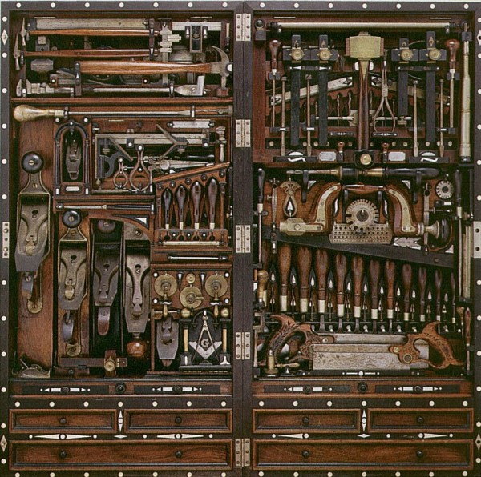
Apply

Slide 33
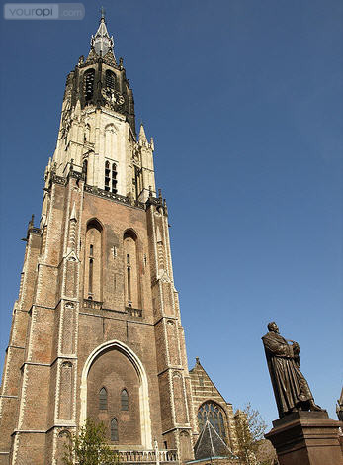
Combine

Slide 34
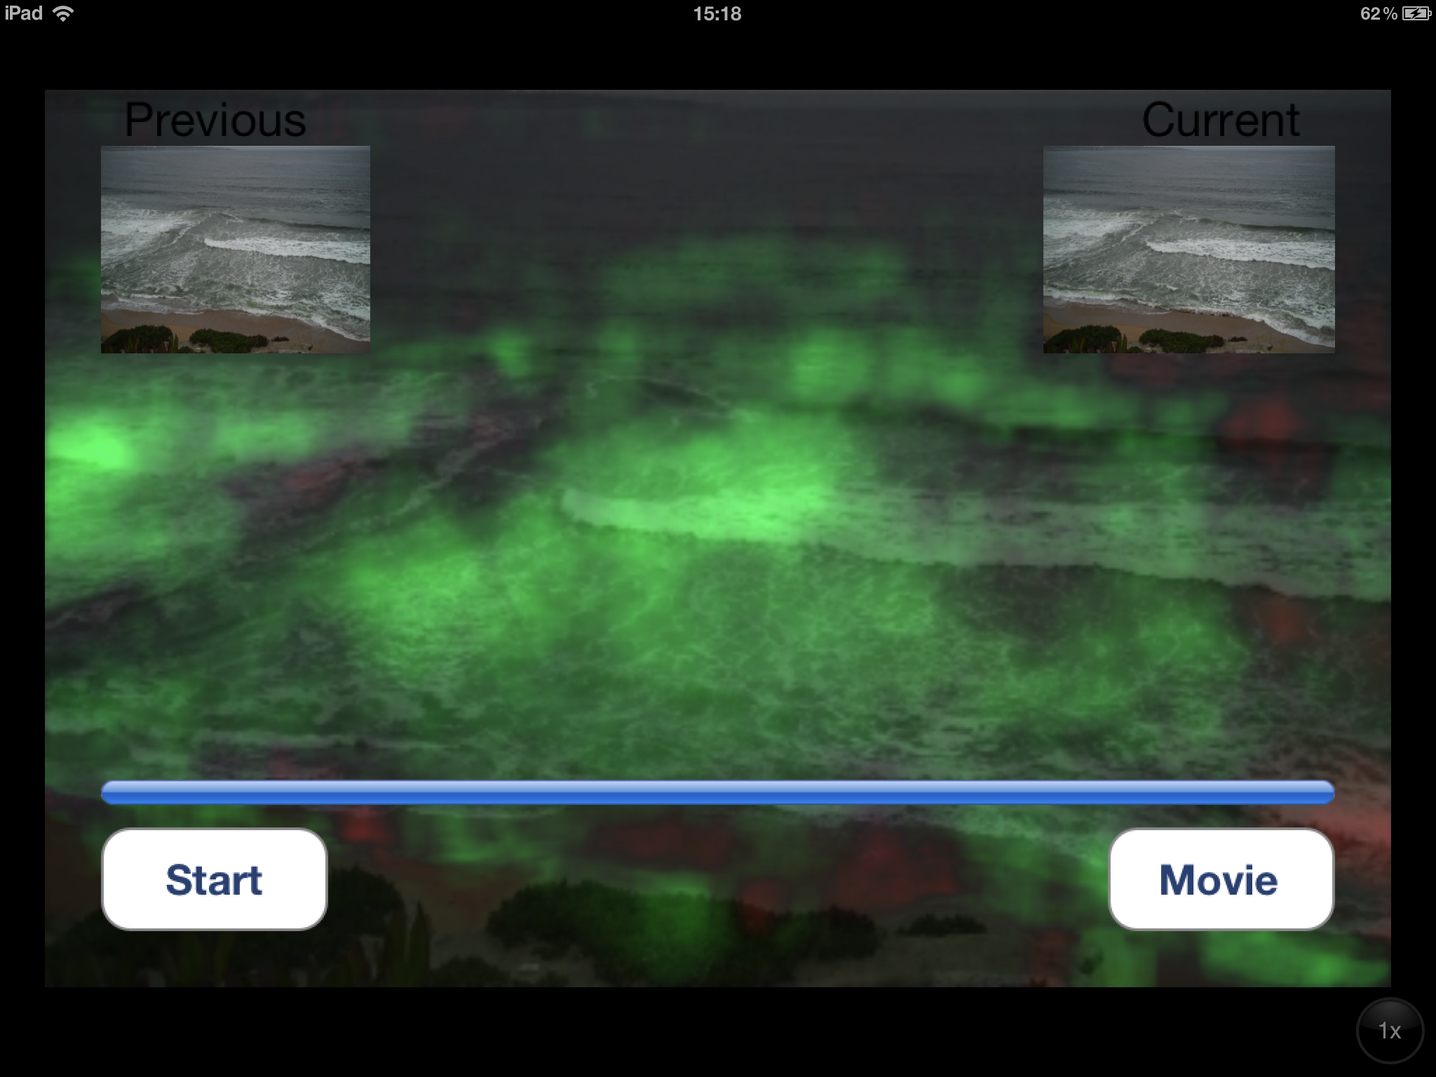
Bring the algorithm to the data

Slide 35
Services

Slide 36
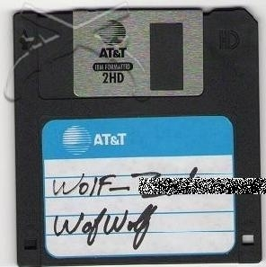
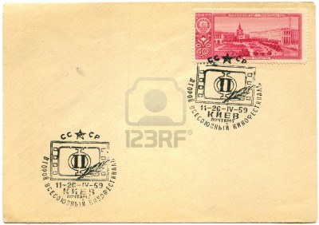
Floppy 1980

Slide 37
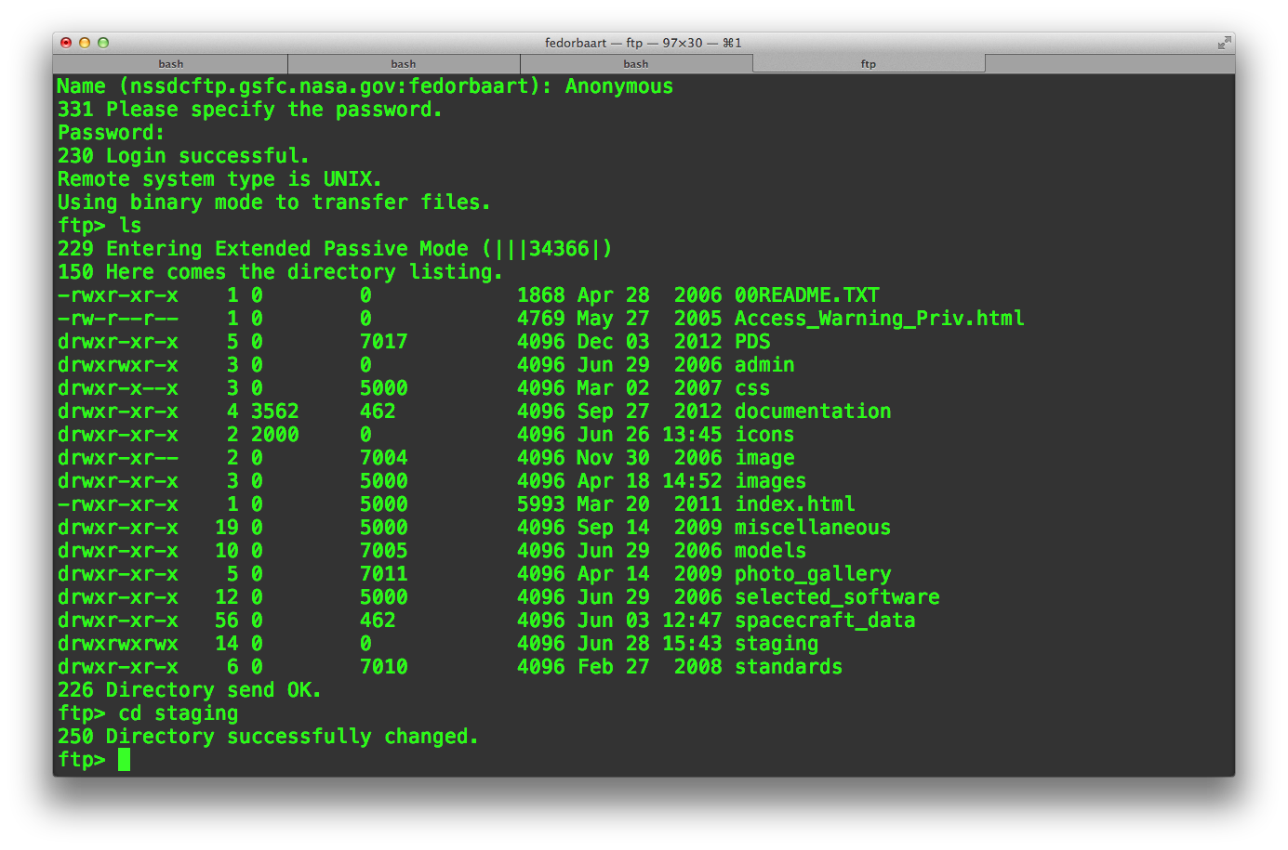
FTP 1990

Slide 38
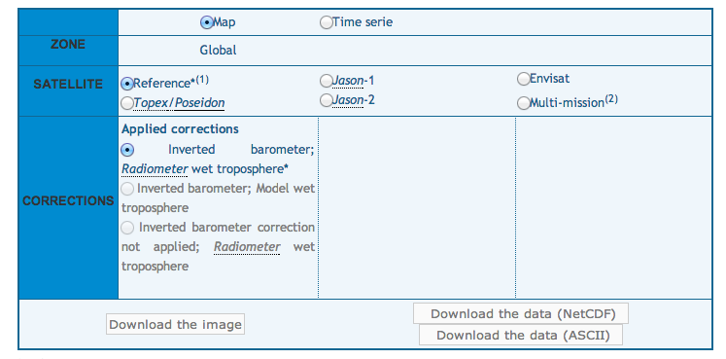
Download forms 2000

Slide 39
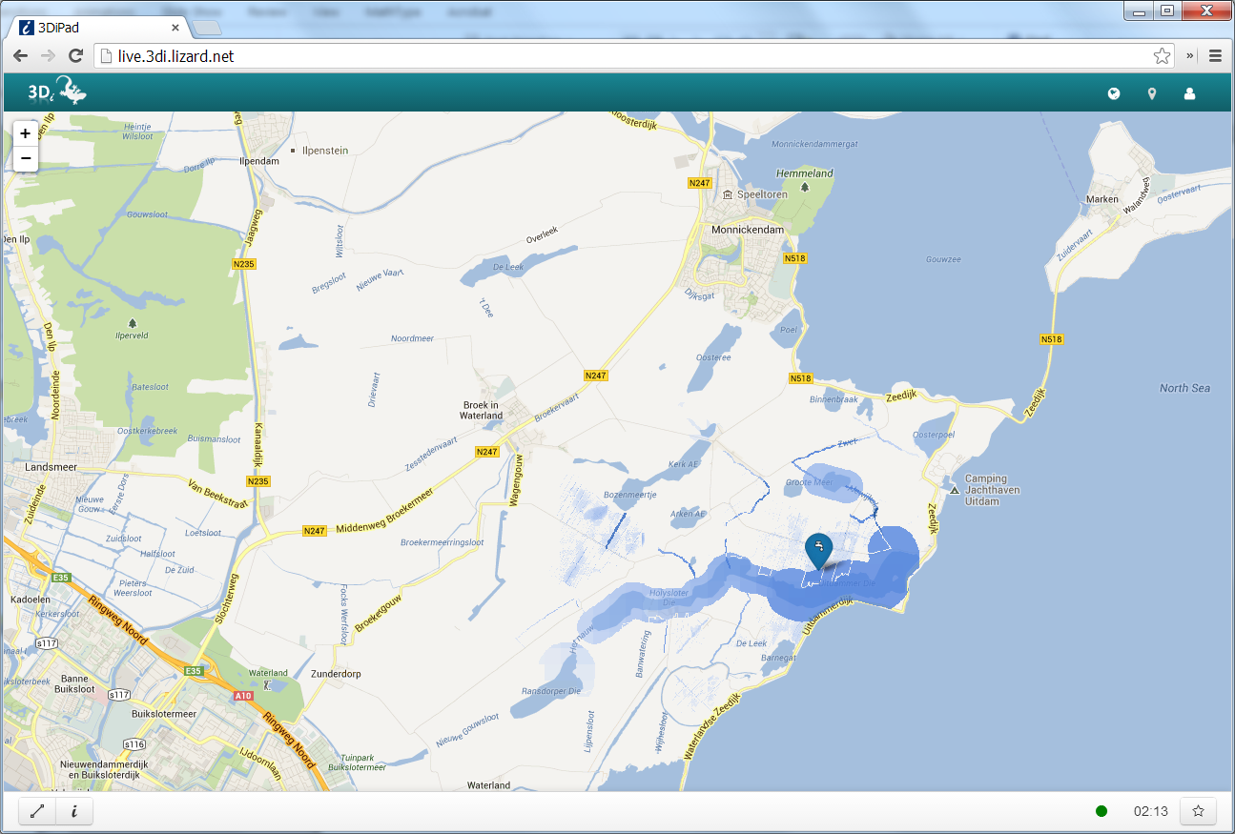
Web services 2010

Slide 40
Future
Finding/Discovery/Crawling
Streaming/Subscribing
Coupling/Chaining
Processes

Slide 41
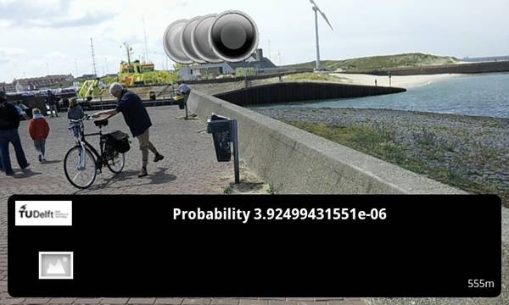
Services

Slide 42
Metadata

Slide 43
The semantic web
Metadata
Vocabularies
Ontologies
Semantics
I have a dream for the Web [in which computers] become capable of analyzing all the data on the Web – the content, links, and transactions between people and computers. A "Semantic Web", which makes this possible, has yet to emerge …
Tim Berners-Lee

Slide 44
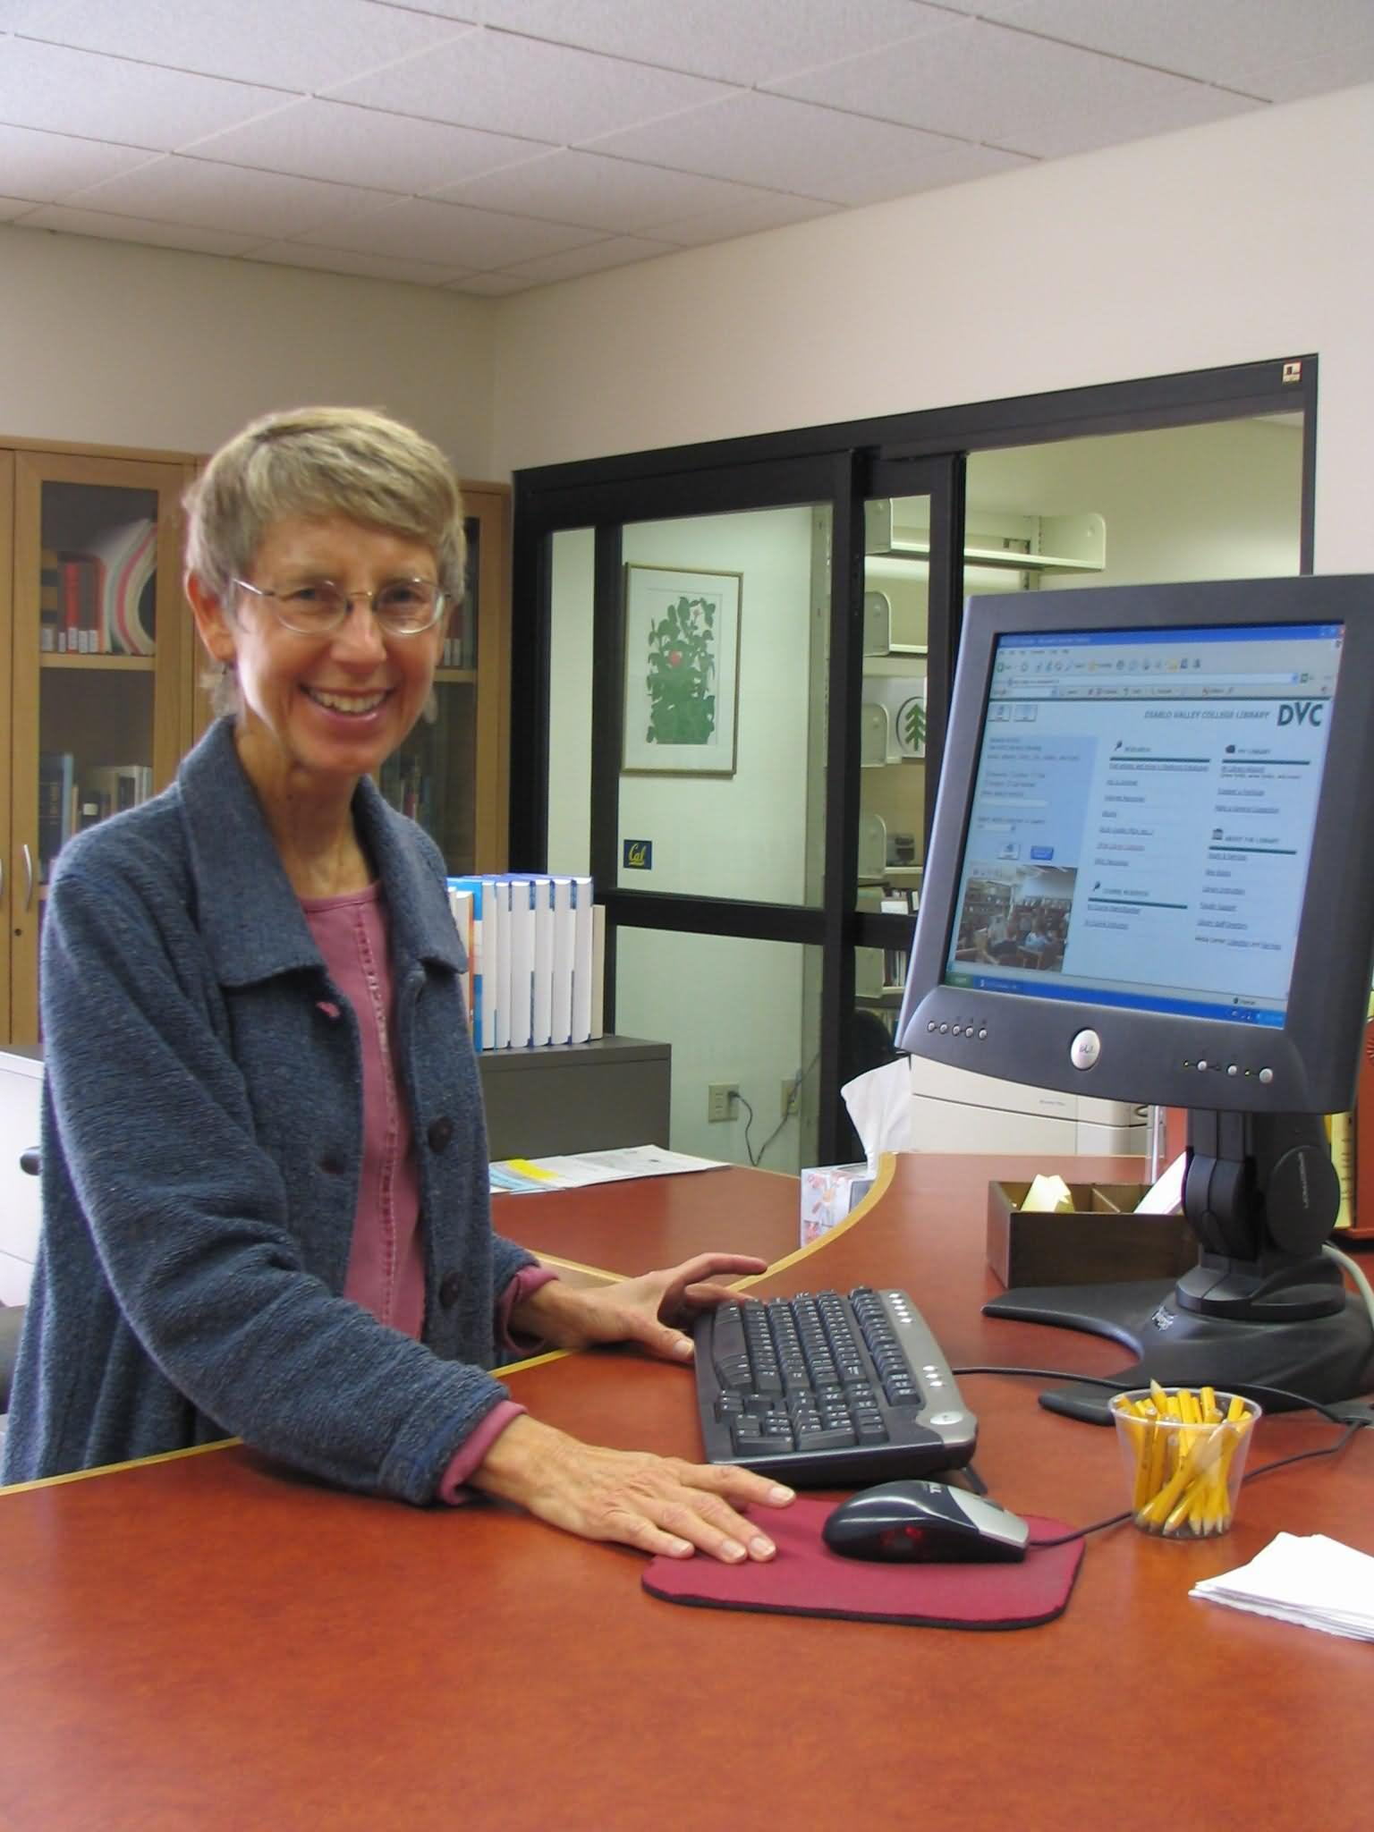
Dublin Core
Title
Creator
Subject
Description
Publisher
Contributor
Date
Type
Format
Identifier
Source
Language
Relation
Coverage
Rights
Src: celebritynetworth.com

Slide 45
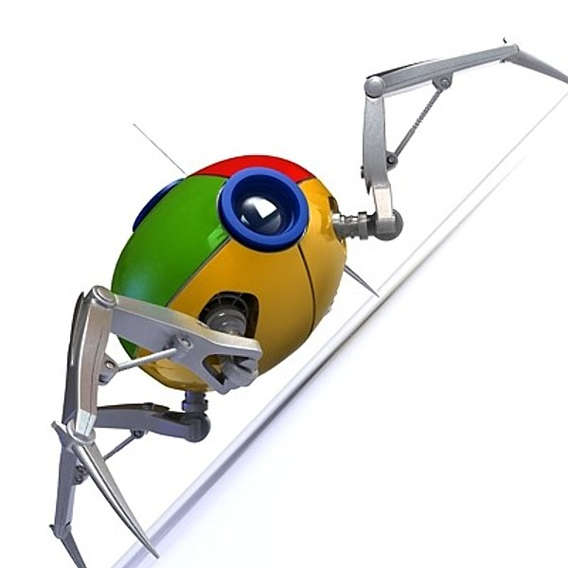
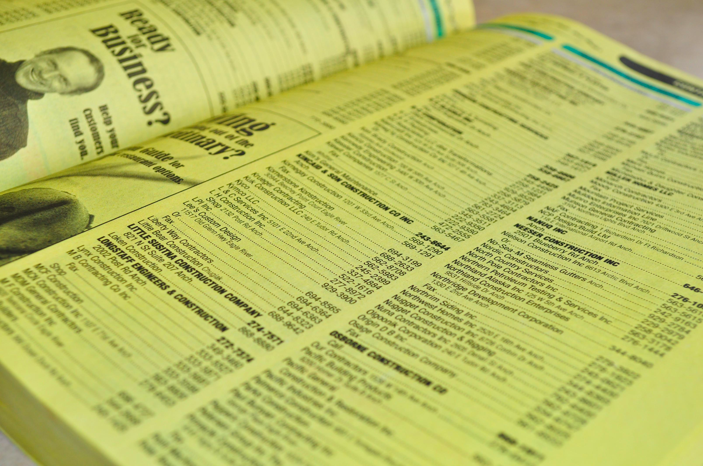
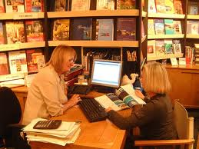
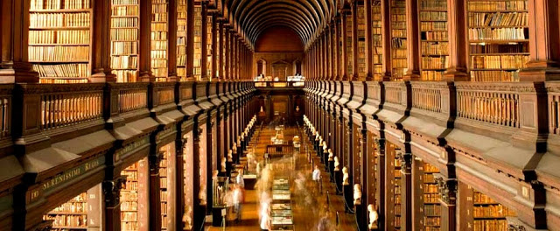
Approaches
Catalogues
Crawlers
Src: 3idatascraping.com
Data shops
Catalogues of catalogues

Slide 46
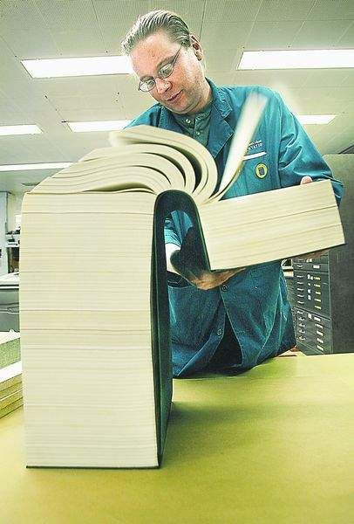
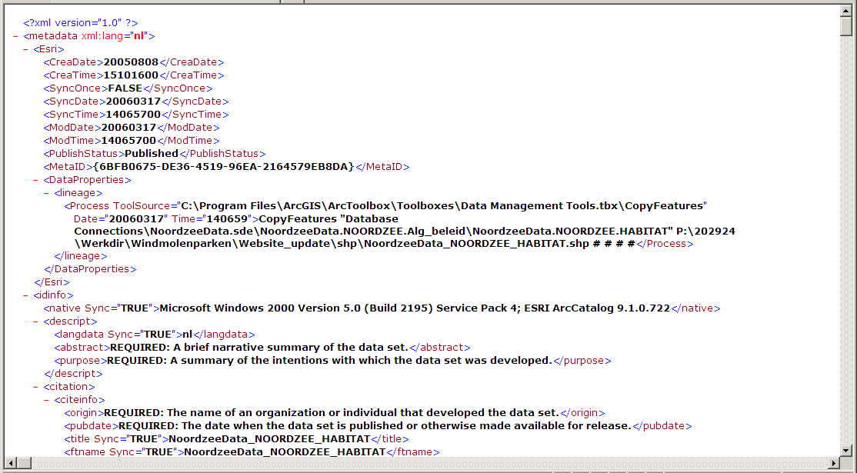

Slide 47
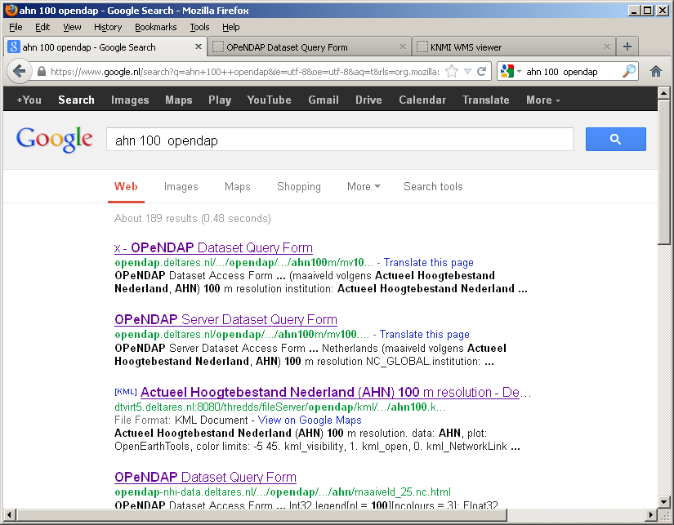
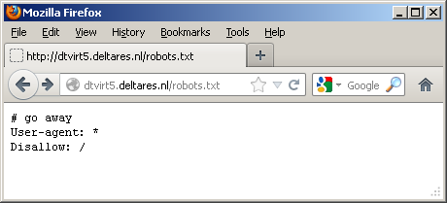
Data

Slide 48
Layers of information
scientists
professionals
smart phone & tablet users
work done
on client
catalogue
of data
graphics
of data
…
tailored
data
> OGC KML
…
standard
data
> OGC WxS
…
raw
data
> ISO SQL-
PostGIS
> OGC netCDF- CF
OPeNDAP
what
where
when
who
why
how
…
data URLs
SubVersion
…
work done
on server

Slide 49
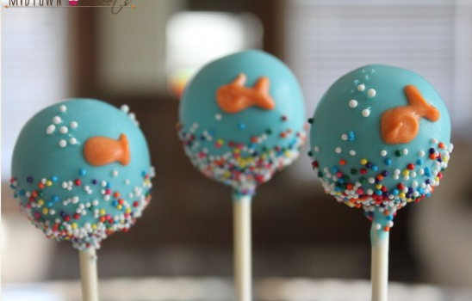
Candy
Src: http://midtownsweets.com/

